Slide 1


Slide 2
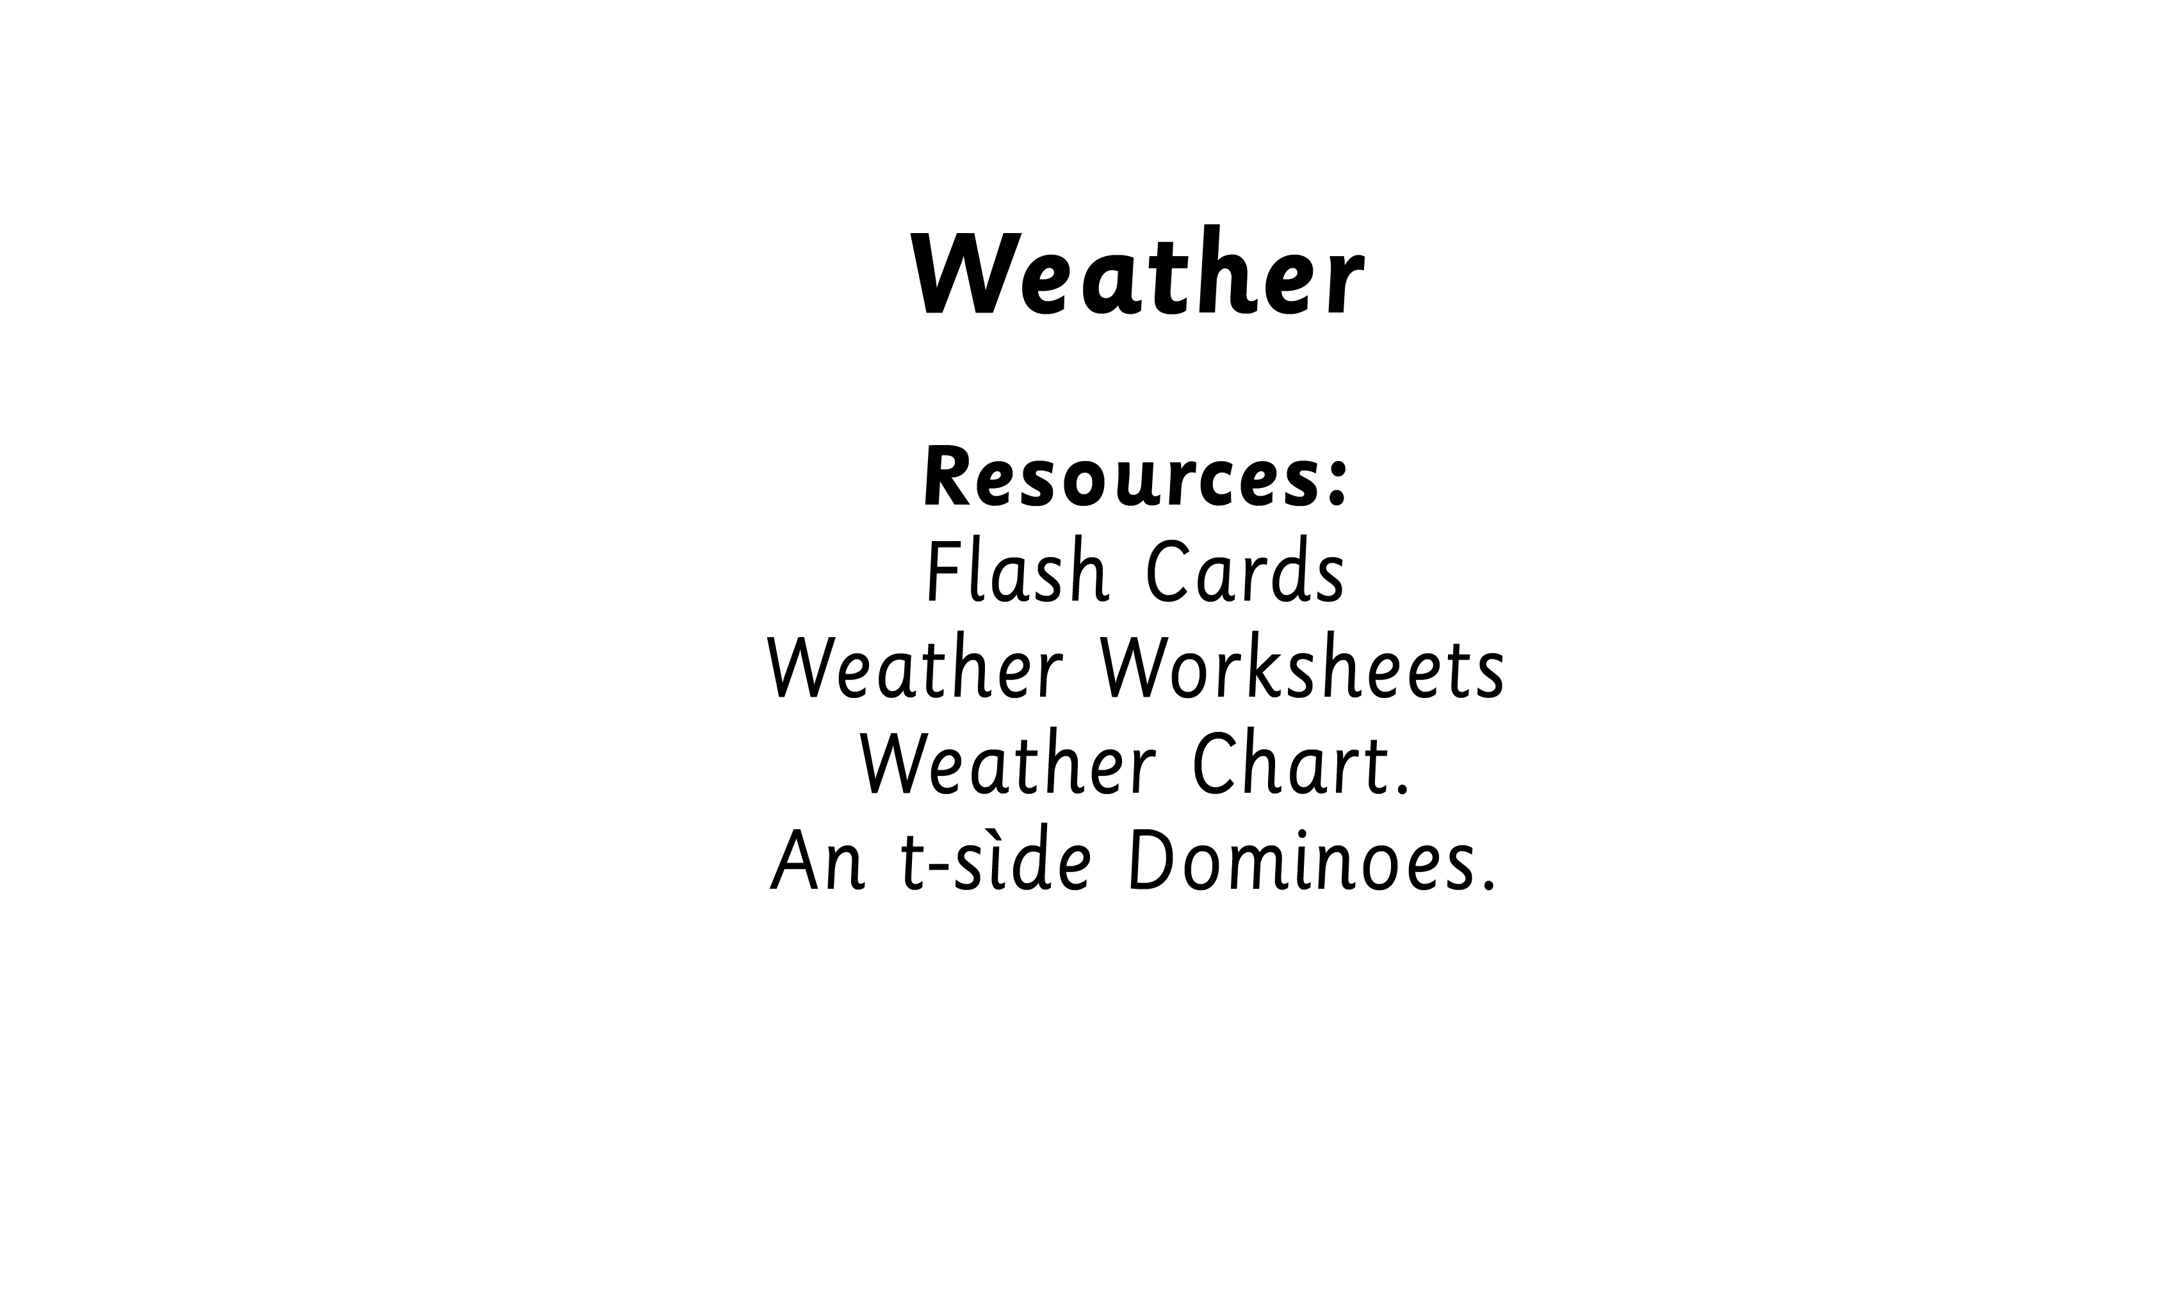
Notes:
Display Weather Pictures and weather chart.

Slide 3
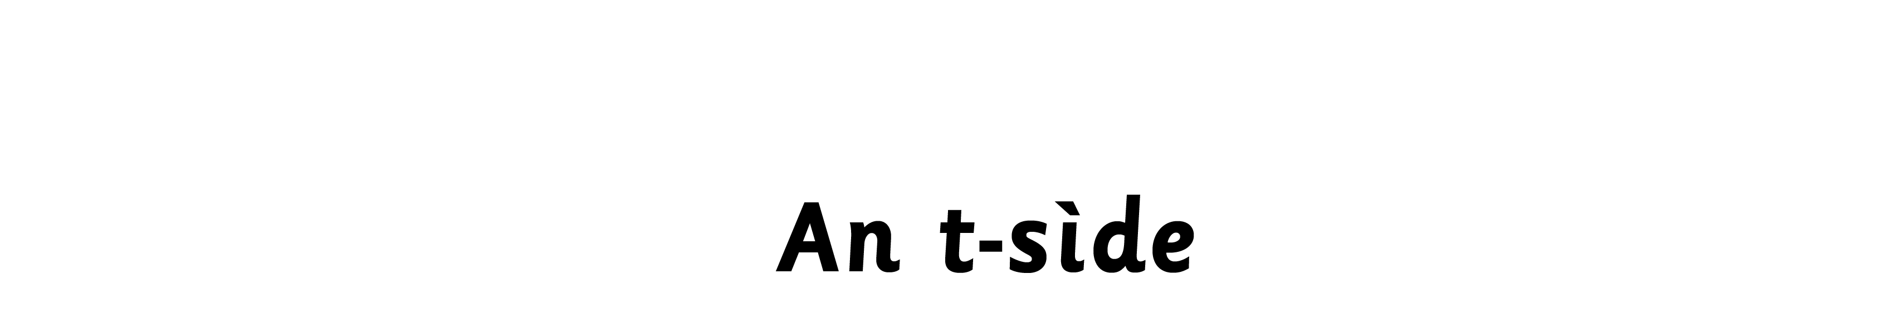

Notes:
Display figure, phrase bubbles and pictures to encourage daily use.

Slide 4

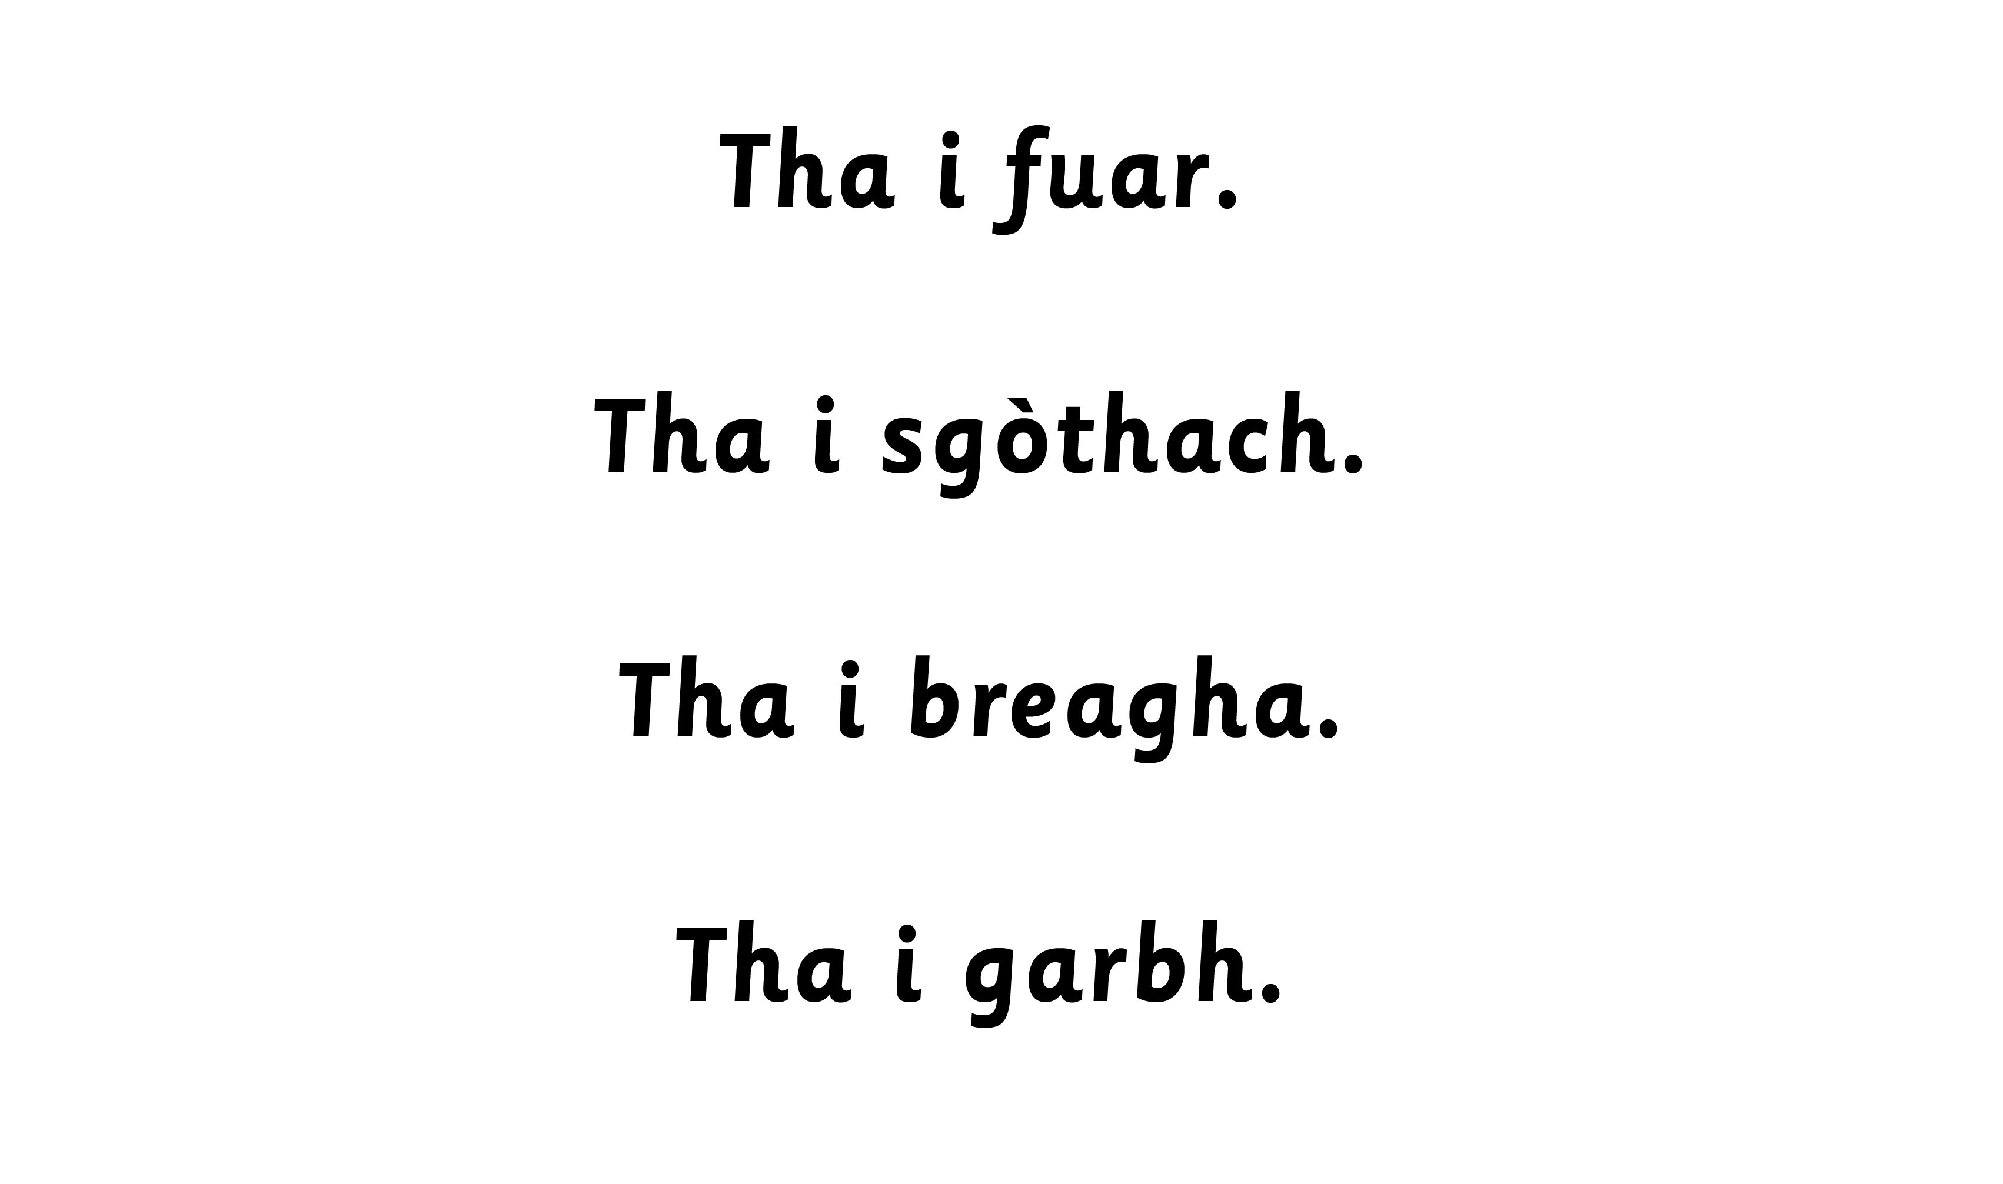
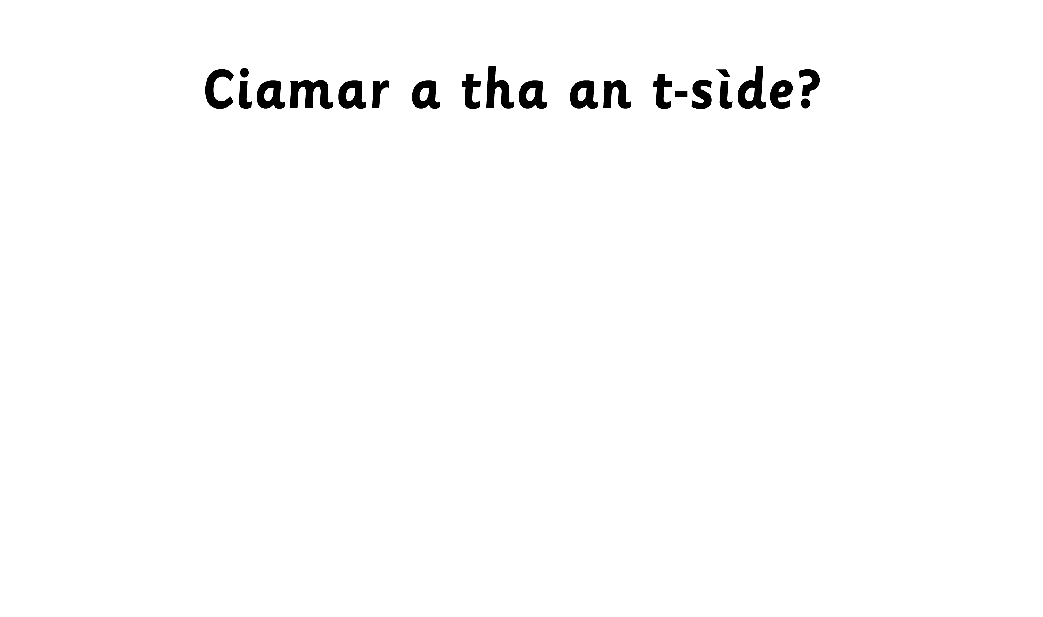
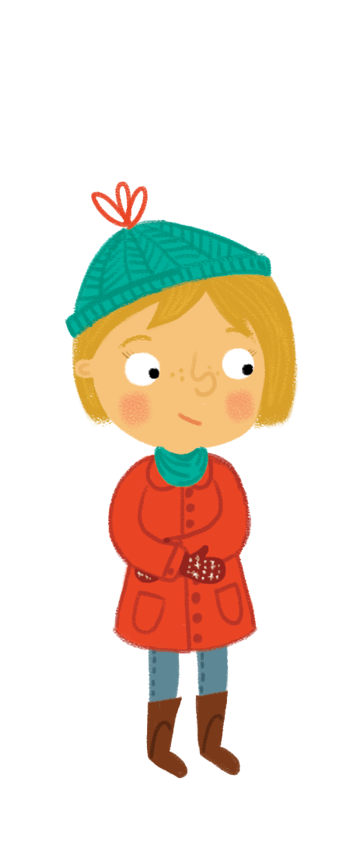
Notes:
Children to circulate shaking hands and using Fàilte, Hallò and Hai.

Slide 5
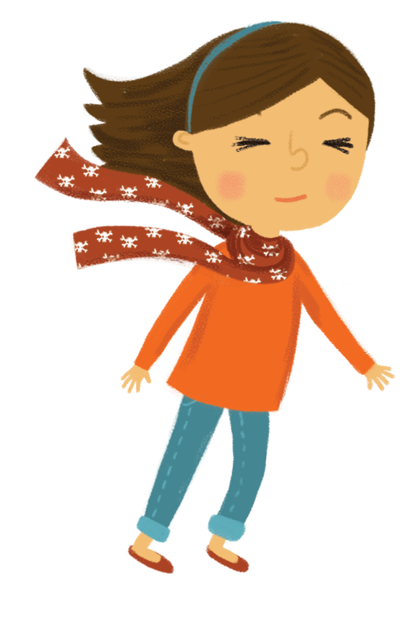
Notes:
Children to circulate shaking hands and using Fàilte, Hallò and Hai.

Slide 6
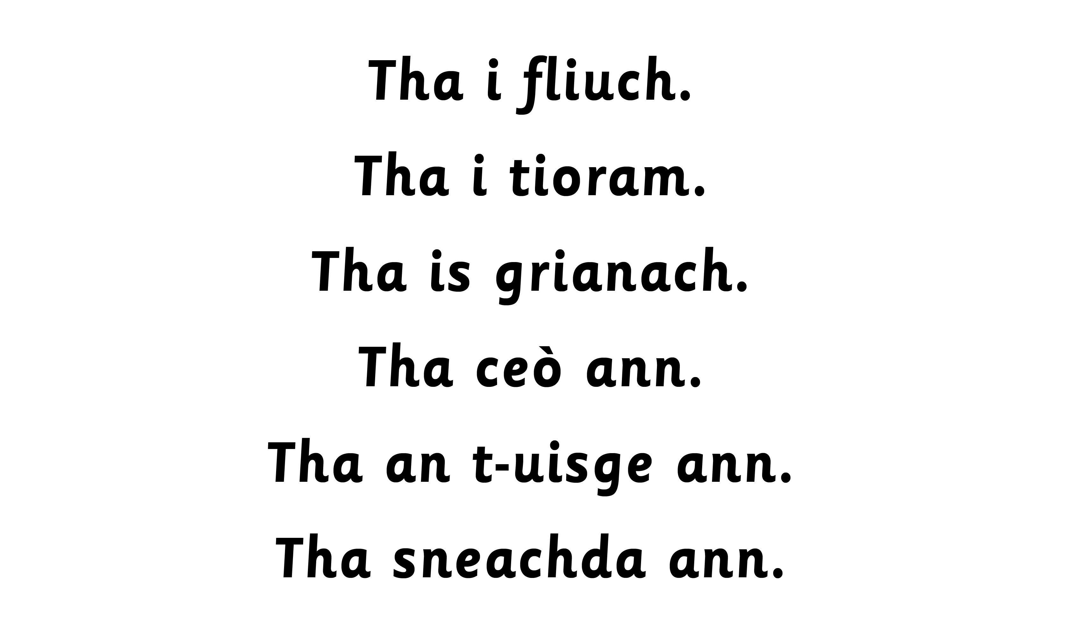
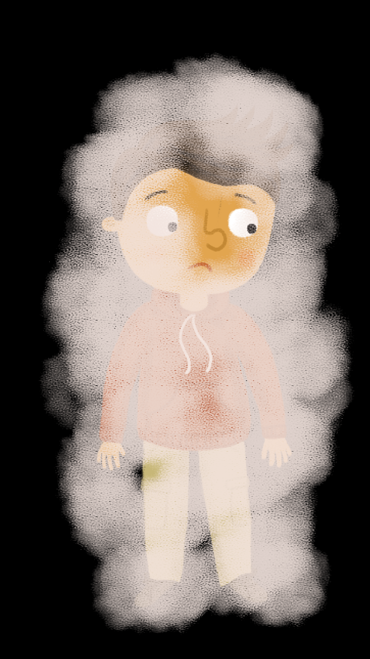



Slide 7


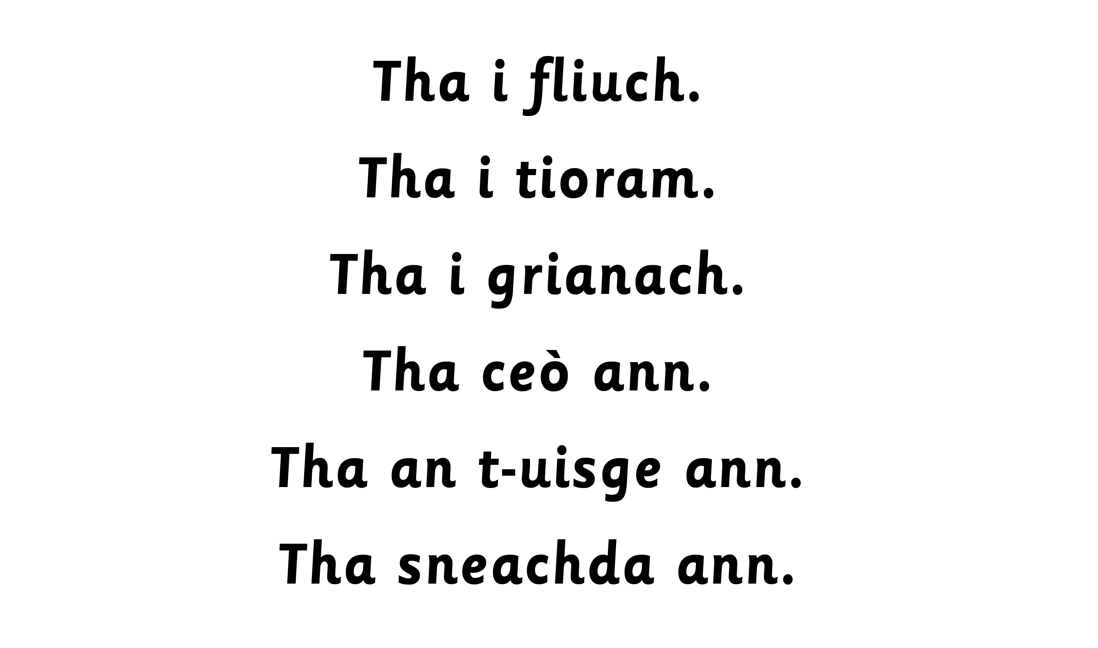



Slide 9

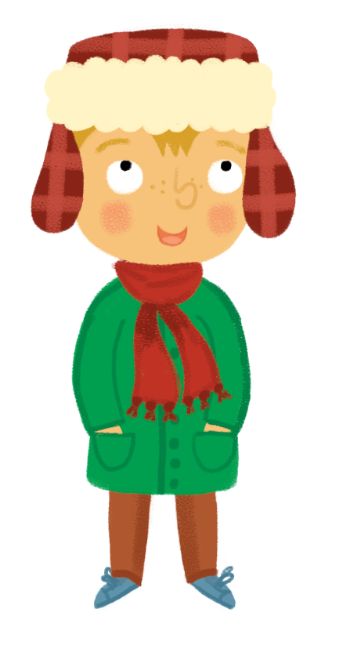

Slide 10
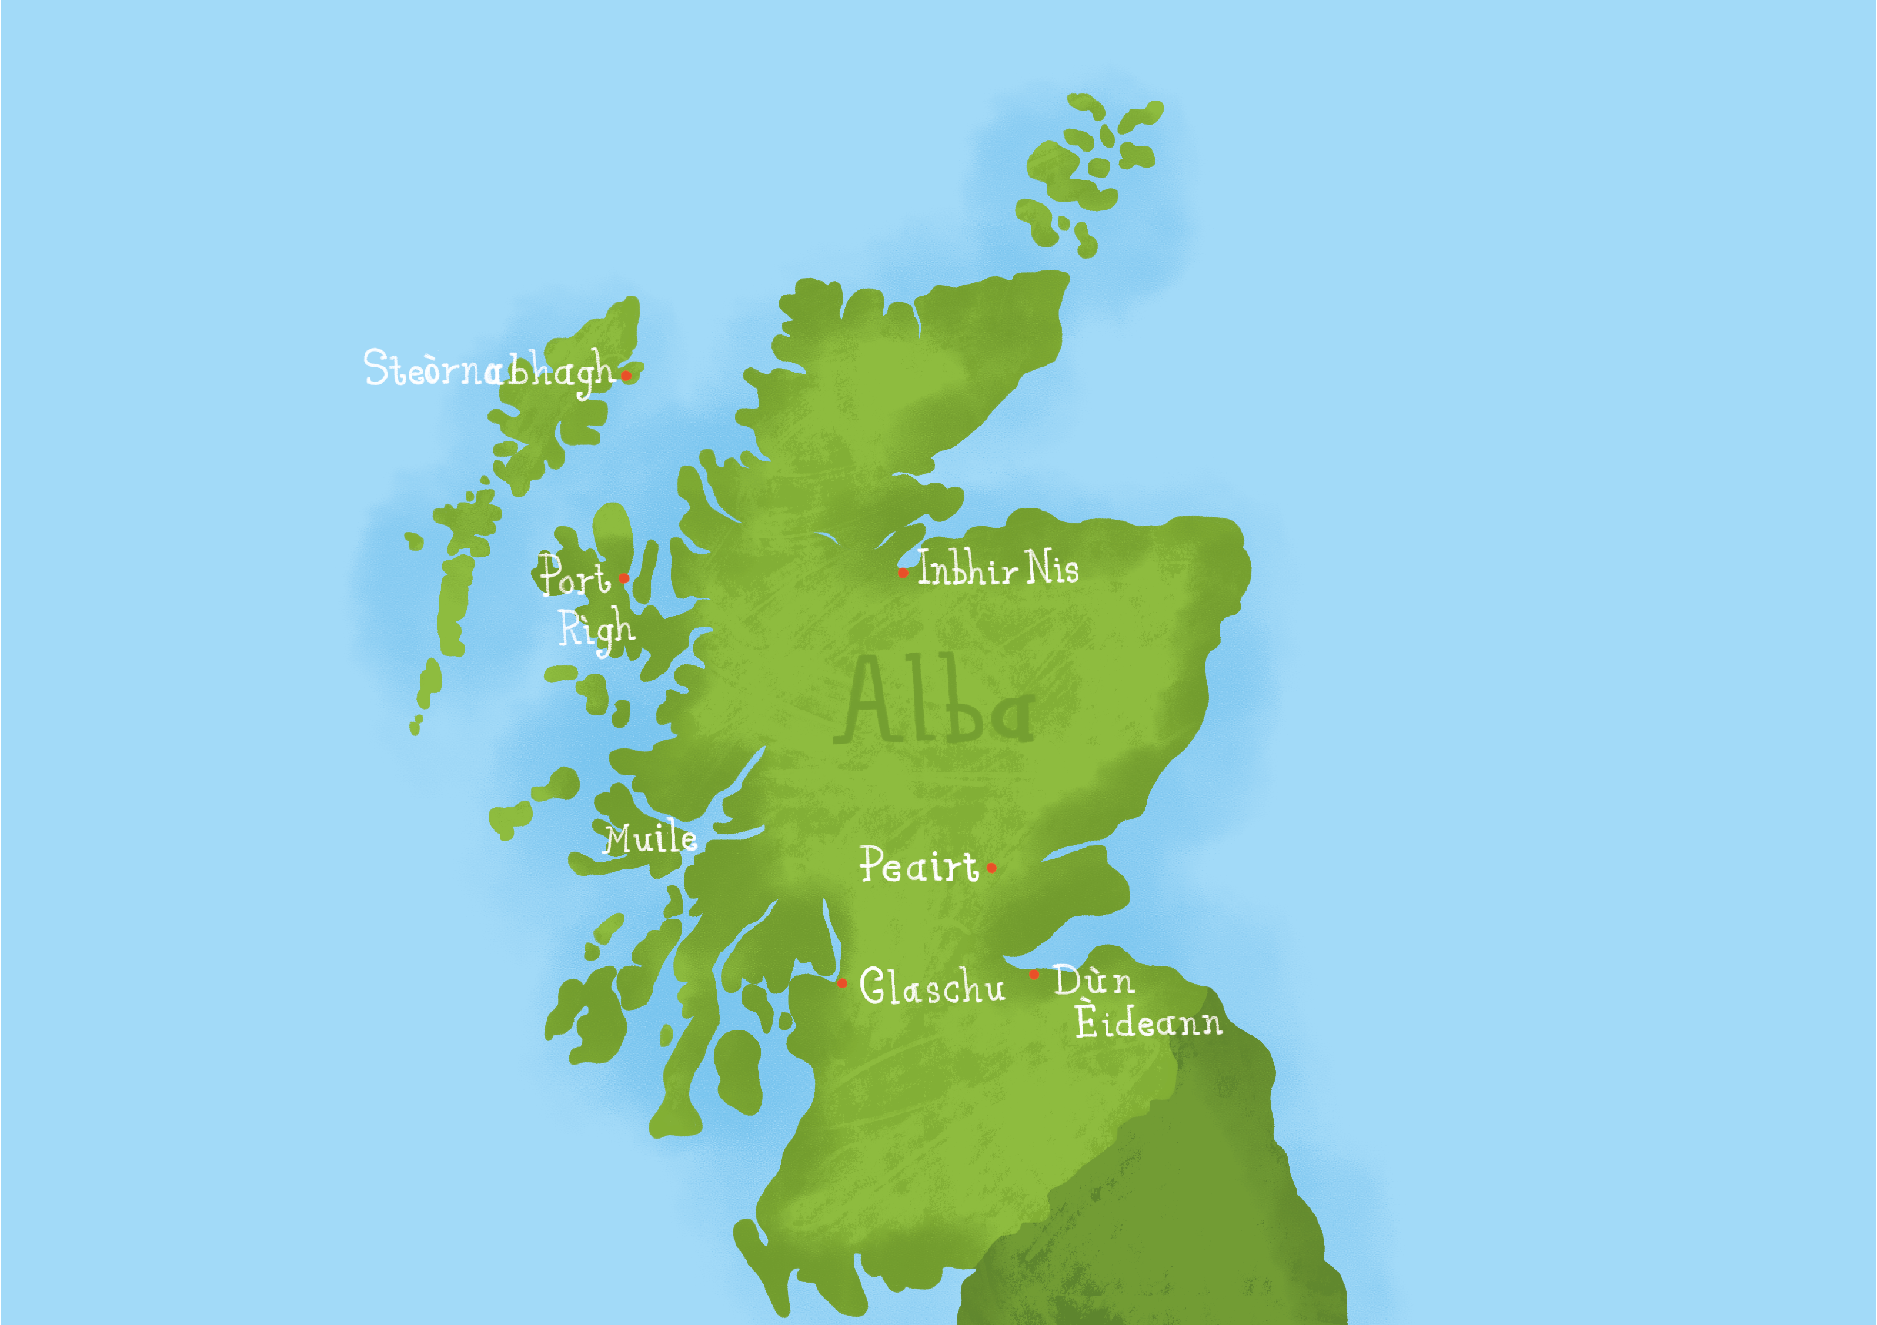

Notes:
Children to take turns to be the weather presenter. Children are given a flash card to match to the correct weather symbol/place. This can be used as an opportunity to introduce place names.
Corners Game – place names to be displayed in different areas in the classroom and children to go to a place and practise ann an/ ann am

Slide 11

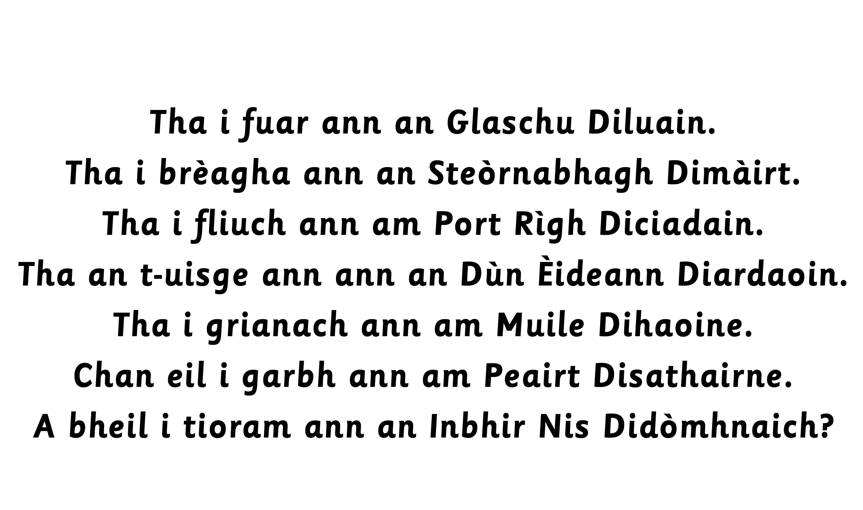
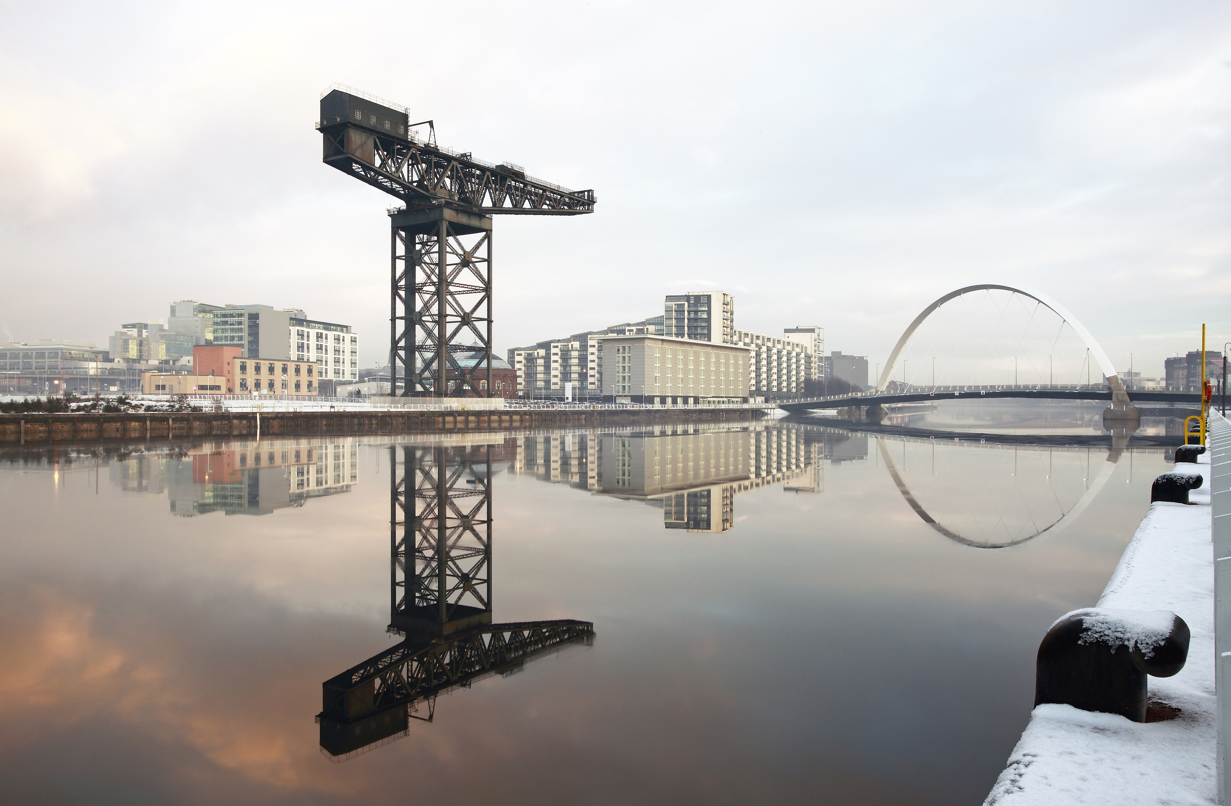

Slide 12

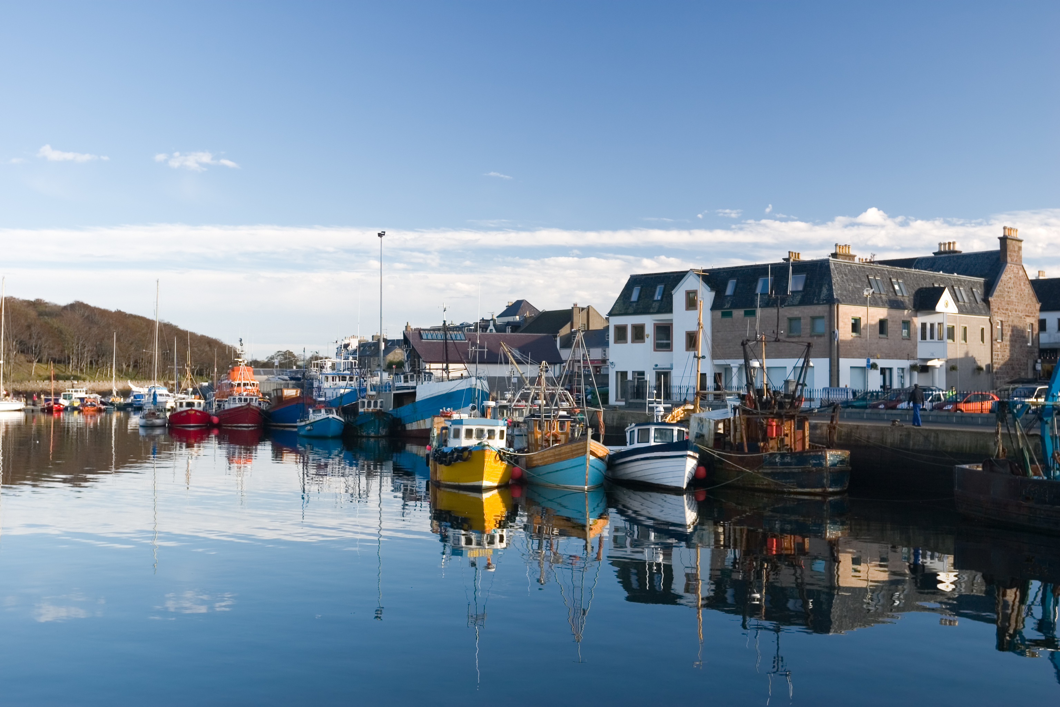

Slide 13

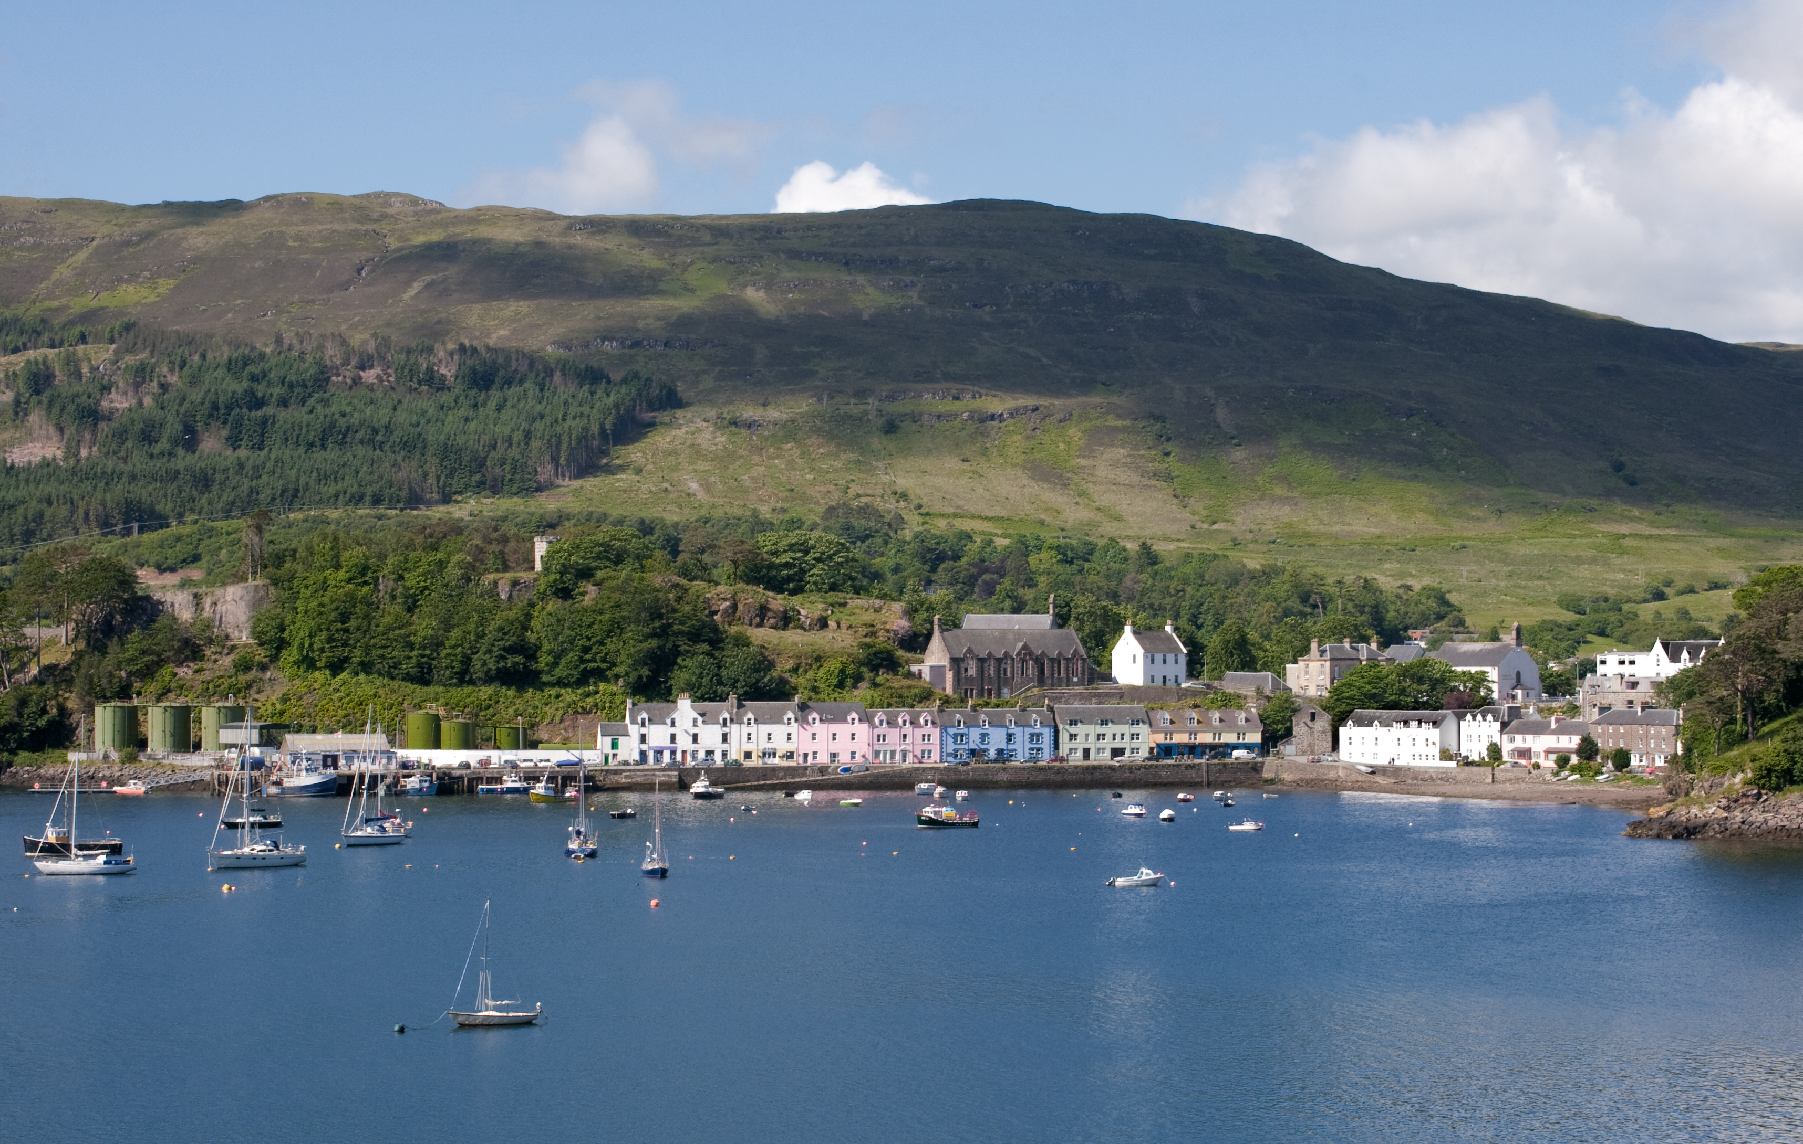

Slide 14

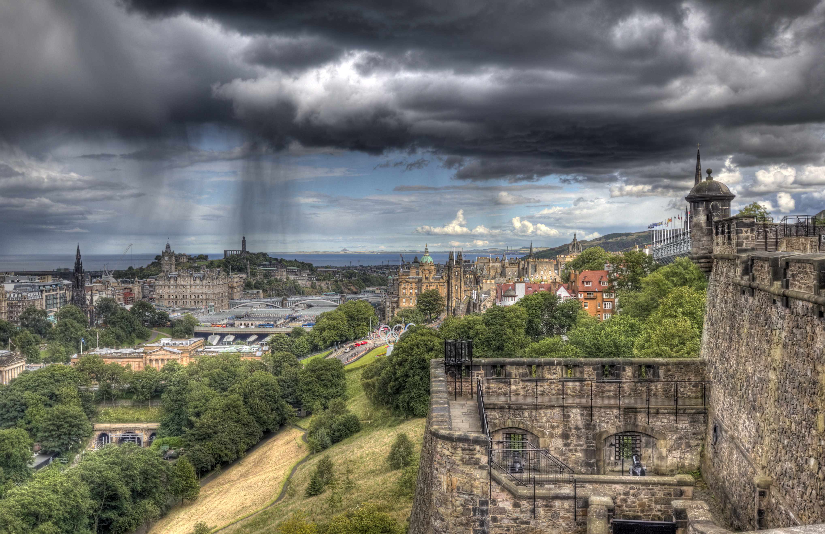

Slide 15

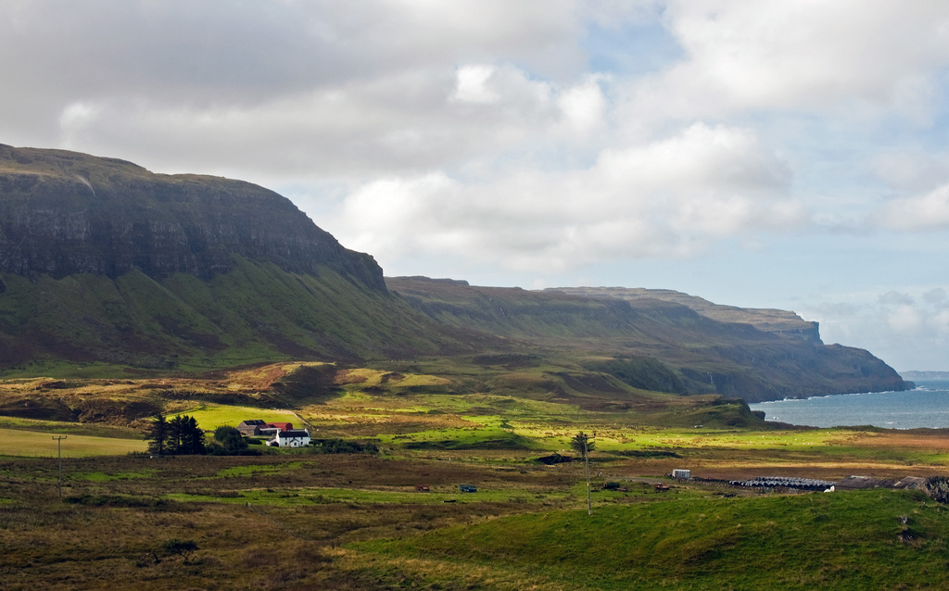

Slide 16

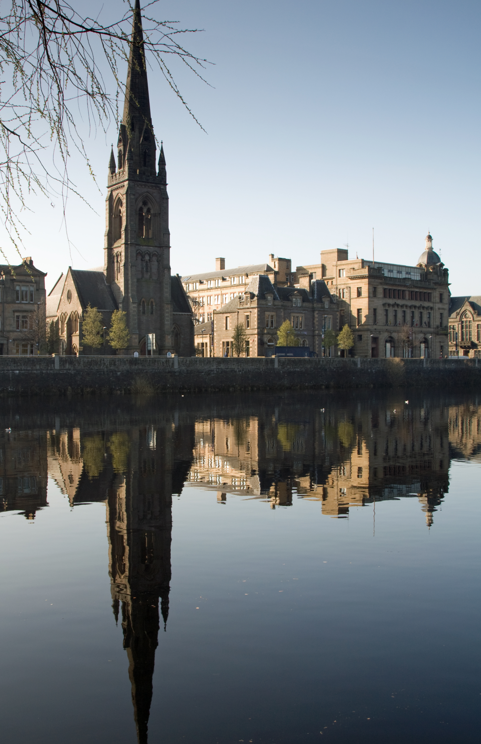

Slide 17

