Slide 1


Slide 2
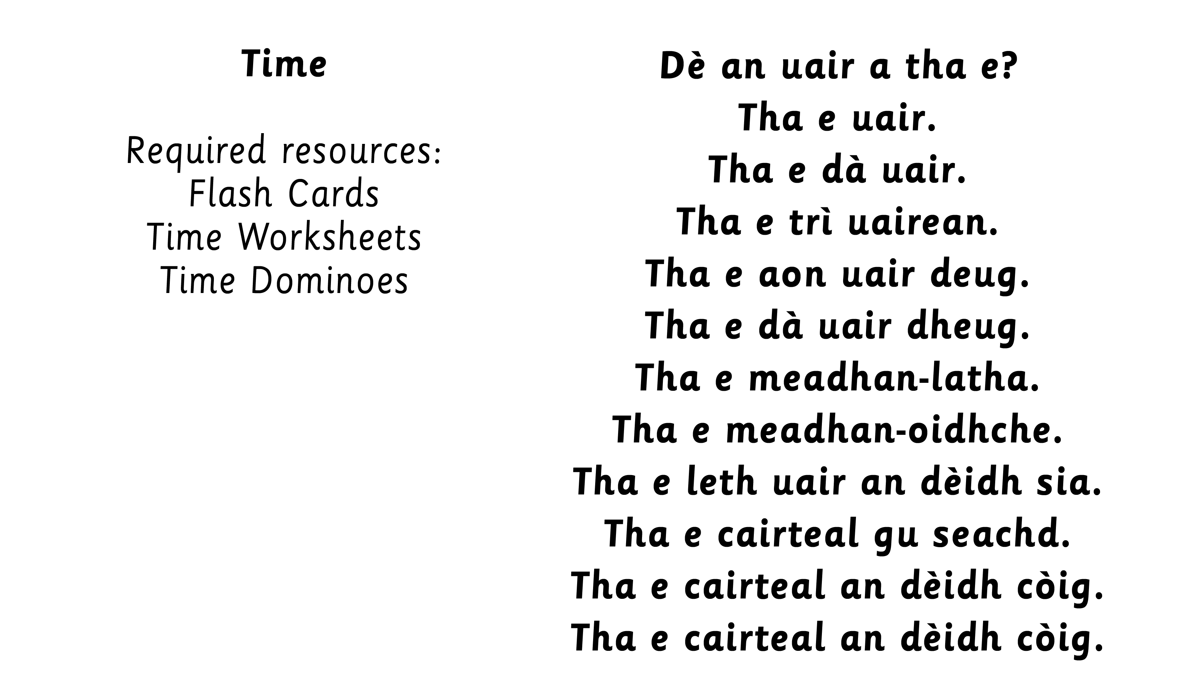
Notes:
Before using the PowerPoint, it is recommended that a clock is used to teach the hours 3 o’ clock to 10 o’ clock to establish the pattern. Then teach 11 o’ clock, 12 o’ clock, 1 o’ clock and 2 o’ clock. The PowerPoint can then be used as a follow up to reinforce and consolidate.
Initially teach only hours and gradually introduce other times as appropriate.

Slide 3



Slide 6
Notes:
Teachers then to use a clock to practise
3 o’ clock to 10 o’ clock reinforcing the pattern.

Slide 11
Notes:
Teach half past for each hour.

Slide 12
Notes:
Teach quarter to for each hour.

Slide 13
Notes:
Teach quarter past for each hour.

Slide 14
Notes:
Activity: Game carousel idea – place names displayed around the classroom. Children in small groups go to a place. Teacher to hold up question card – “Dė an uair a tha e?”
Using a clock/fan, children can show and say what the time is in their place - practising using ann an, ann am, anns Class can ask - “Dè an uair a tha e ann an Glaschu?” Group reply verbally and showing the time on their clock.

