Slide 1


Slide 2
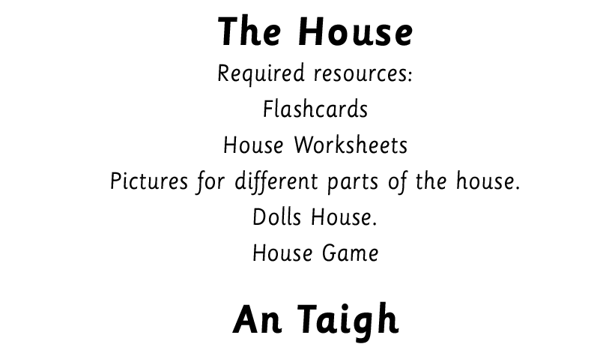
Notes:
Before using the PowerPoint, it is recommended that a clock is used to teach the hours 3 o’ clock to 10 o’ clock to establish the pattern. Then teach 11 o’ clock, 12 o’ clock, 1 o’ clock and 2 o’ clock. The PowerPoint can then be used as a follow up to reinforce and consolidate.
Initially teach only hours and gradually introduce other times as appropriate.

Slide 3


Slide 4
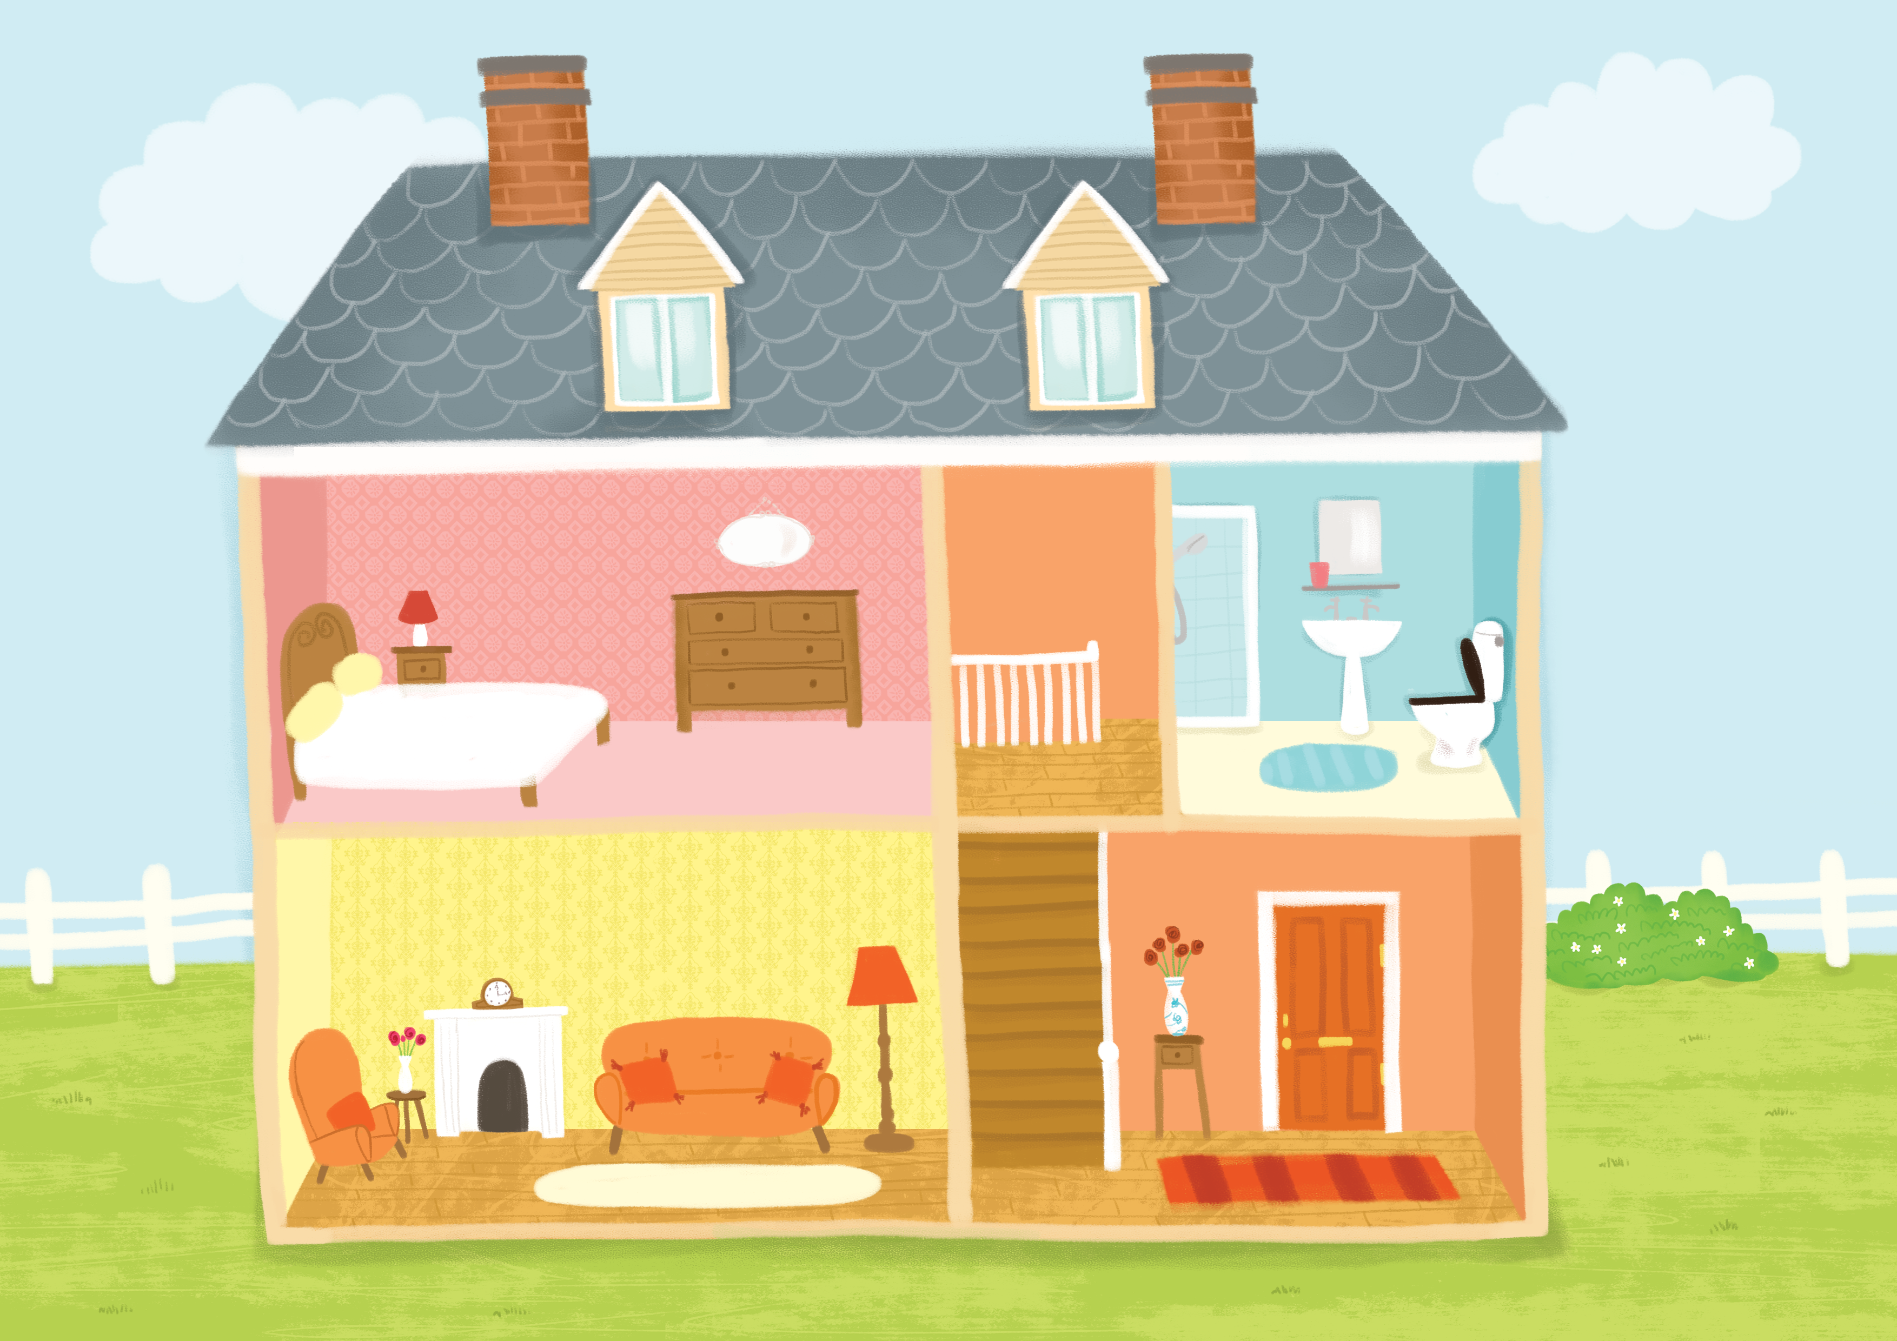
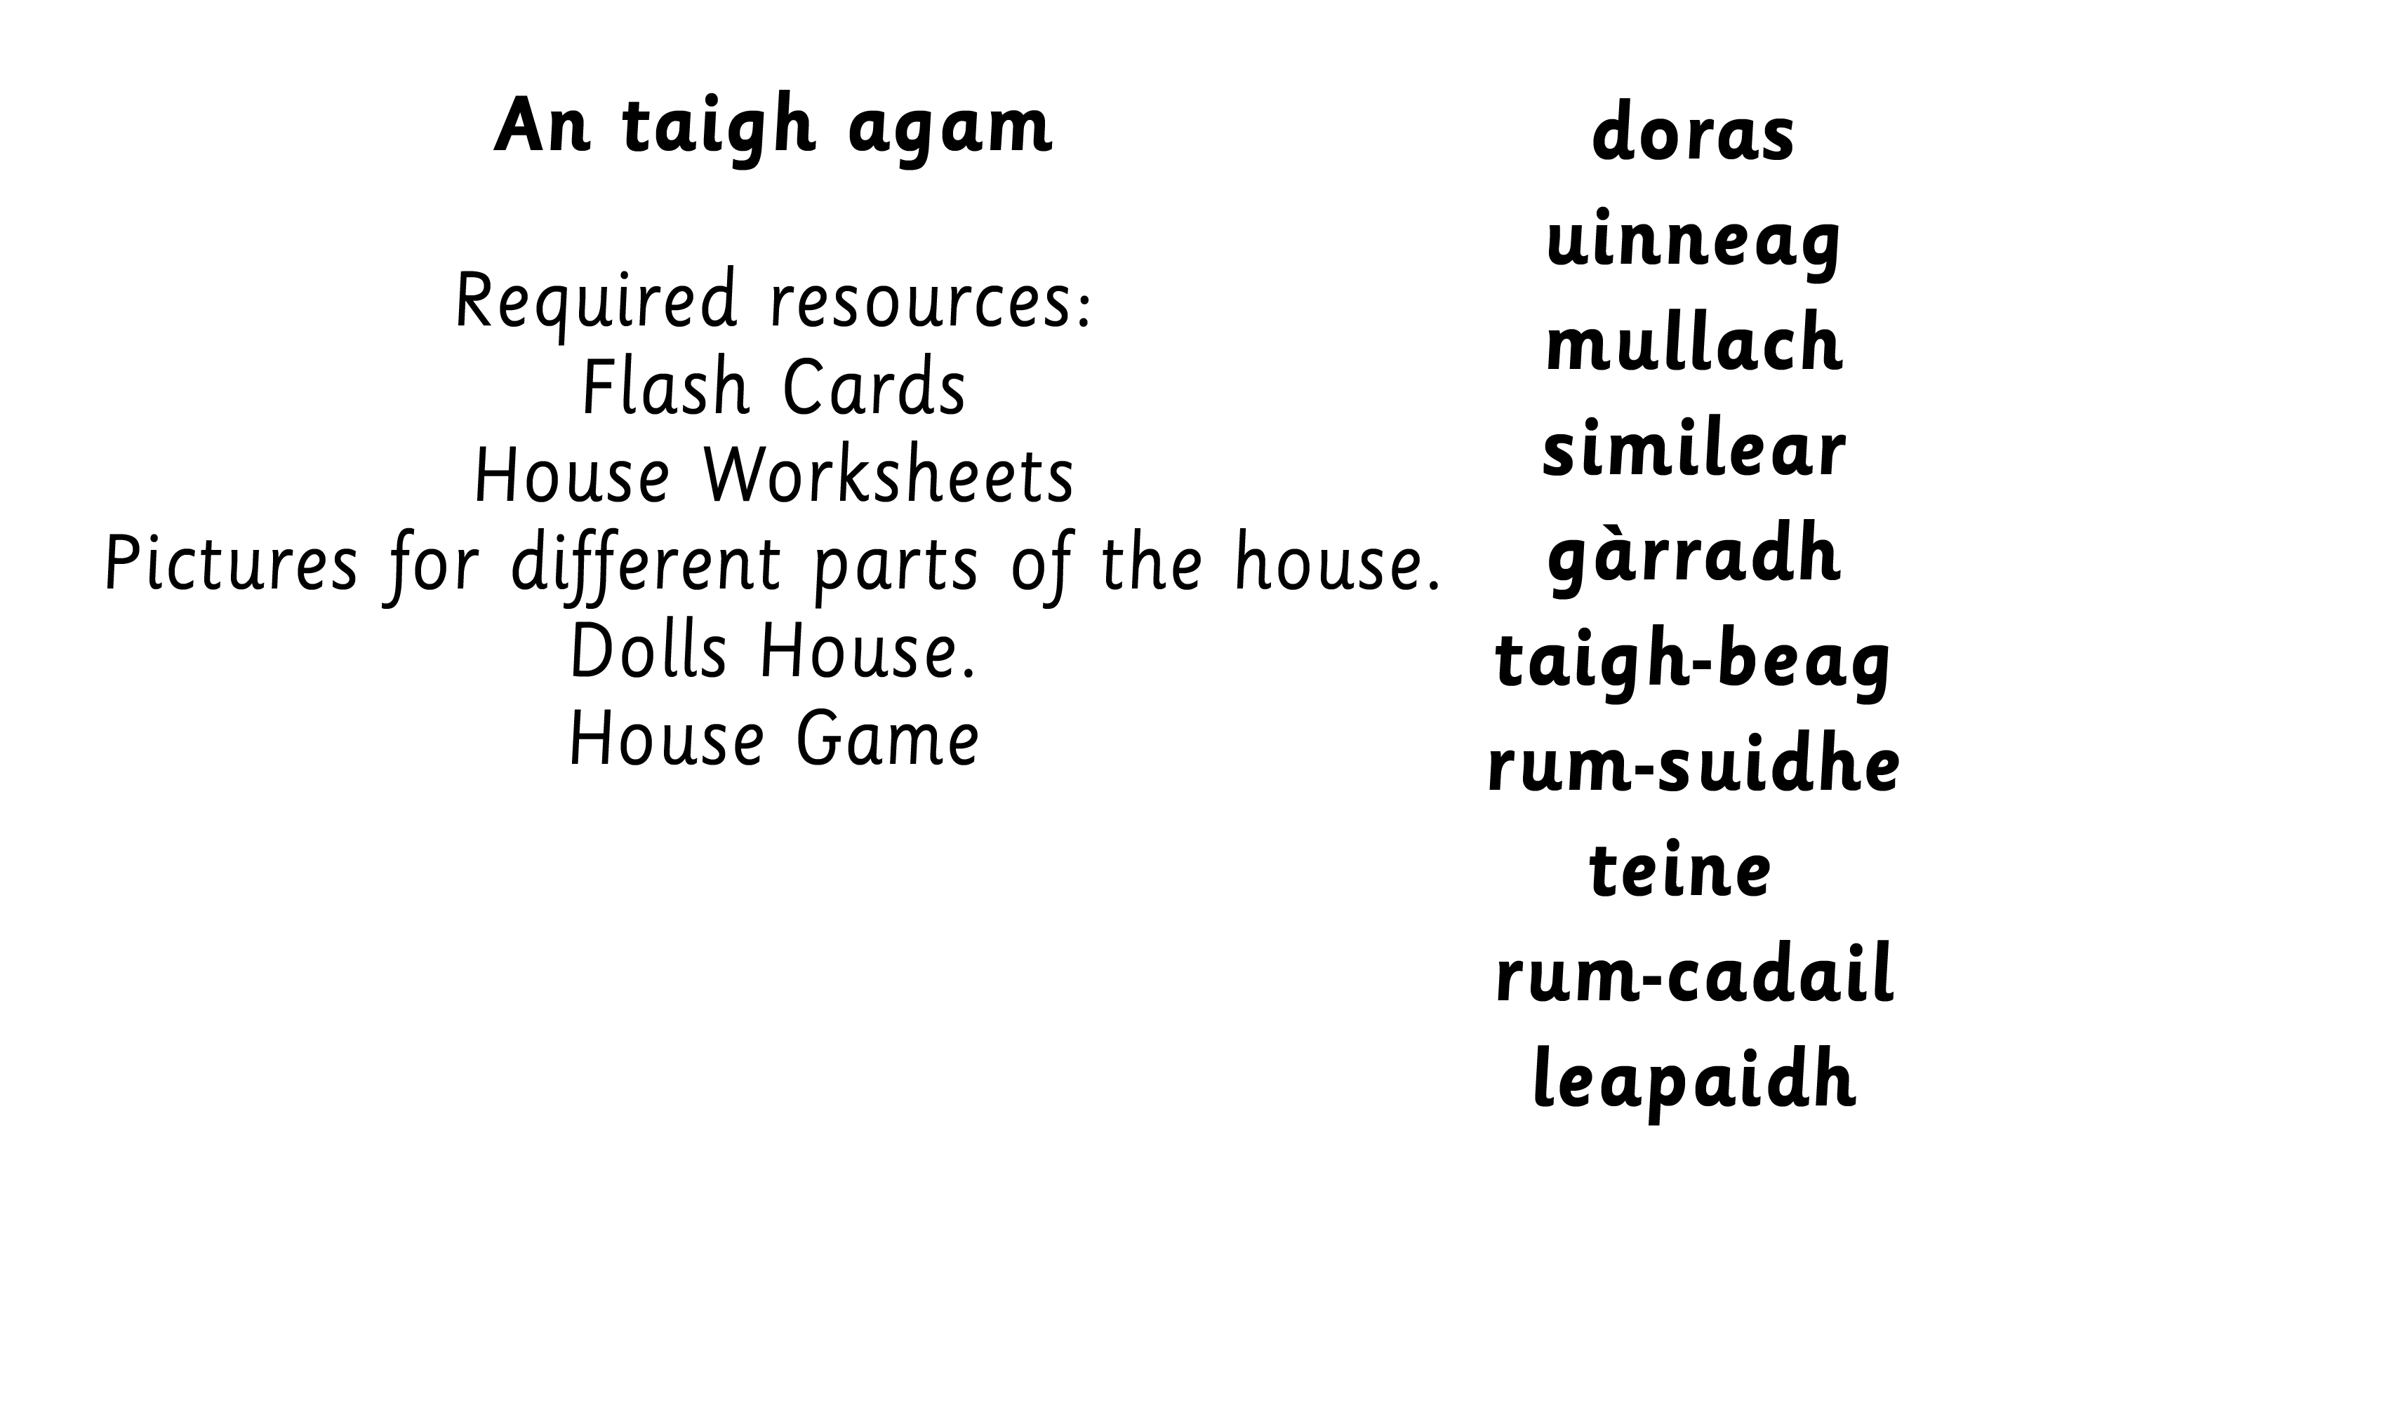

Slide 7
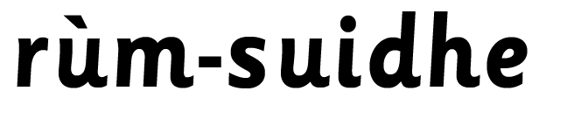

Slide 8

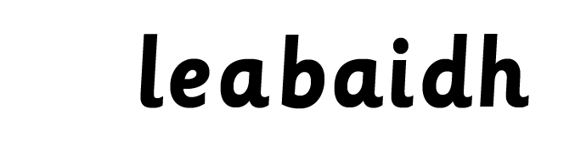
Notes:
Possible activities:
House game
Matching activity - labeling house parts
Colouring activity – follow oral instructions to colour houses.
Drawing activity – draw a house following written instructions.
Play ‘beetle drive’ to build a house.
Describe children’s own/ characters’ houses.

Slide 9
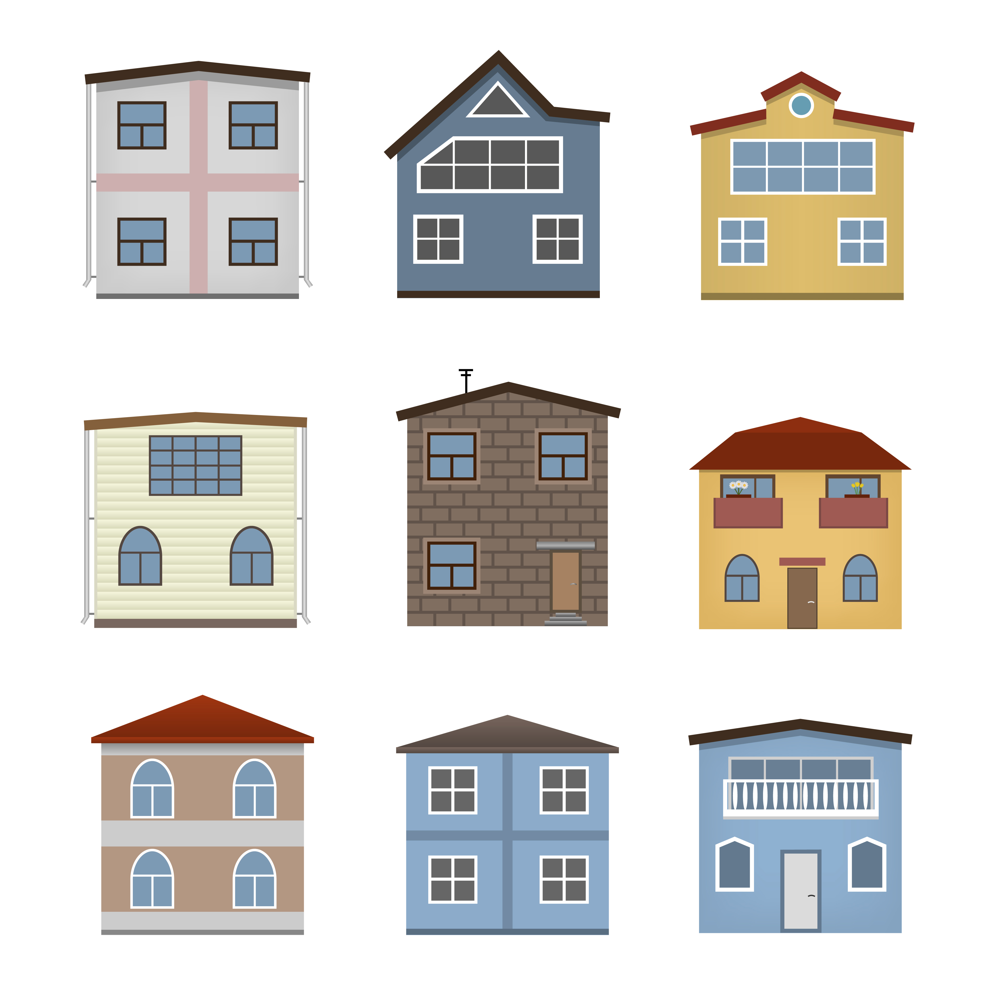

Slide 11
1

Slide 13
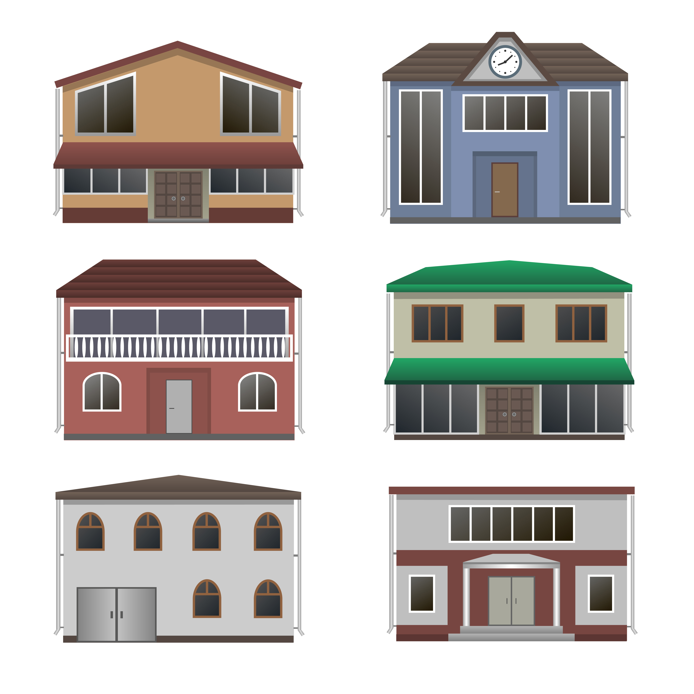
7

Slide 14
8

Slide 15
9

Slide 16
10

