Slide 1


Slide 2
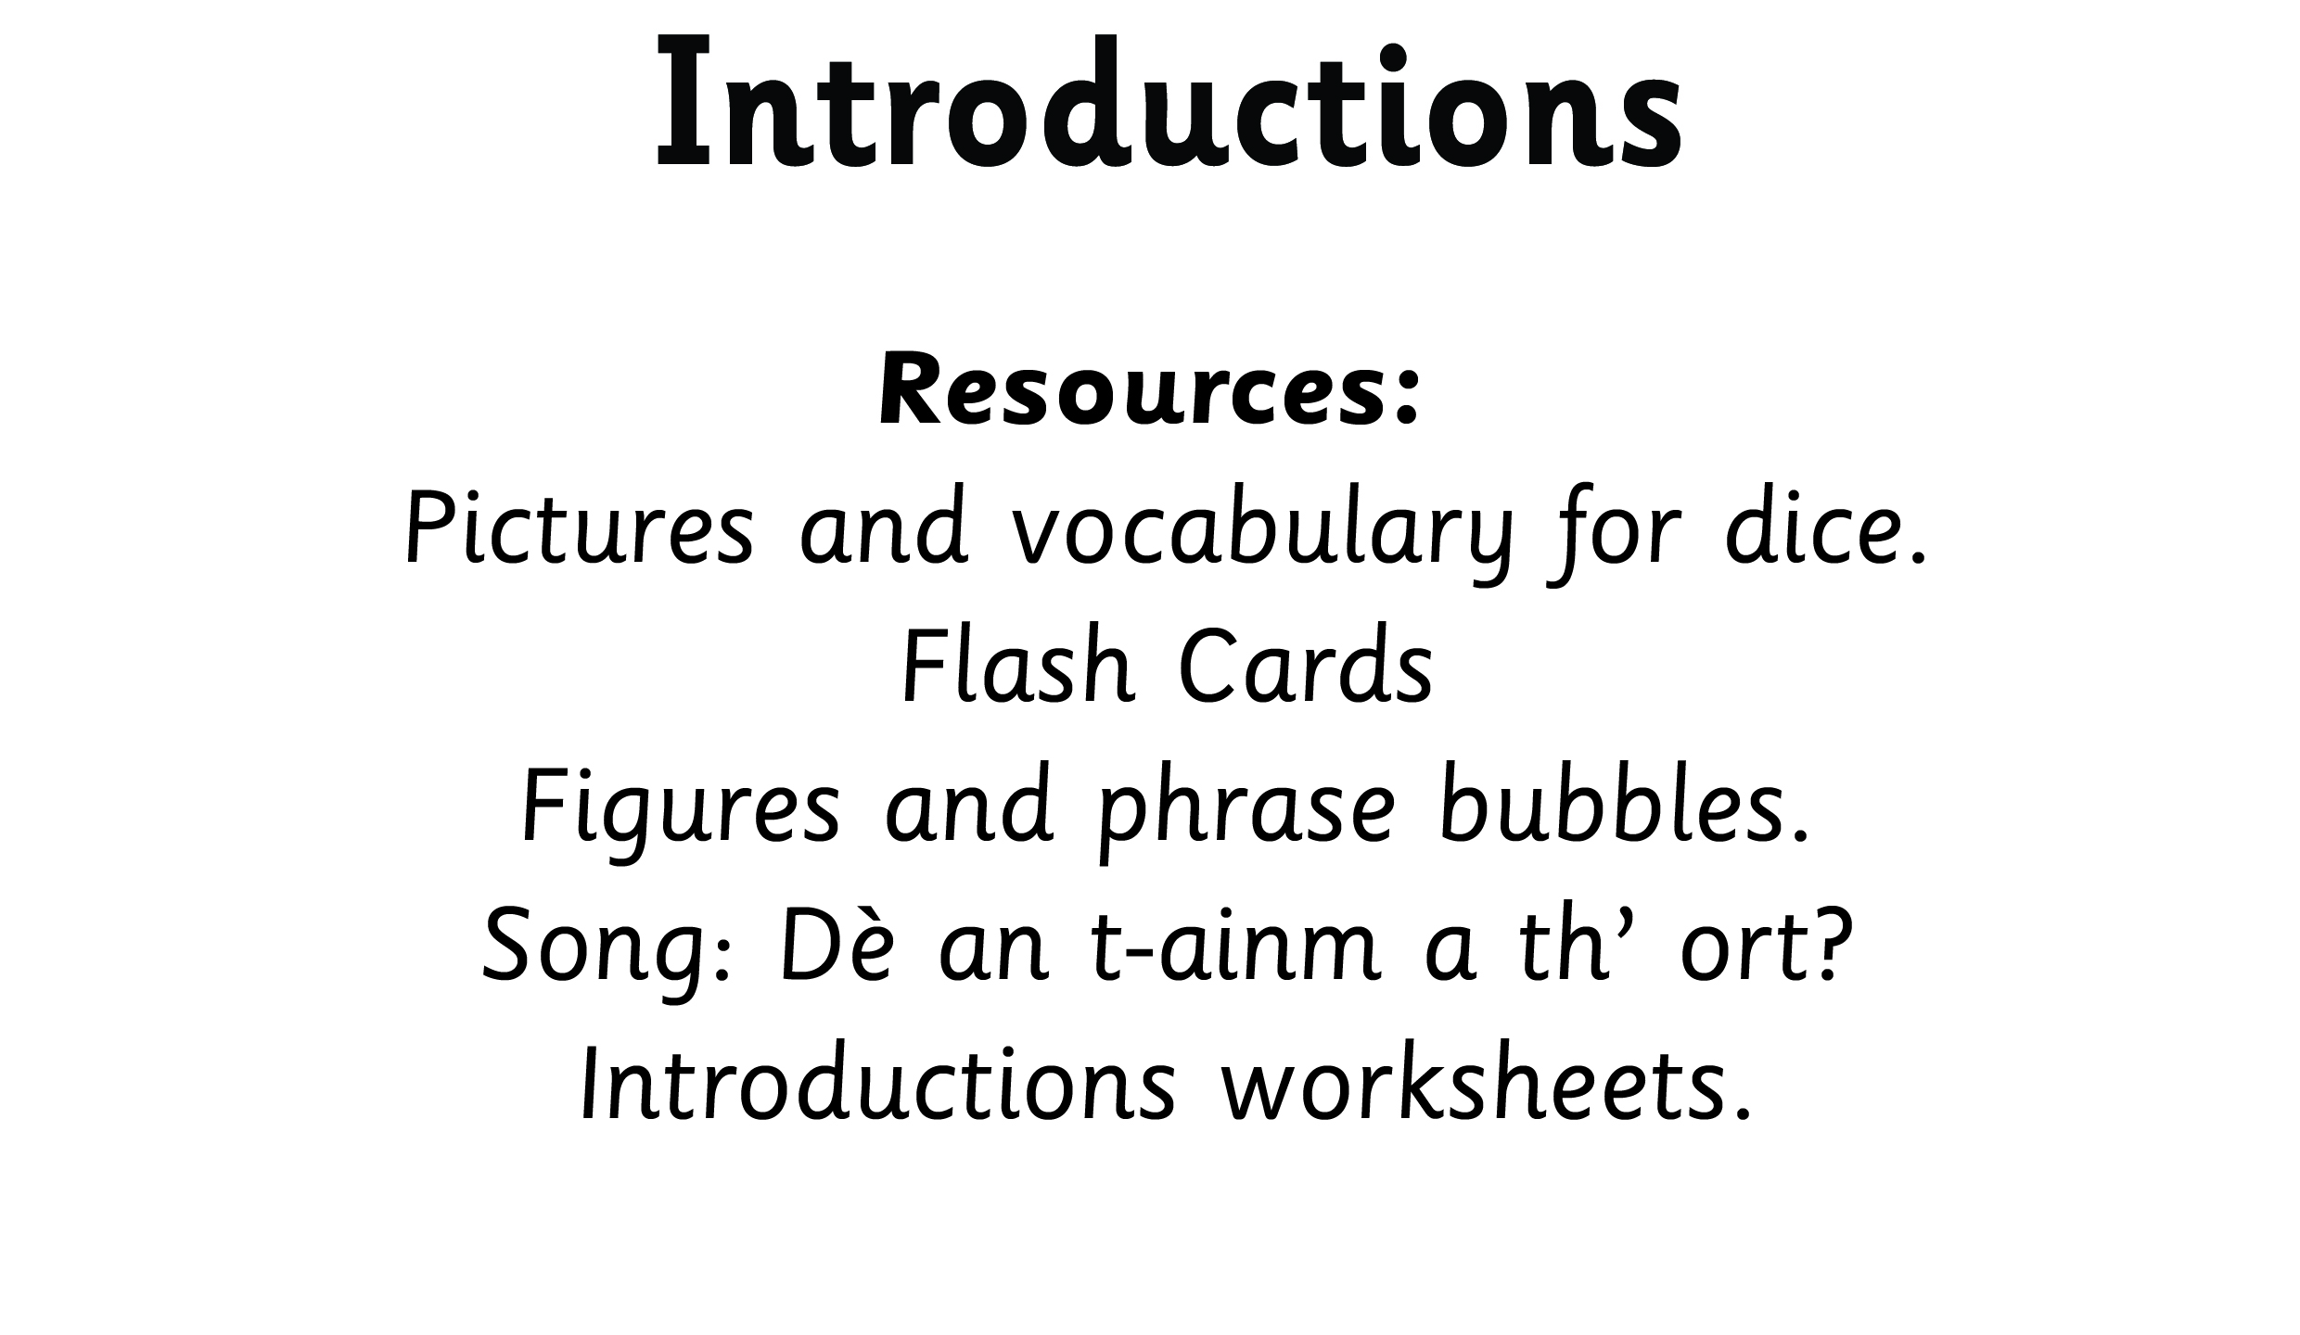
Notes:
Display figure, phrase bubbles and pictures to encourage daily use.

Slide 3
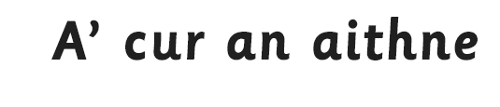


Slide 4
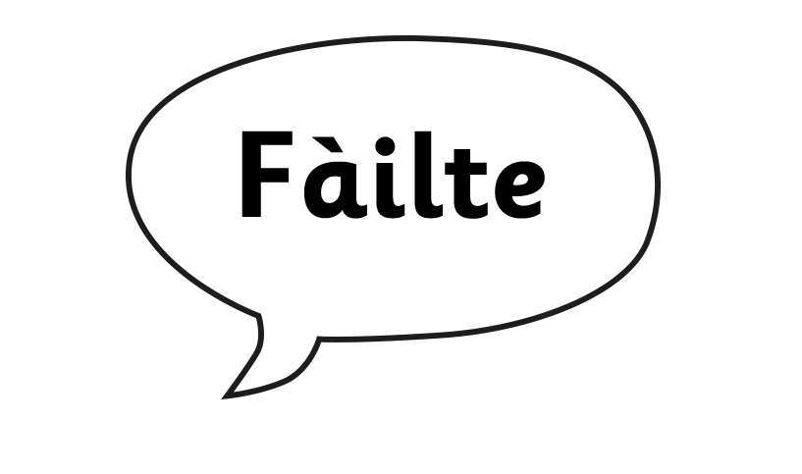

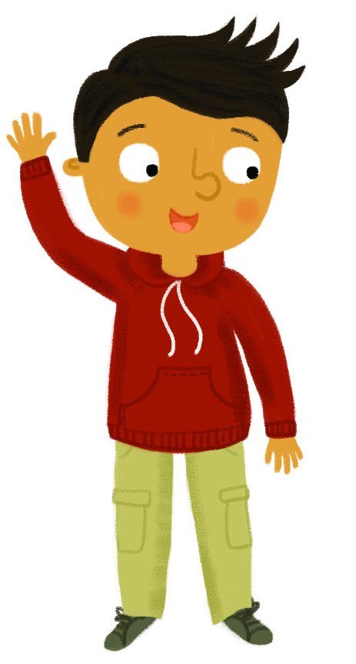

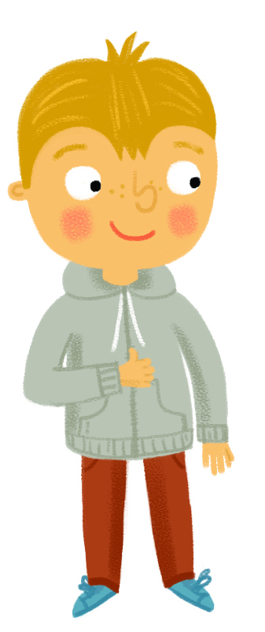
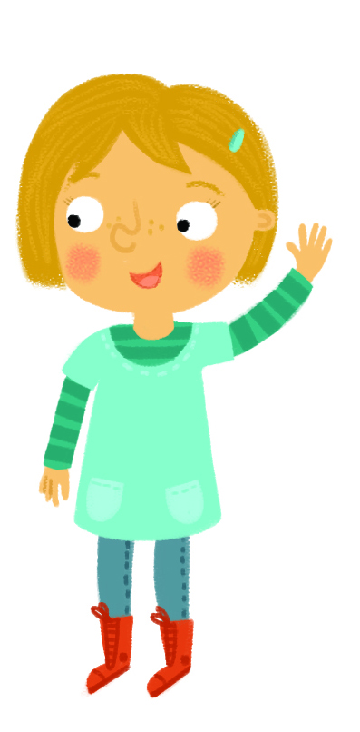
Notes:
Children to circulate shaking hands and using Fàilte, Hallò and Hai.

Slide 5
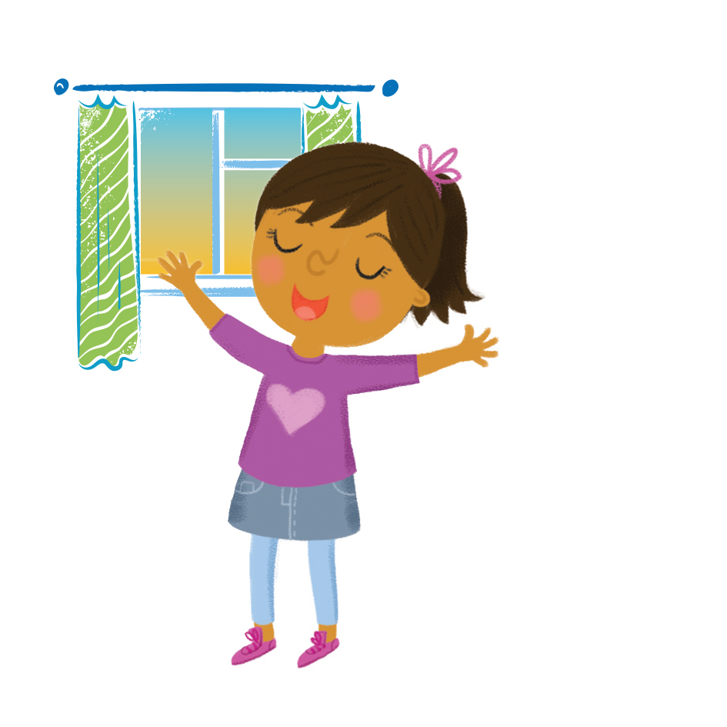
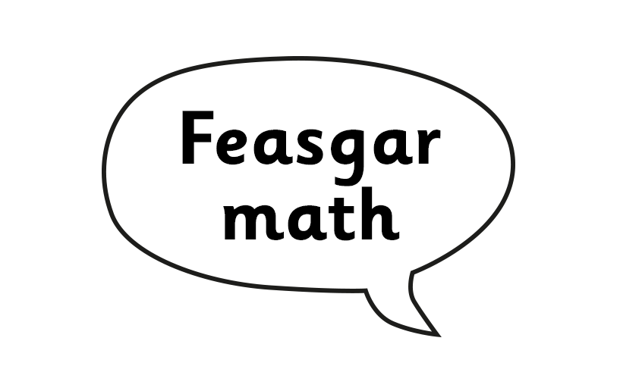

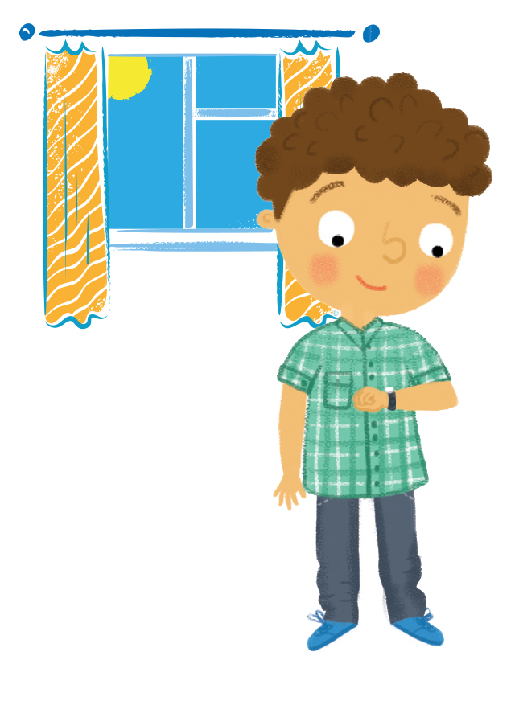


Notes:
Learn vocabulary – using repetition.
Circle gam: Large dice with pictures and words inserted – 3 pictures of morning, afternoon and night and 3 with only vocabulary.

Slide 6
Notes:
Children to tell a partner which phrase would match this picture

Slide 7
Notes:
Children to tell a partner which phrase would match this picture

Slide 8
Notes:
Children to tell a partner which phrase would match this picture

Slide 9
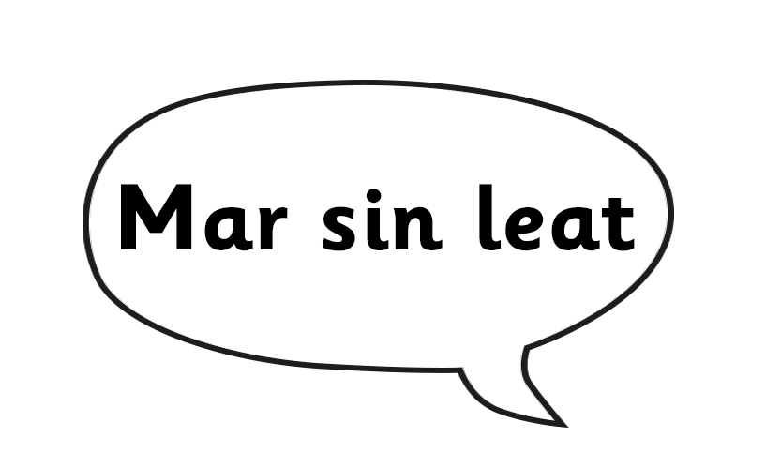
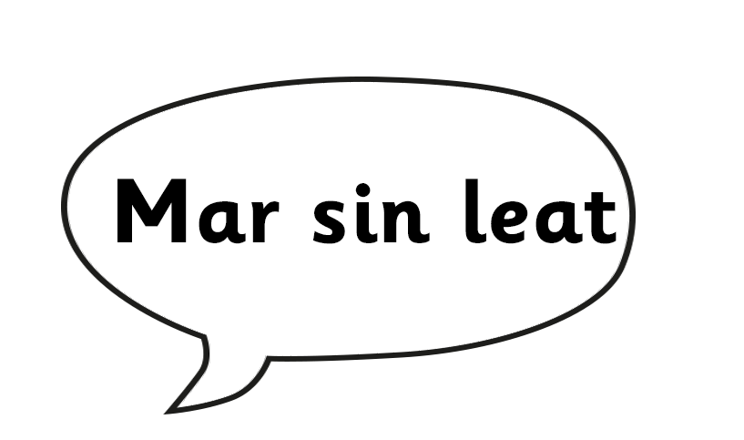
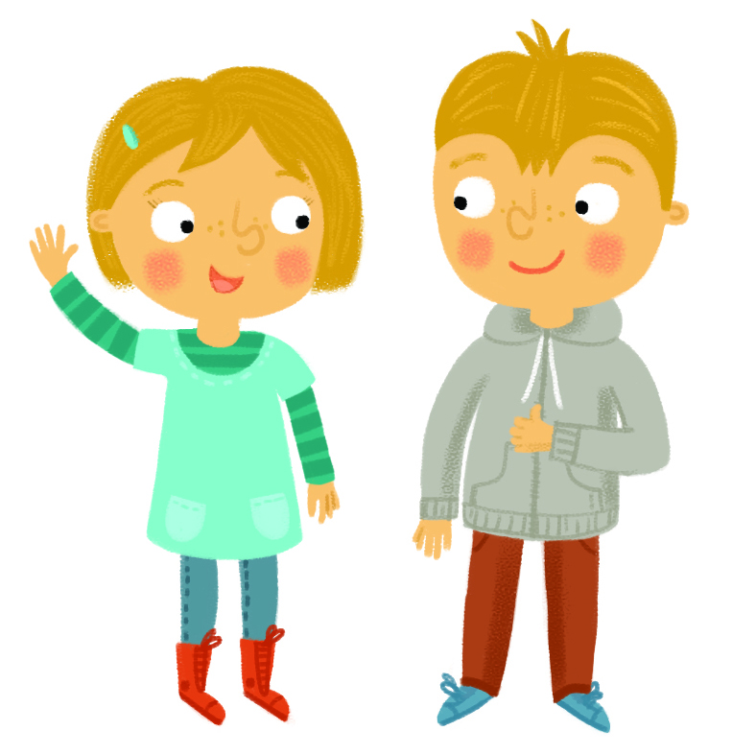
Notes:
Explain/highlight use of leat/leibh

Slide 10
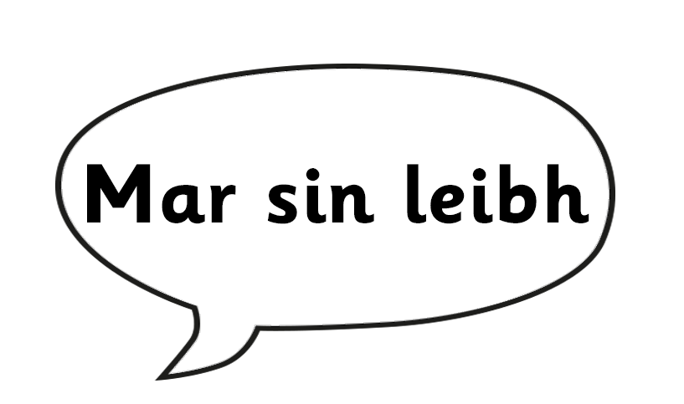
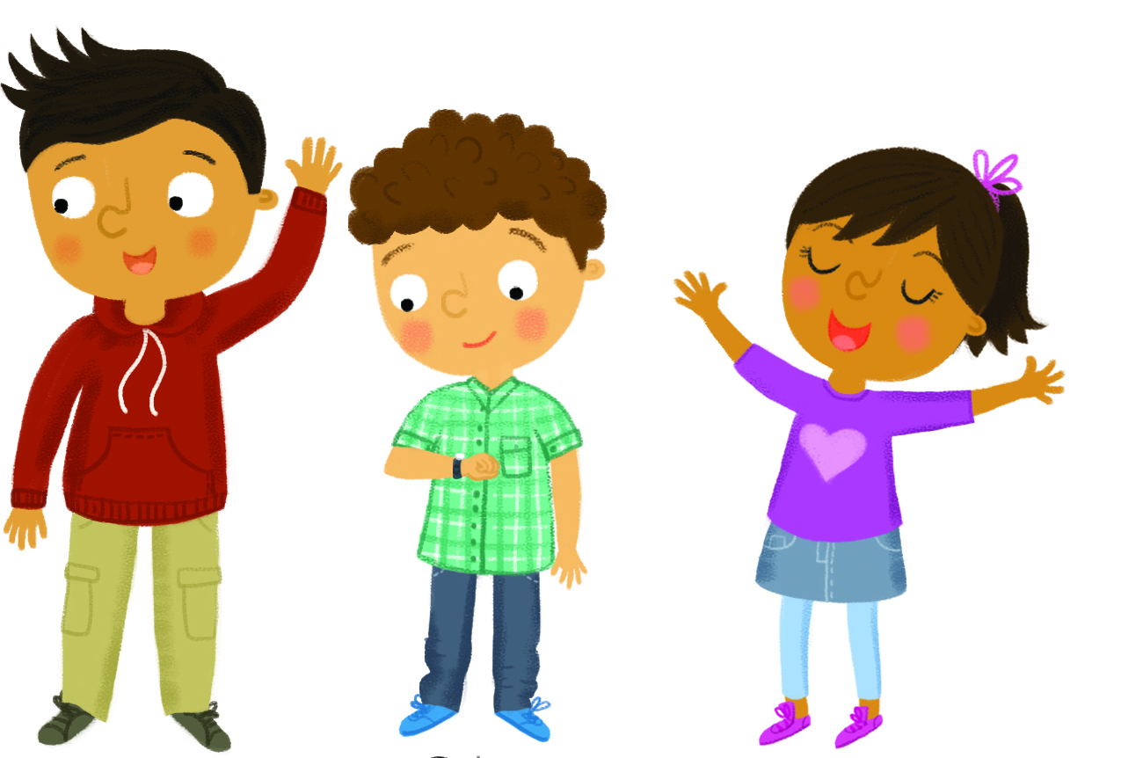
Notes:
Explain/highlight use of leat/leibh

Slide 11
Notes:
Explain/highlight use of leat/leibh

Slide 12
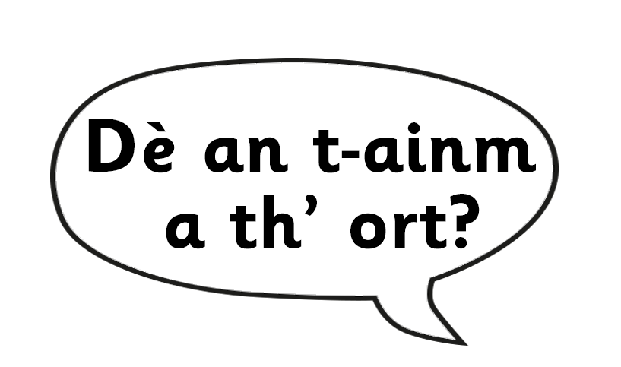
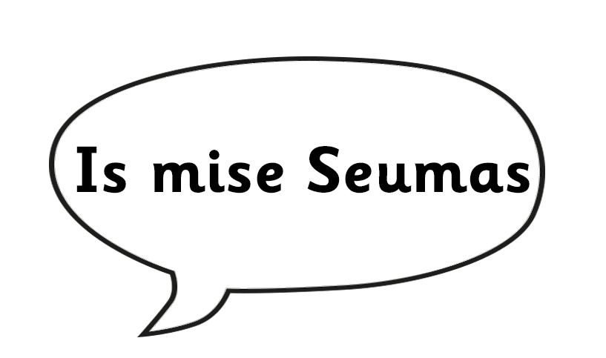
Notes:
Use figures to introduce the vocabulary through repetition.

Slide 13
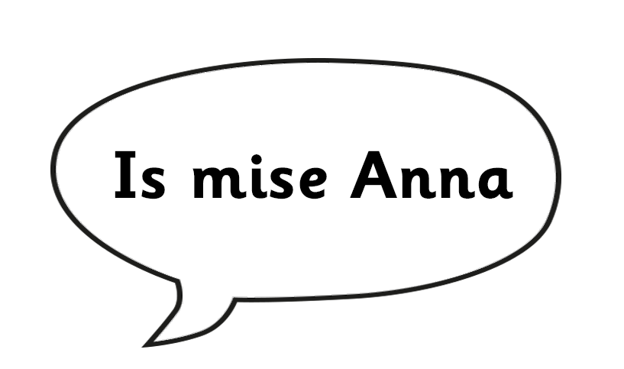
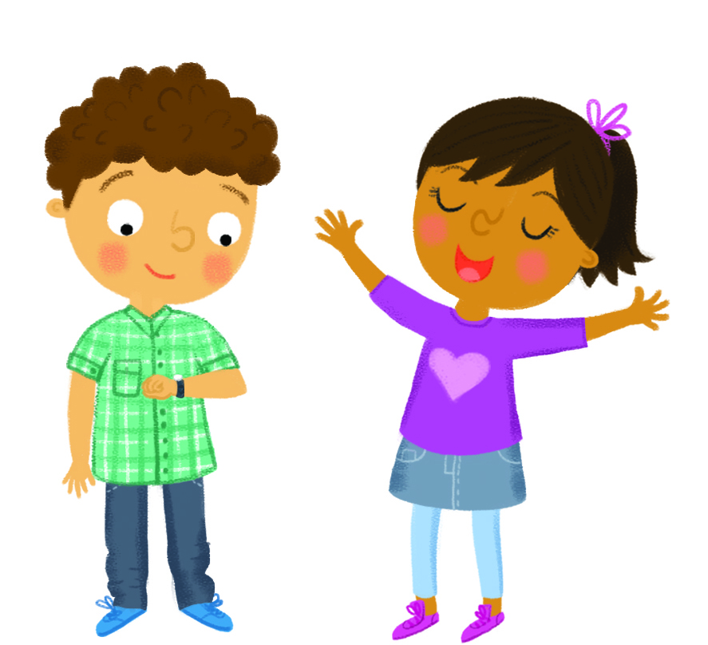
Notes:
Use figures to introduce vocab through repetition.
Song: Dè an t-ainm a th’ ort?

Slide 14

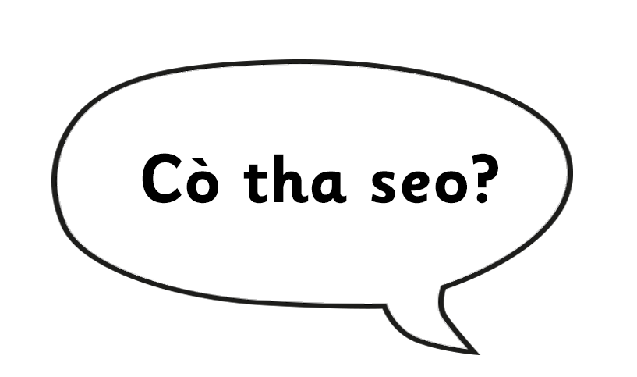
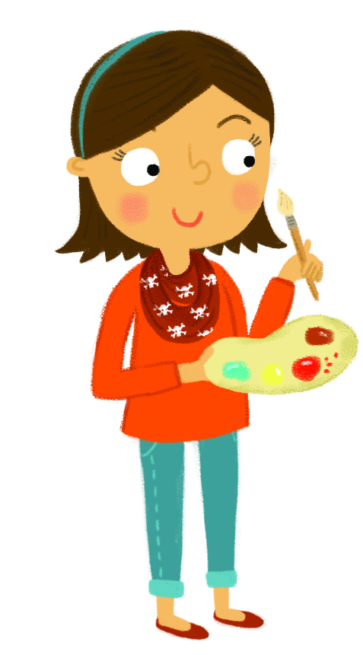
Notes:
Use figures and/or children to introduce themselves and others.

Slide 15

Notes:
Use figures and/or children to introduce themselves and others.

Slide 16
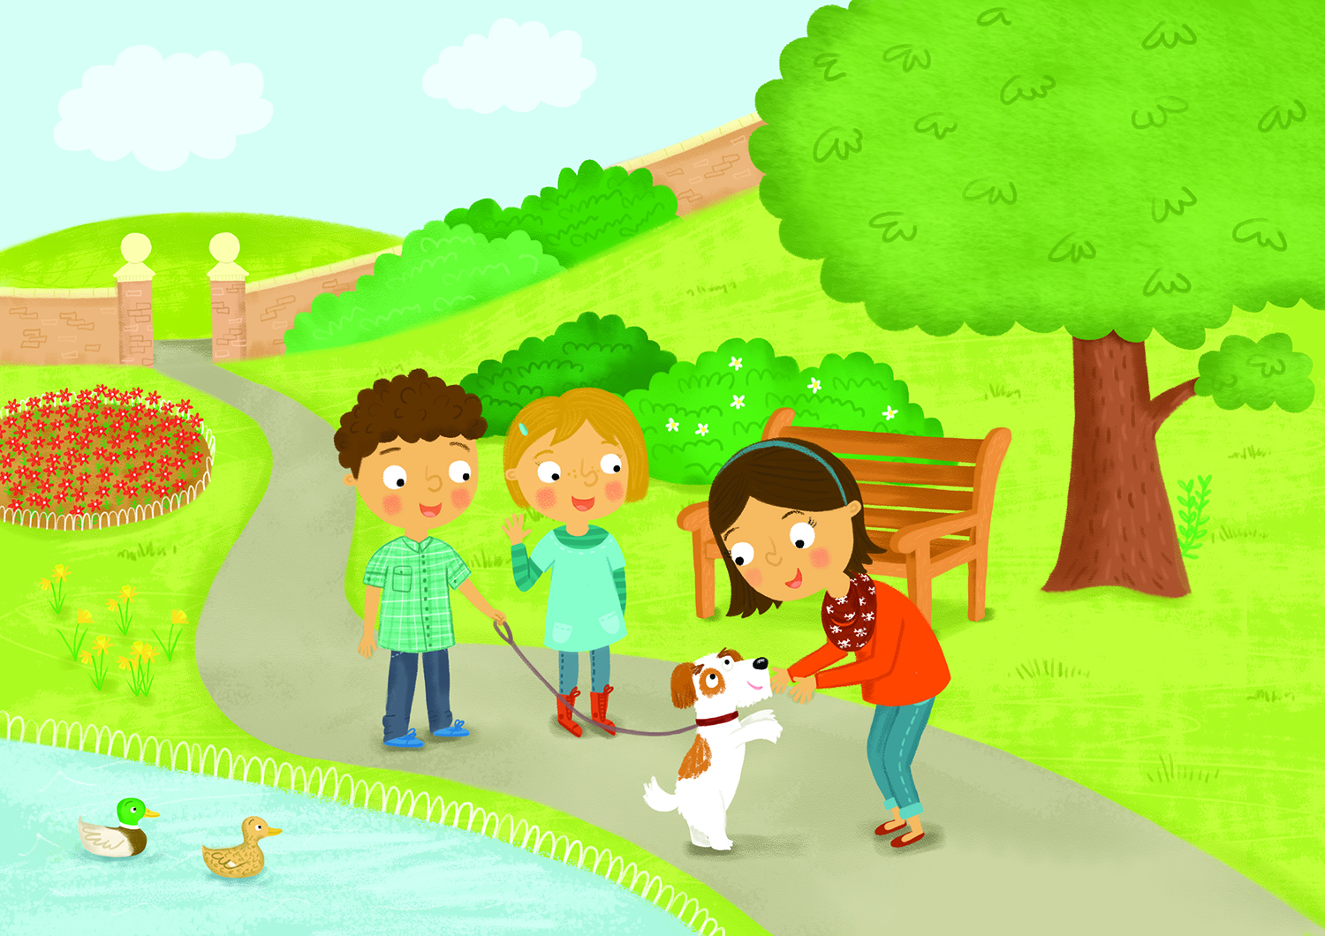

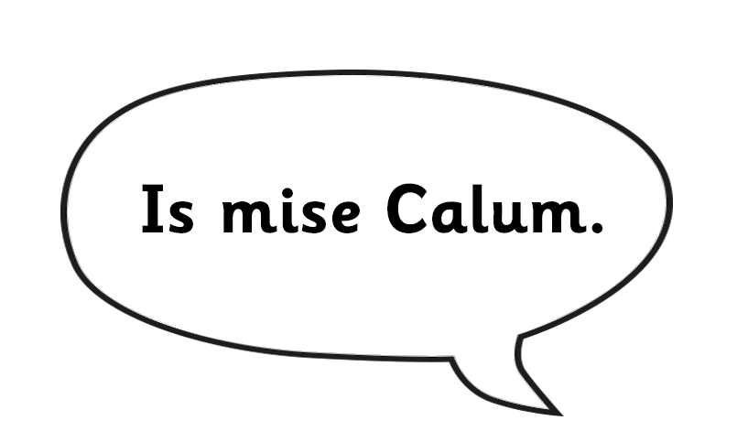

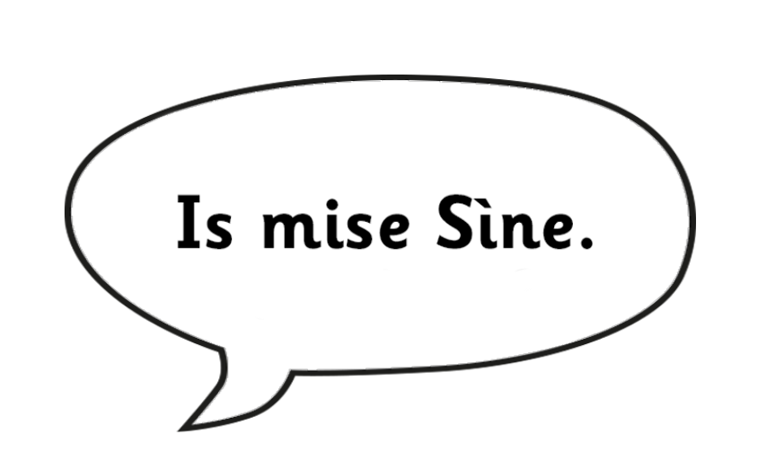
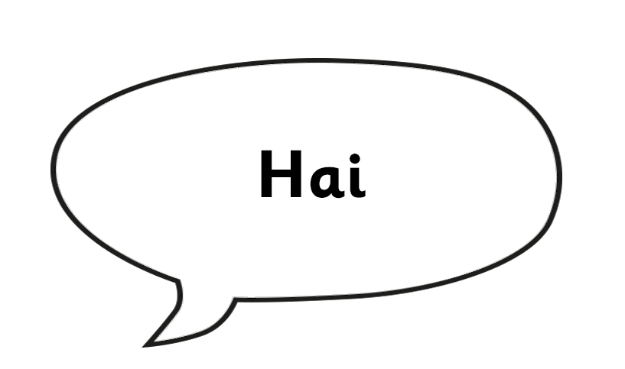

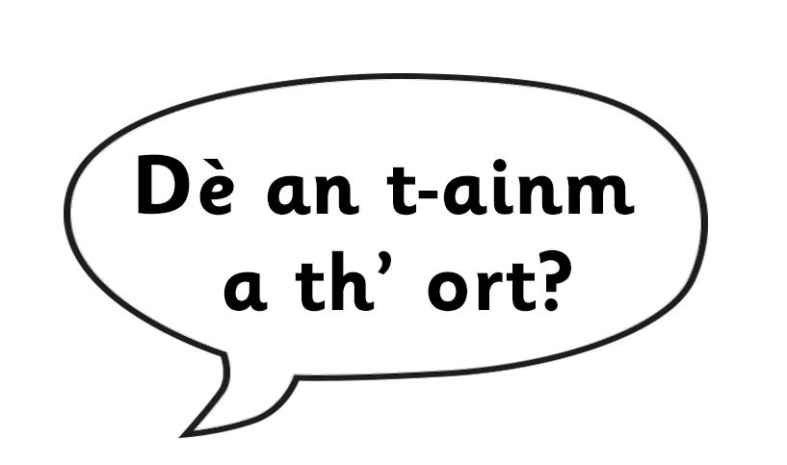


Notes:
Children or teacher to read story

