Slide 1


Slide 2
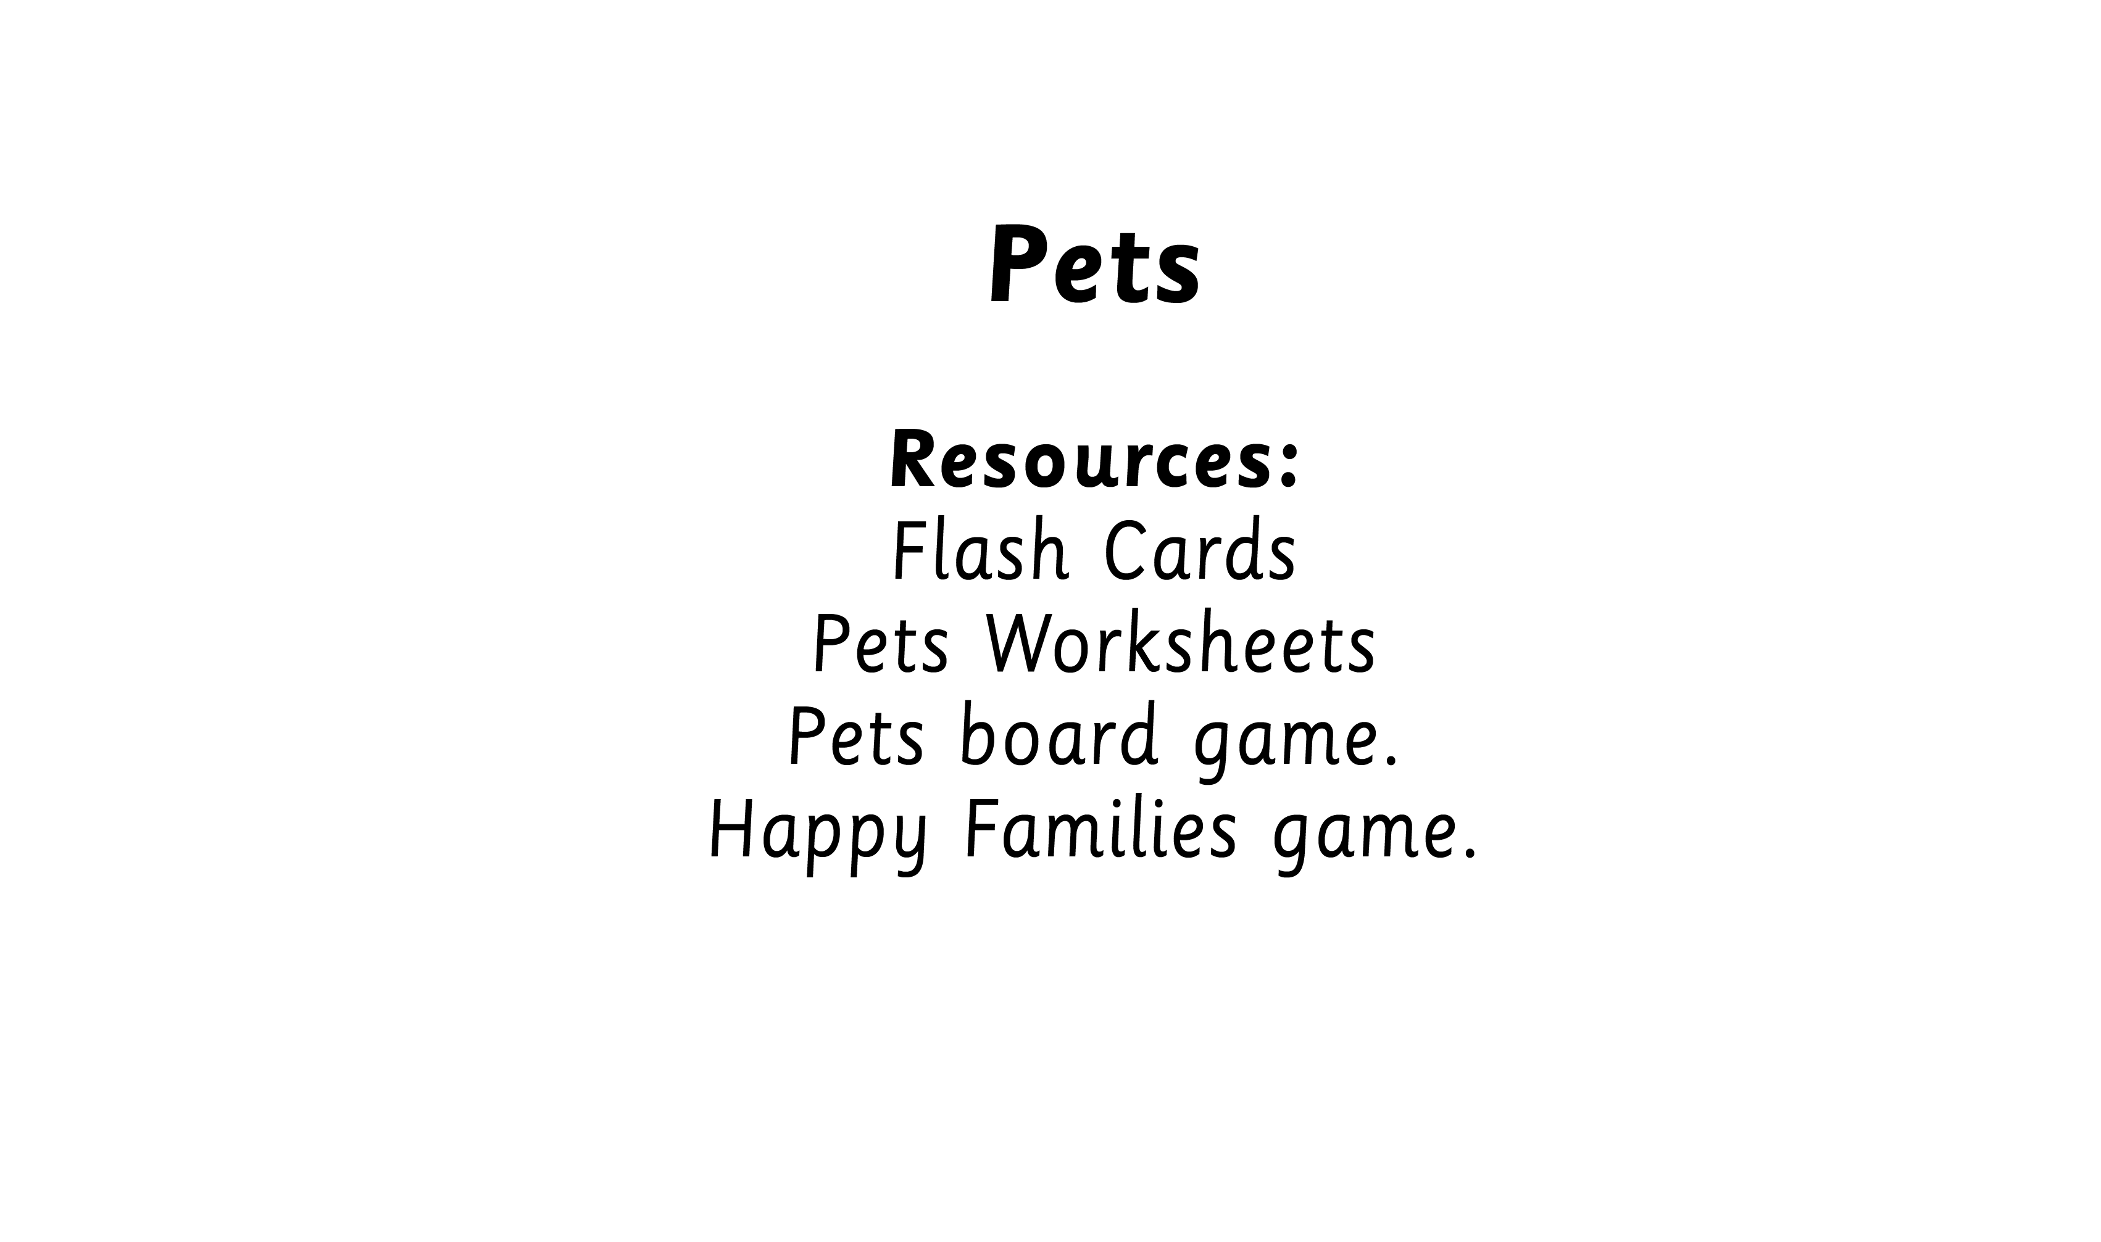

Slide 3



Slide 4


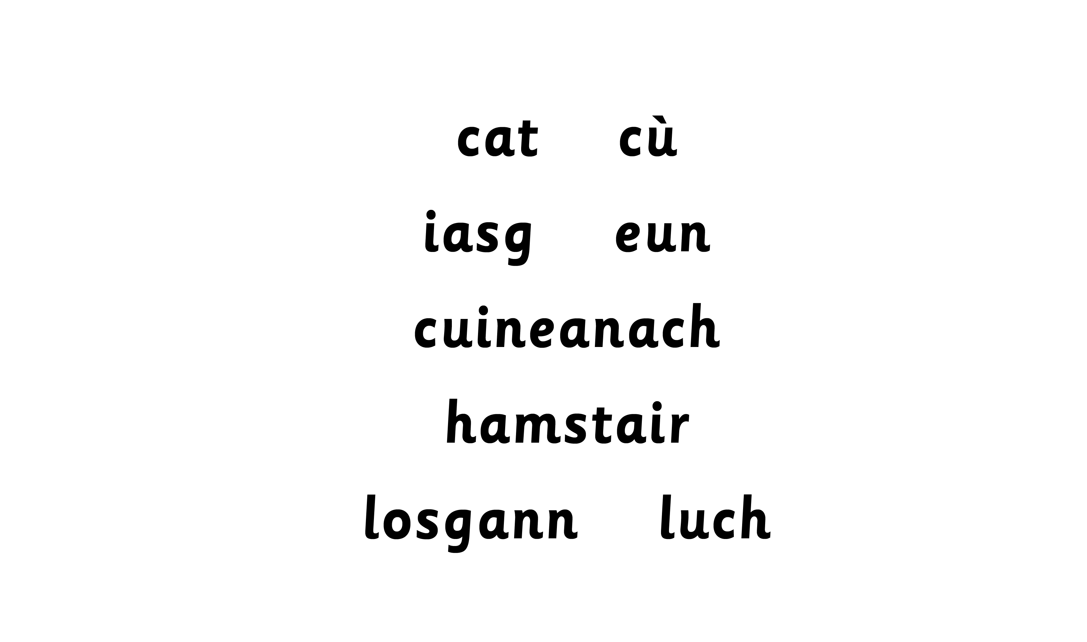

Slide 5


Slide 7
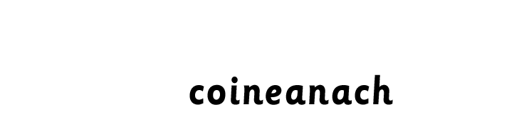

Slide 8

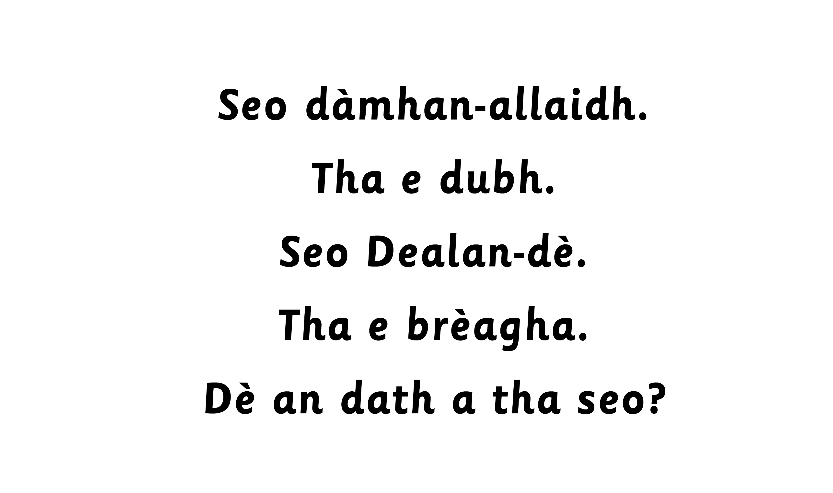

Slide 9


Notes:
another opportunity to revise colours.
.

Slide 10
