Slide 1


Slide 2
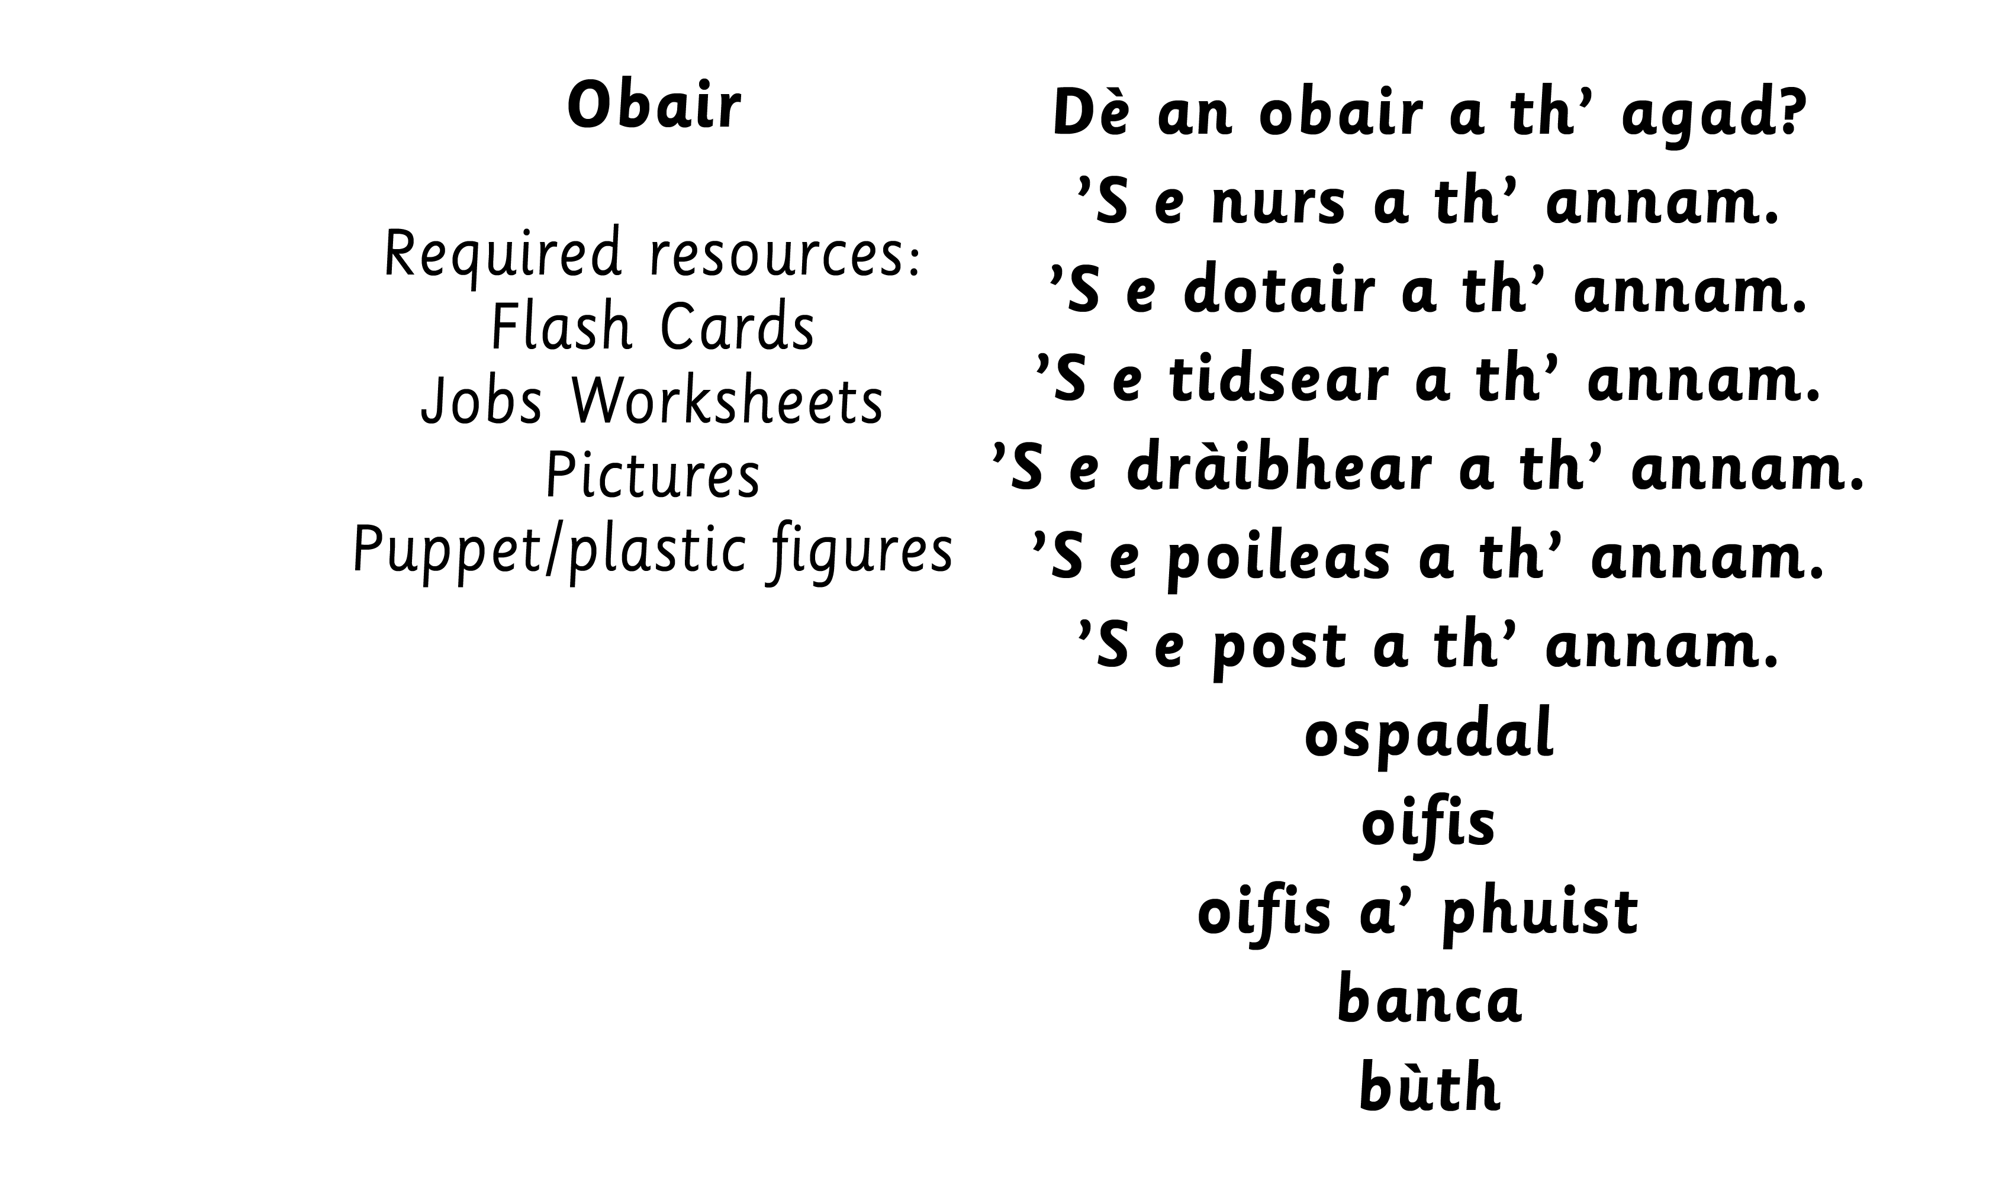

Slide 3



Slide 4


Slide 5


Slide 6


Slide 7
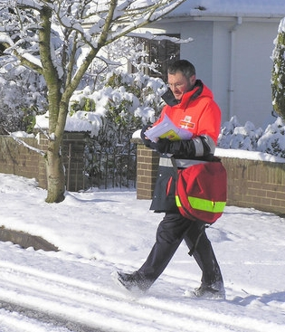

Slide 8


Slide 9


Slide 10
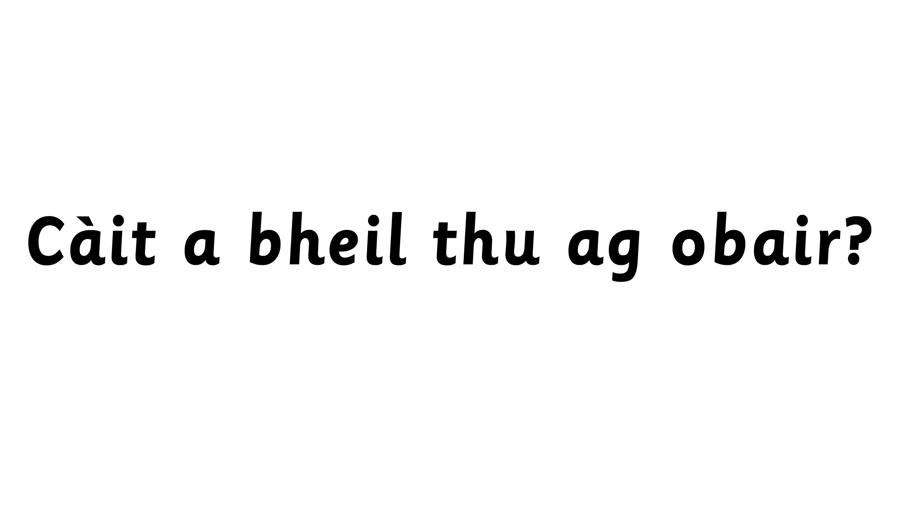

Notes:
Teacher to highlight use of ann an/ann am/anns
Using the following games, introduce and practise using: ‘S e/ Chan e/ An e?
Guess Who? Children to have a character on a post it on their head – asking ‘An e… a th’ annam?’
Answering with S’ e/ Chan e.
Possibility of introducing annad.

Slide 11
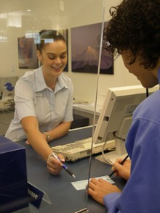

Slide 12


Slide 13


Slide 14

Notes:
Teacher to highlight use of ann an/ann am/anns
Using the following games, introduce and practise using: ‘S e/ Chan e/ An e?
Guess Who? Children to have a character on a post it on their head – asking ‘An e… a th’ annam?’
Answering with ‘S e/ Chan e.
Possibility of introducing annad.

Slide 15

Feasgar math dhuibh.
Is mise Seonag agus tha mi fichead ’s a h-ochd.
’S e tidsear a th’ annam.
Tha mi ag obair ann am bun-sgoil.

Slide 16

Hàllo!
Tha mi ag obair anns an ospadal.
’S e dotair a th’ annam.
Tha mi uabhasach trang
an-diugh.

Slide 17

Hai!
Is mise Dòmhnall.
Tha mi toilichte an-diugh.
Tha mise ag obair anns an ospadal cuideachd.
’S e nurs a th’ annam.

Slide 18
Feasgar math.
Is mise Ruairidh agus is toigh leam dràibheadh.
’S e dràibhear a th’ annam.
Tha bhan mhòr, gheal agam.

Slide 19
Notes:
Picture of postman and police officer for children to discuss/role play.

