Slide 1


Slide 2
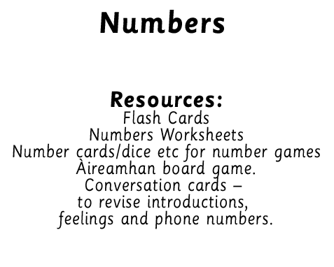
Notes:
Display numbers.

Slide 3



Slide 4
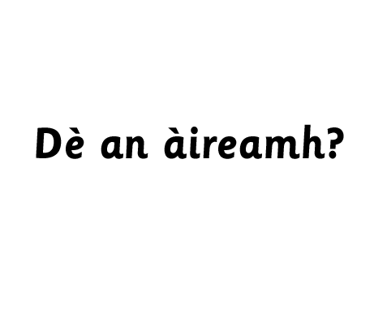
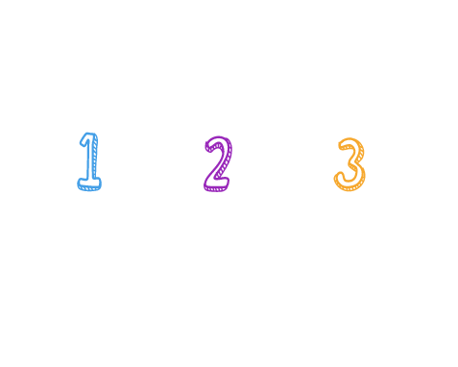
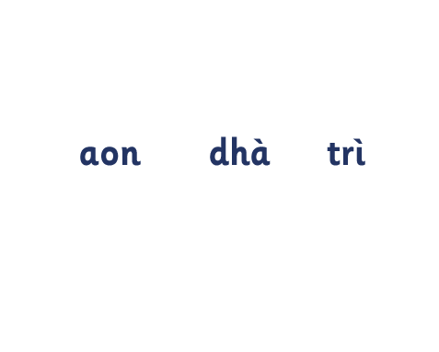
Notes:
Children to circulate and use:
Ciamar a tha thu? Tha gu math. Tha mi toilichte. Tha mi brònach.

Slide 5
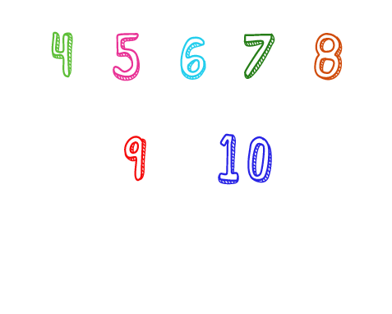
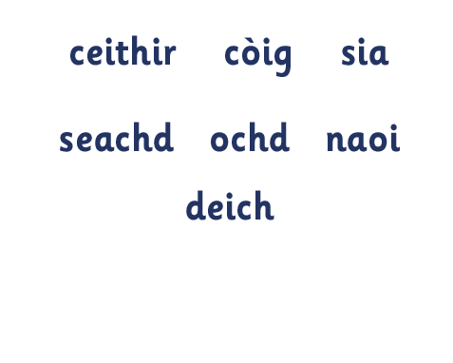
Notes:
Children to circulate and use:
Ciamar a tha thu? Tha gu math. Tha mi toilichte. Tha mi brònach.

Slide 6
Notes:
Children to circulate and use:
Ciamar a tha thu? Tha gu math. Tha mi toilichte. Tha mi brònach.

Slide 7
Notes:
Circle Games – e.g. adding games, counting around the circle etc - e.g. if you say ceithir sit down

Slide 8
Notes:
Children to circulate and use:
Ciamar a tha thu? Tha gu math. Tha mi toilichte. Tha mi brònach.

Slide 9
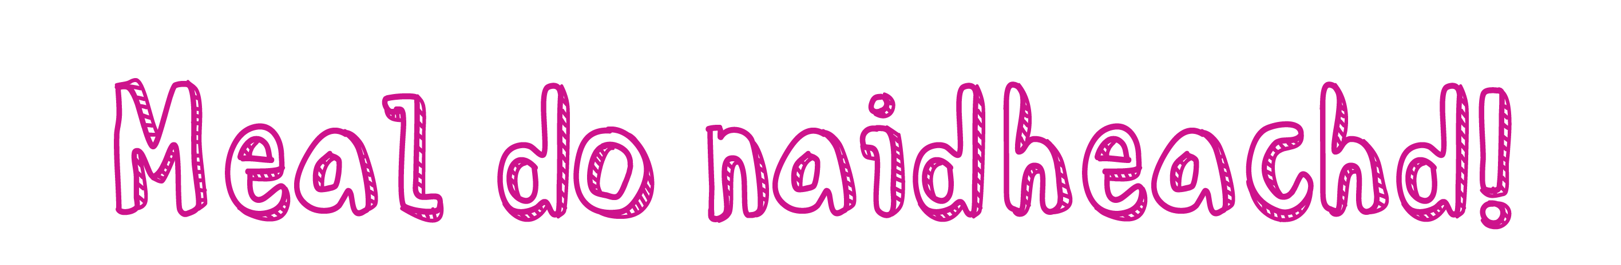


Slide 10
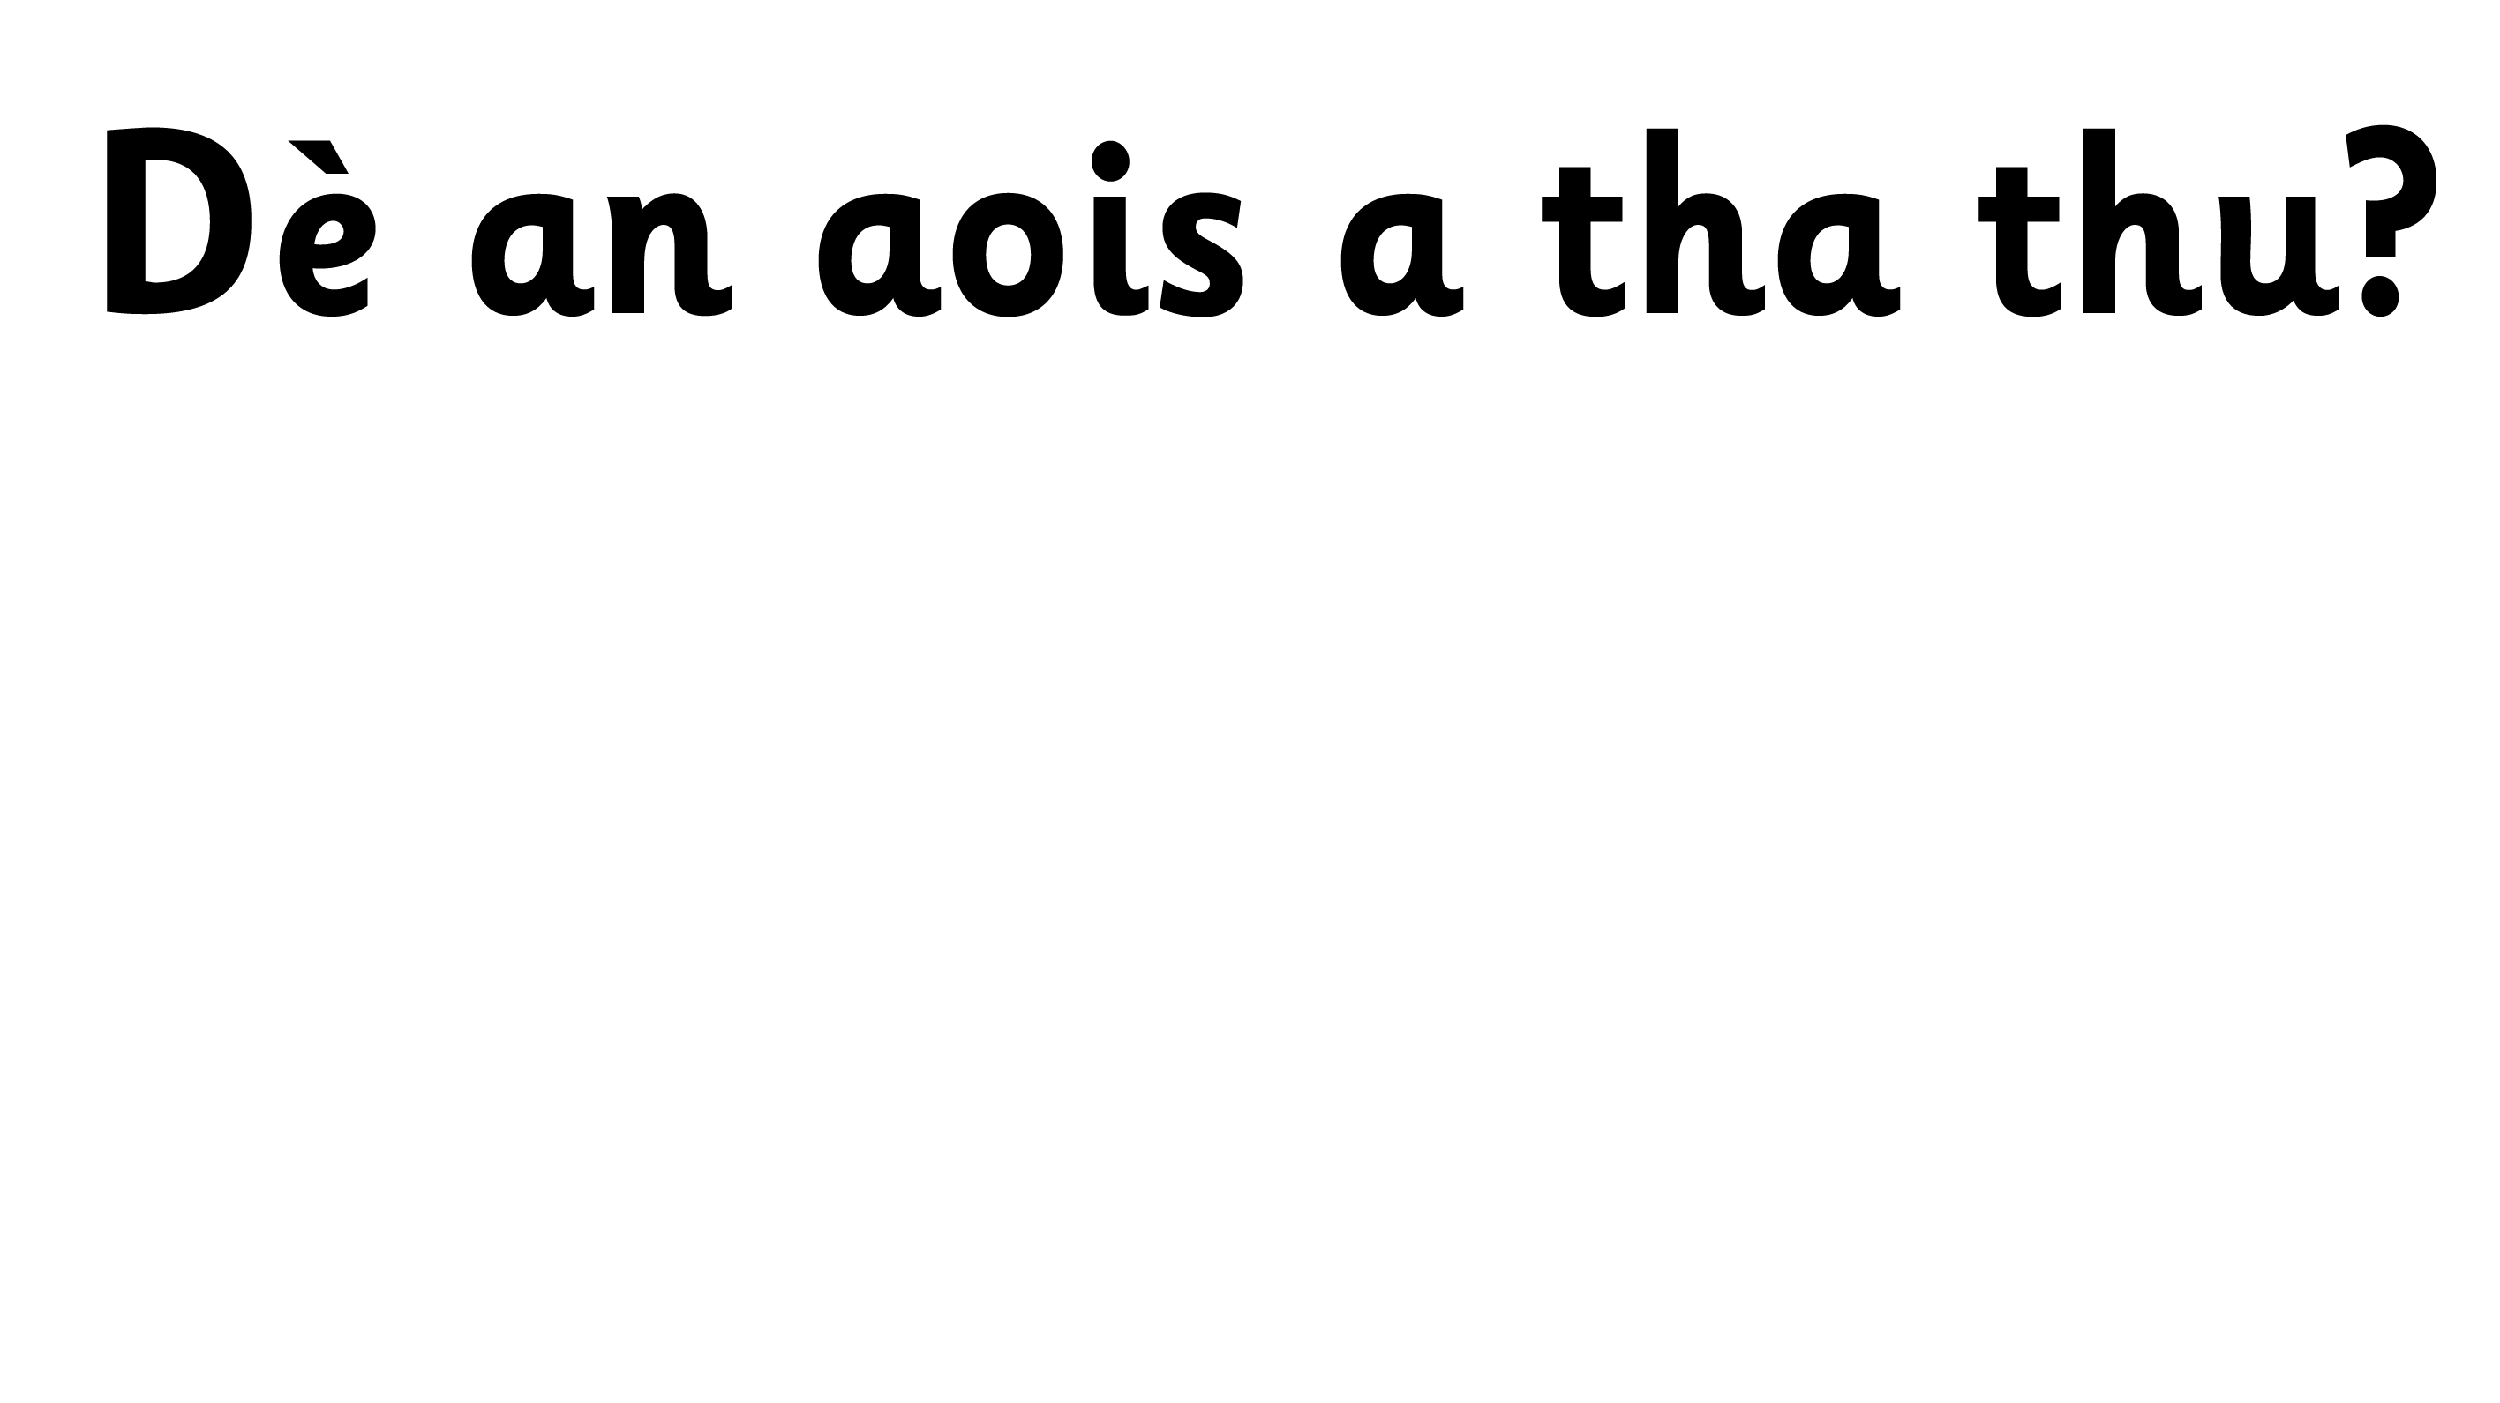
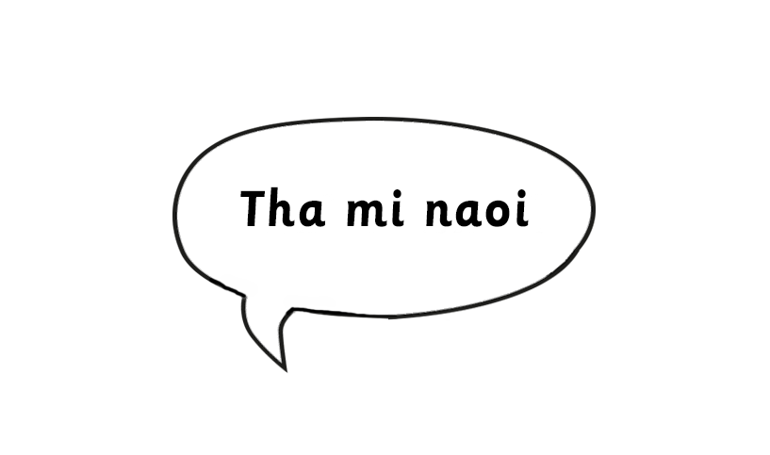


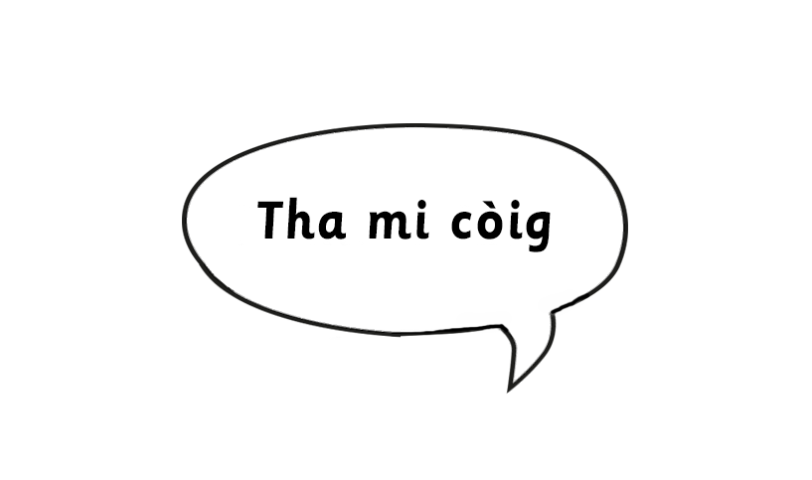

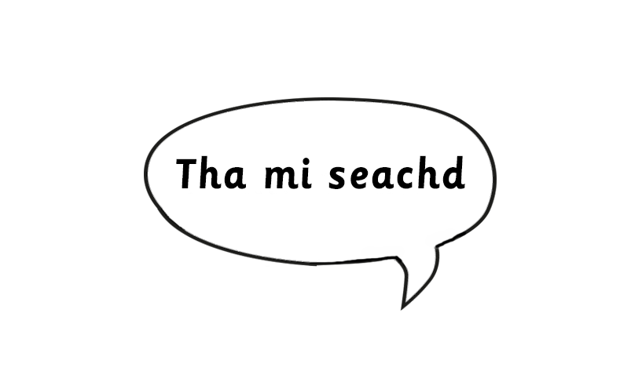

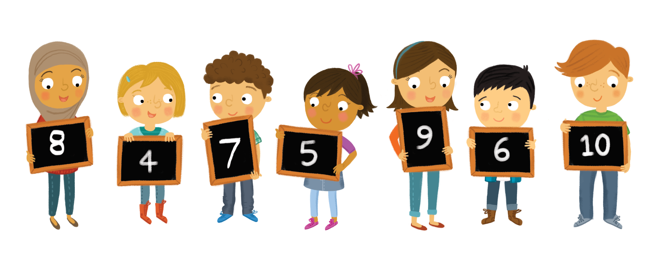

Slide 11
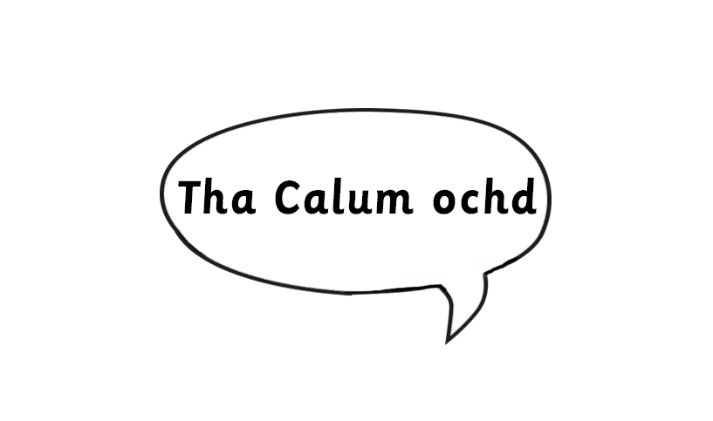
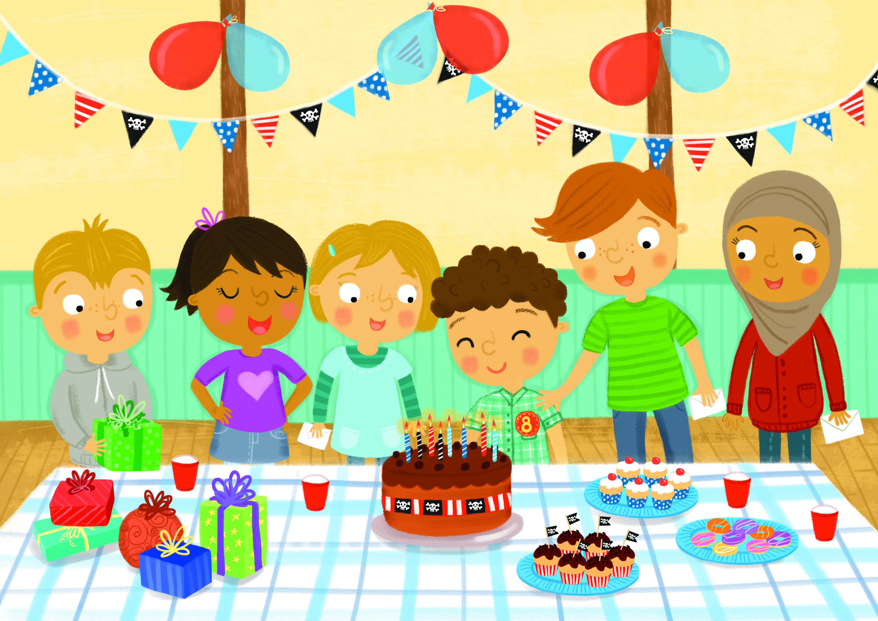
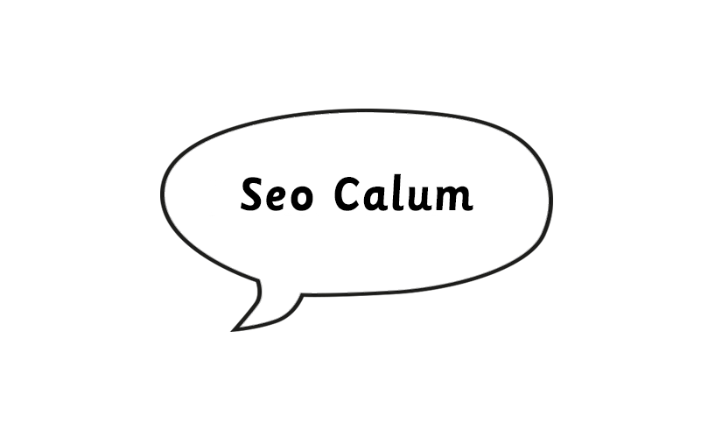
Notes:
Children to practise introducing a friend.
Teacher to ask ‘Dè an àireamh?’
Children to count objects in each picture or read the numerals.

Slide 12
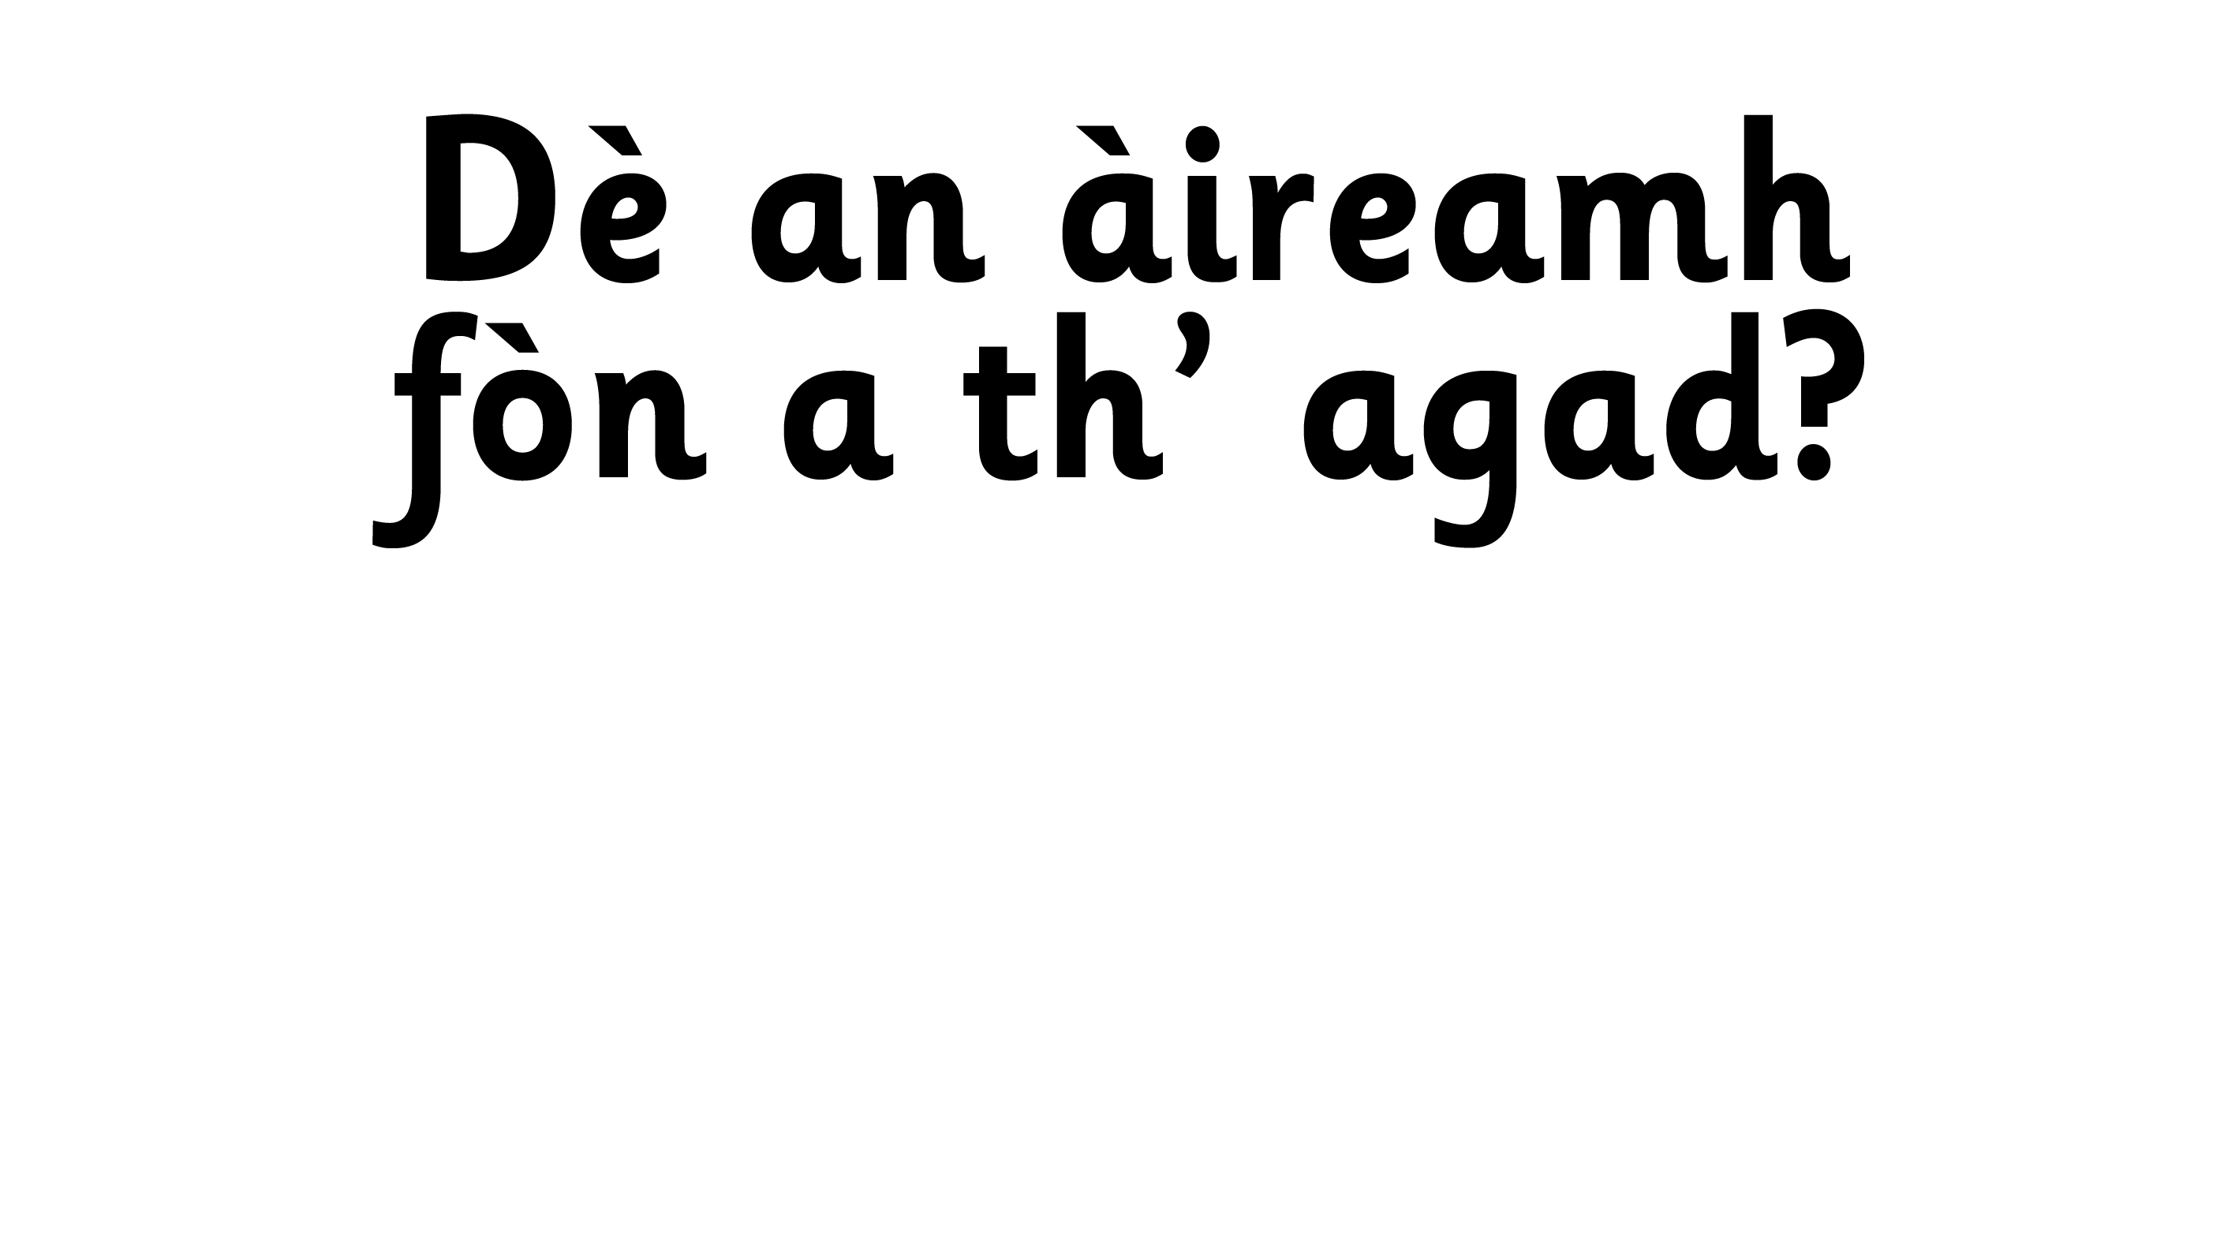
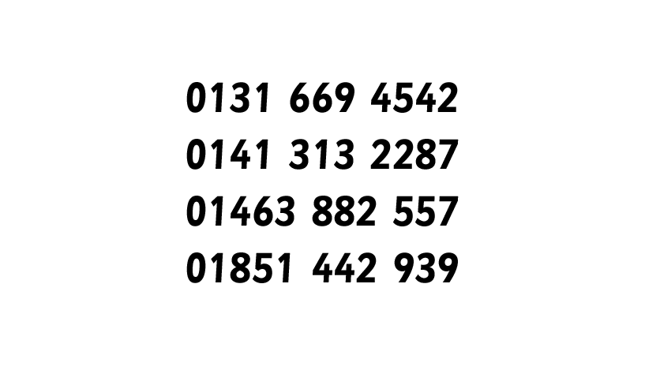
Notes:
Children will reply to the questions stating numbers only.

