Slide 1


Slide 2
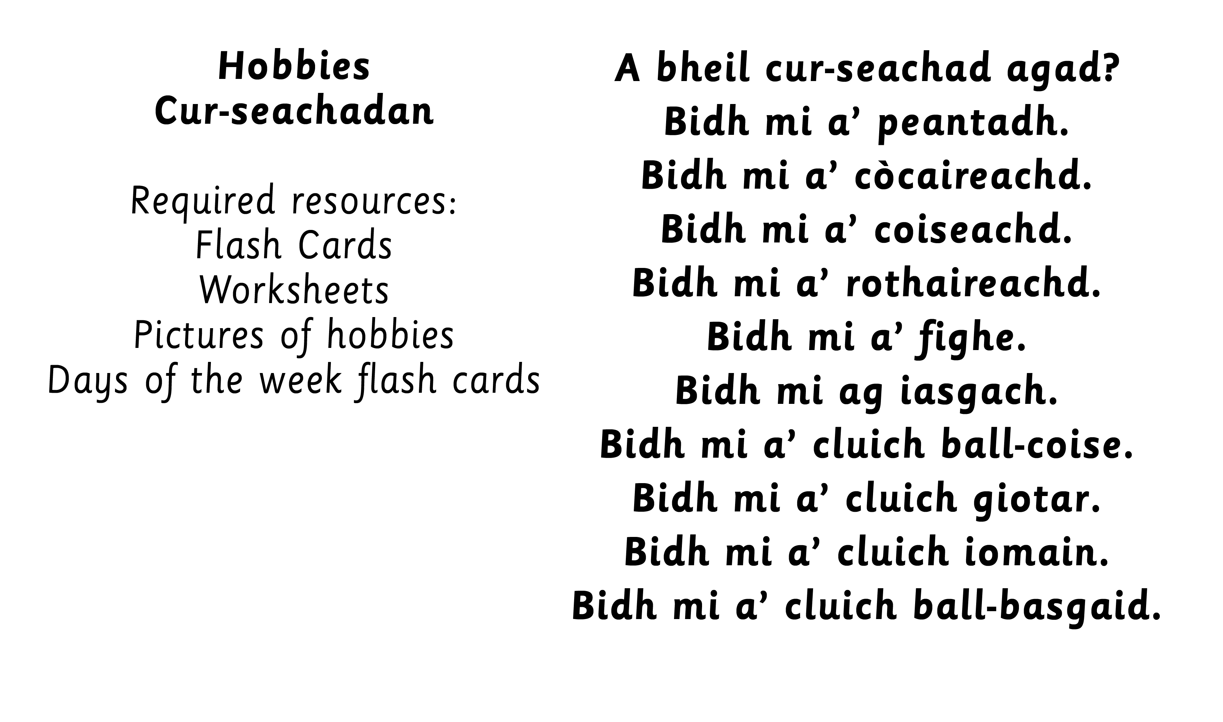

Slide 3

Notes:
Revision and use of tha/chan eil/A bheil?
Teach bha/ cha robh/ An robh?
Dè bha thu a’ dèanamh?

Slide 4
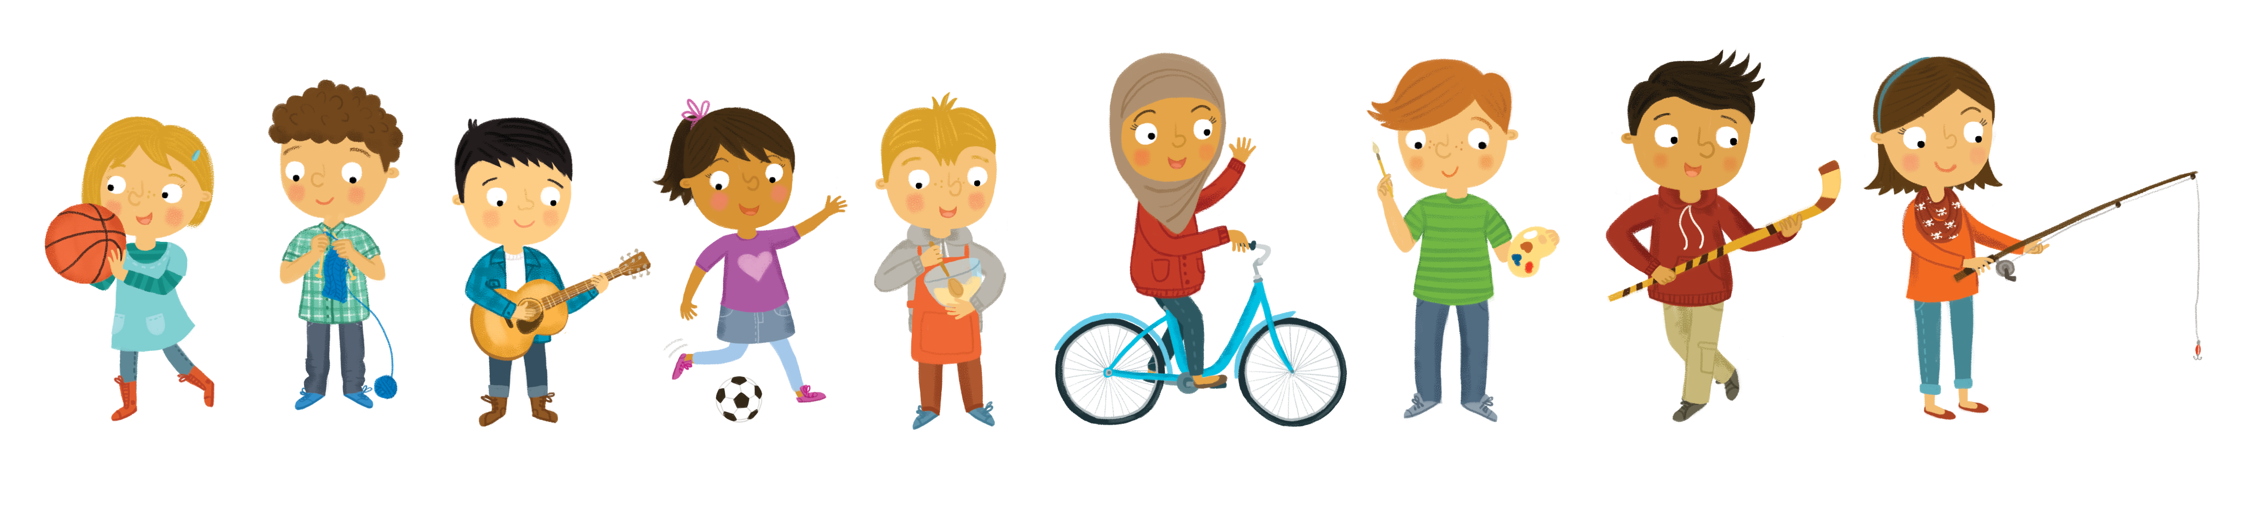
Notes:
could use with adjectives e.g. ubhal uaine, aran donn

Slide 5
Notes:
could use with adjectives e.g. ubhal uaine, aran donn

Slide 6
Notes:
could use with adjectives e.g. ubhal uaine, aran donn

Slide 7
Notes:
could use with adjectives e.g. ubhal uaine, aran donn

Slide 8
Notes:
could use with adjectives e.g. ubhal uaine, aran donn

Slide 9
Notes:
could use with adjectives e.g. ubhal uaine, aran donn

Slide 10
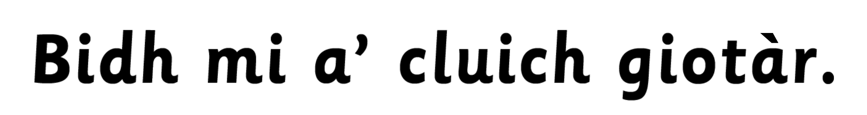
Notes:
could use with adjectives e.g. ubhal uaine, aran donn

Slide 11
Notes:
could use with adjectives e.g. ubhal uaine, aran donn

Slide 12
Notes:
Using the following games, introduce and practise using: Bidh/ Cha bhi/ Am bi?
Miming game – act out your hobby.
Game carousel idea – Days of the week displayed around the classroom. Children split into small groups to go to a day of the week. Teacher to hold up question card – “Dè bhios tu a’ dèanamh?” Children to tell a partner what they do on that day. All to move on to next day of the week.
Possibly introduce ‘Is toil leam a bhith…’

Slide 13
