Slide 1


Slide 2
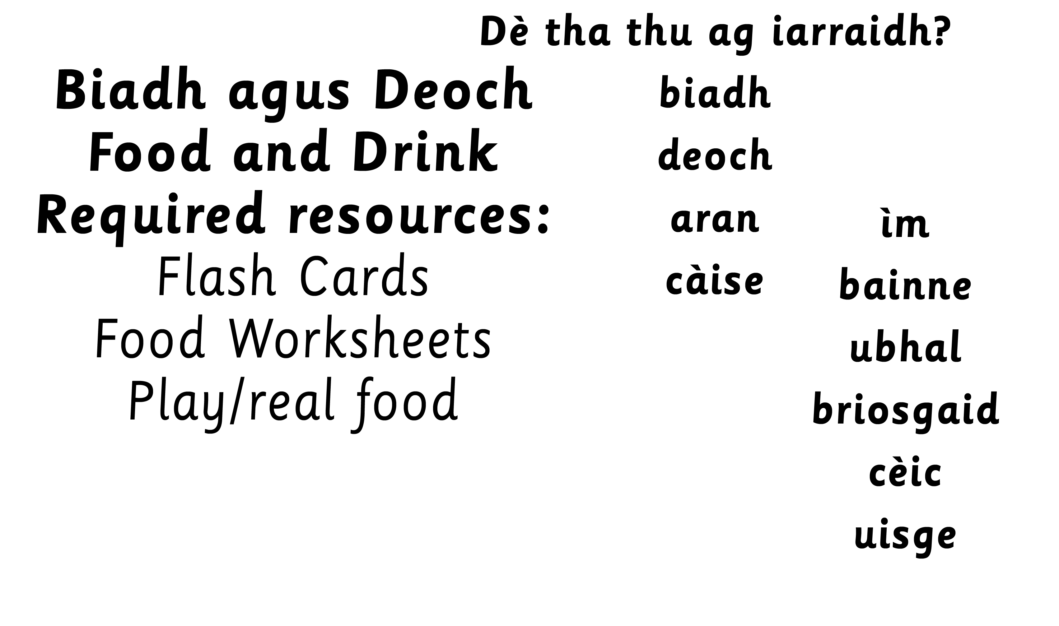

Slide 3

Notes:
Revision and use of tha/chan eil/A bheil?
Teach bha/ cha robh/ An robh?
Dè bha thu a’ dèanamh?

Slide 4
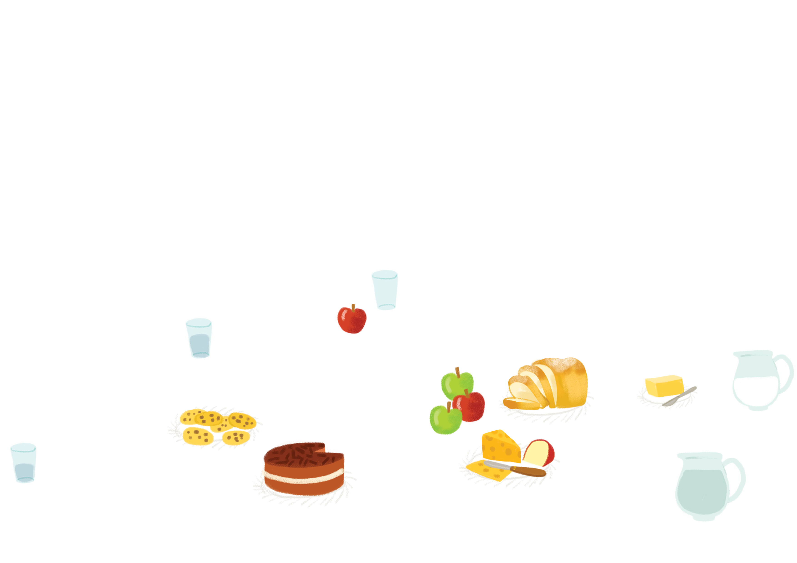
Notes:
could use with adjectives e.g. ubhal uaine, aran donn

Slide 5
Notes:
could use with adjectives e.g. ubhal uaine, aran donn

Slide 6
Notes:
could use with adjectives e.g. ubhal uaine, aran donn

Slide 7
Notes:
could use with adjectives e.g. ubhal uaine, aran donn

Slide 8
Notes:
could use with adjectives e.g. ubhal uaine, aran donn

Slide 9
Notes:
could use with adjectives e.g. ubhal uaine, aran donn

Slide 10
Notes:
could use with adjectives e.g. ubhal uaine, aran donn

Slide 11
Notes:
could use with adjectives e.g. ubhal uaine, aran donn

Slide 12
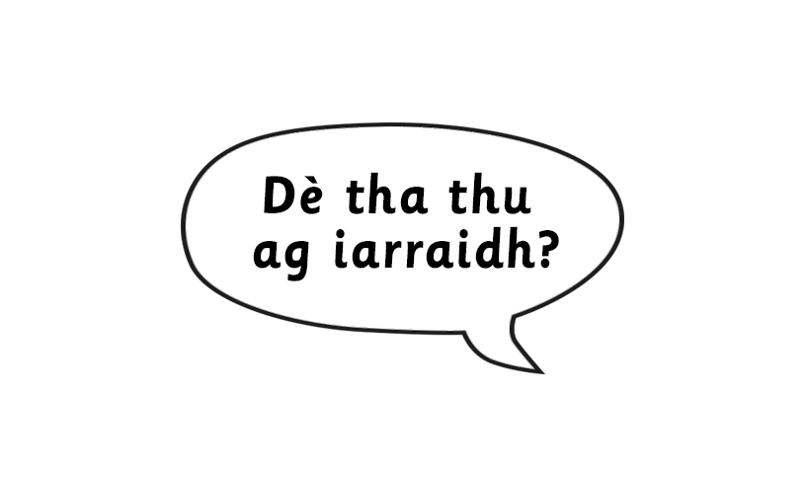
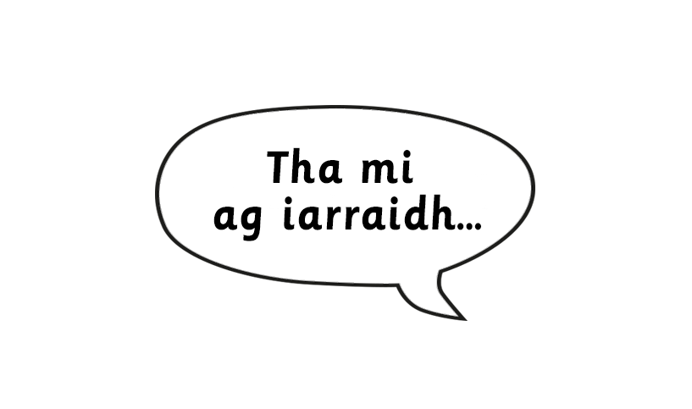
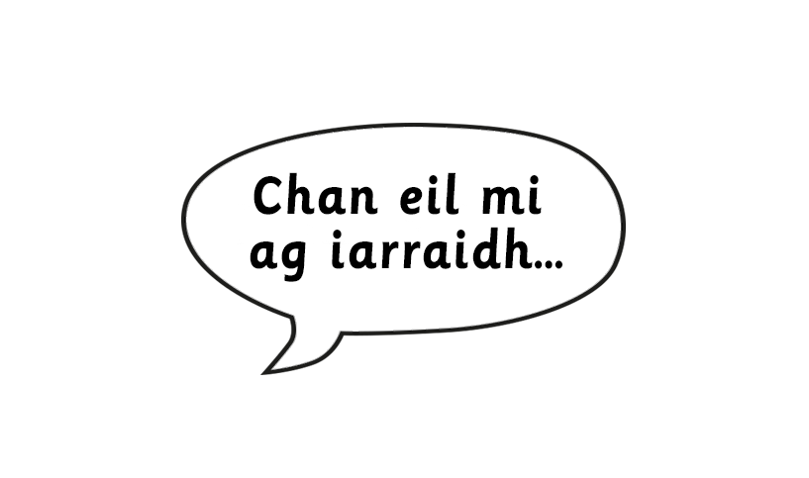
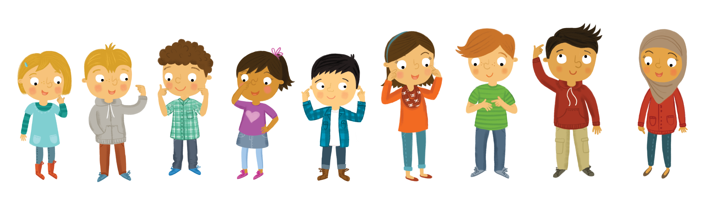
Notes:
Teacher to hold up the flash card/ picture for children to say what they want/don’t want.

Slide 13
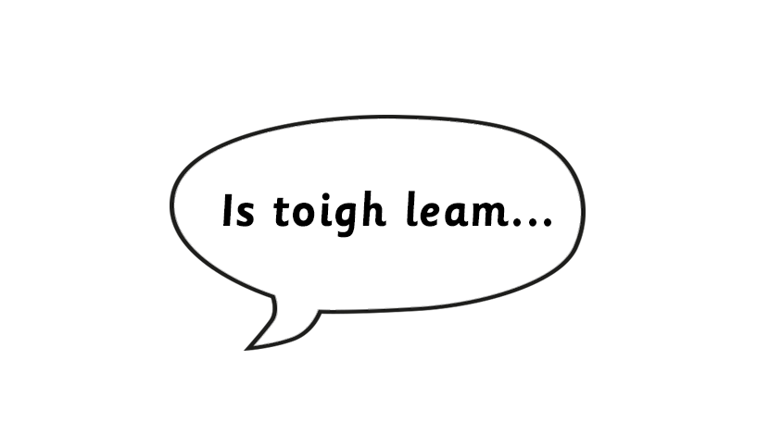
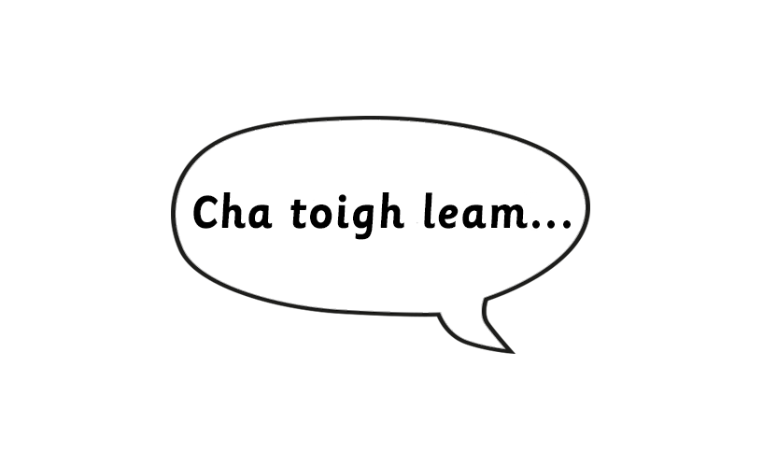
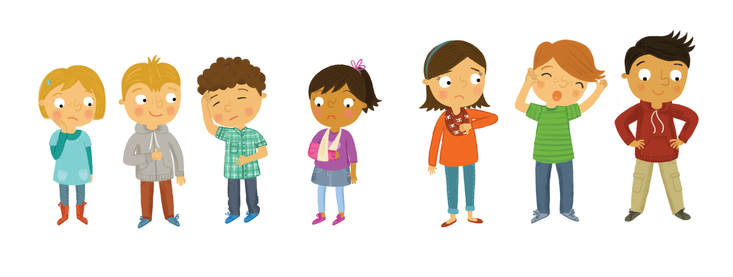
Notes:
Teach these sentences.
Teacher to hold up the flash card/picture for children to say what they like/don’t like.
Sort food onto plates of things children like and don’t like.
Also practise using ag ithe/ag òl

Slide 14
