Slide 1


Slide 2
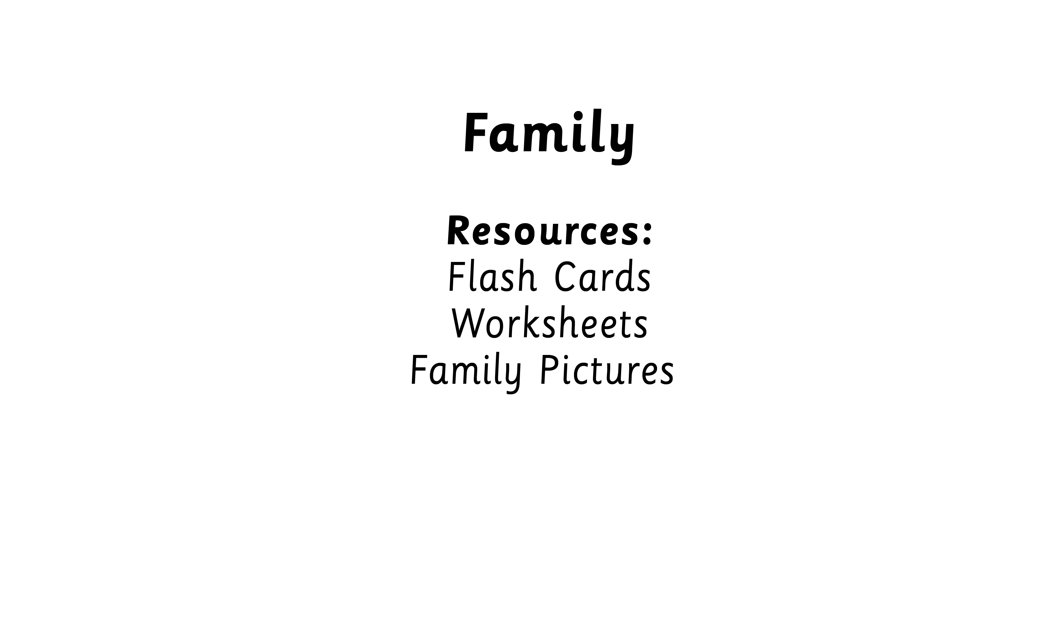

Slide 3



Slide 4


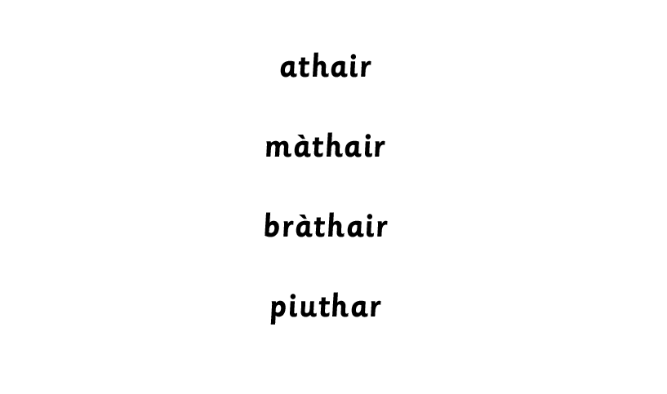
Notes:
Opportunity to discuss and use i/e/iad

Slide 5

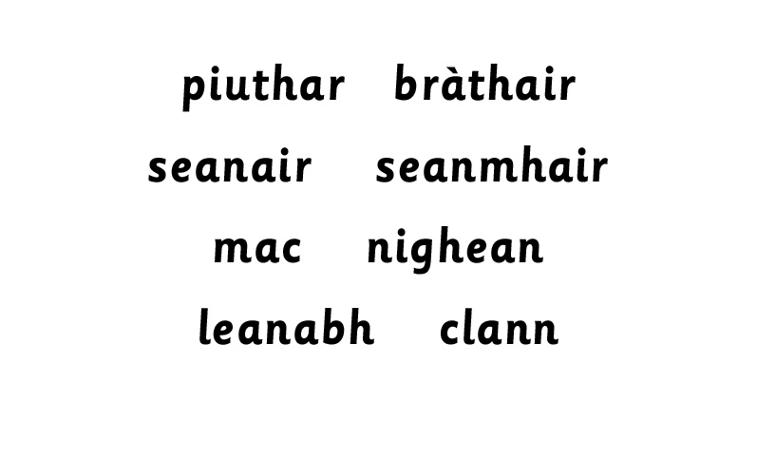

Slide 7




Slide 8
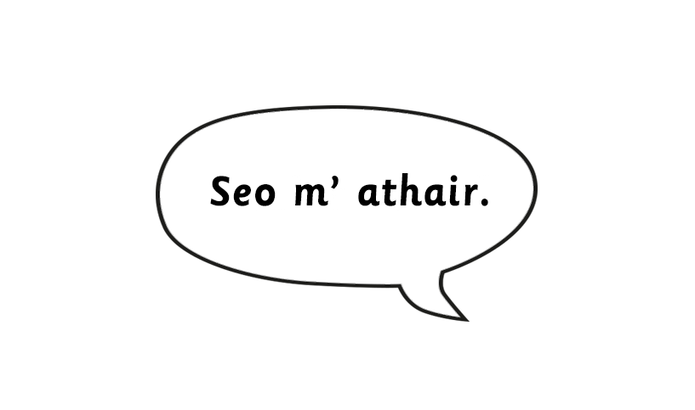

Notes:
Opportunity to discuss and use i/e/iad
Opportunity to use and discuss:
mòr/ mhòr
beag/ bheag

Slide 9

Notes:
Opportunity to discuss and use i/e/iad
Opportunity to use and discuss:
mòr/ mhòr
beag/ bheag

Slide 10



Slide 12

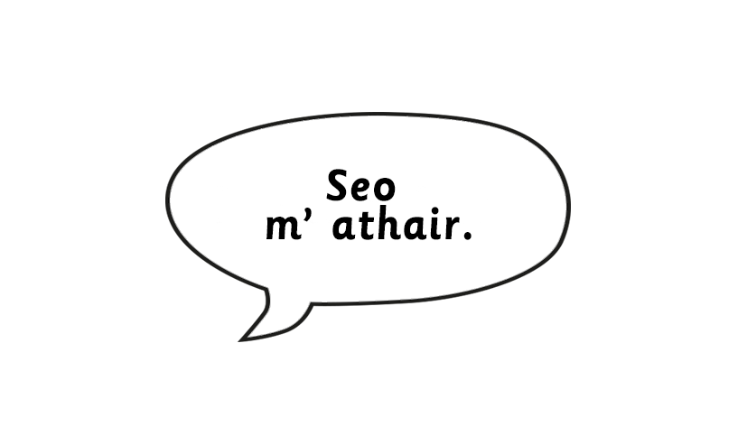

Slide 13
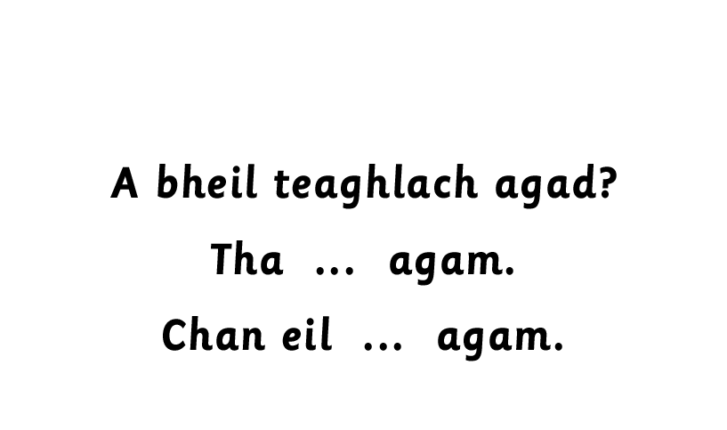

Slide 14

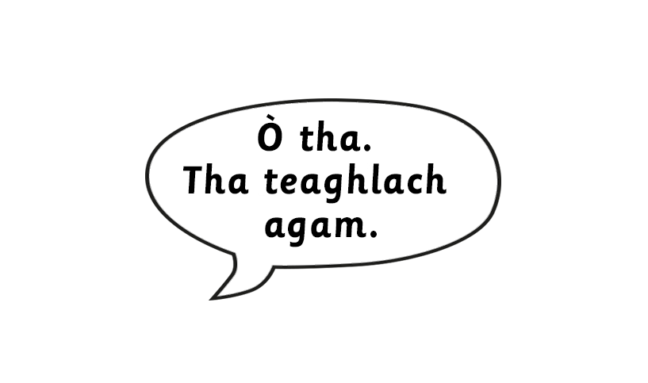

Slide 15

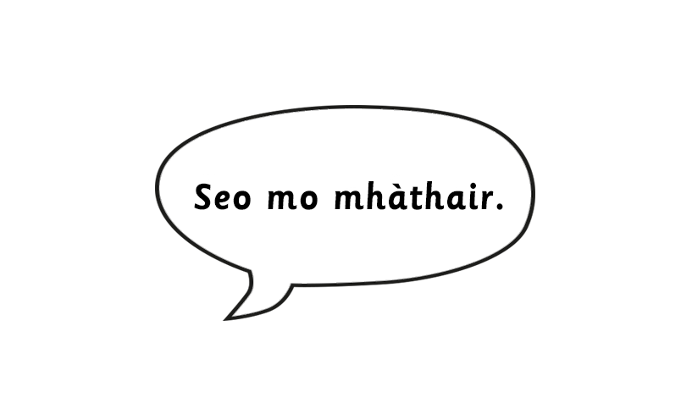
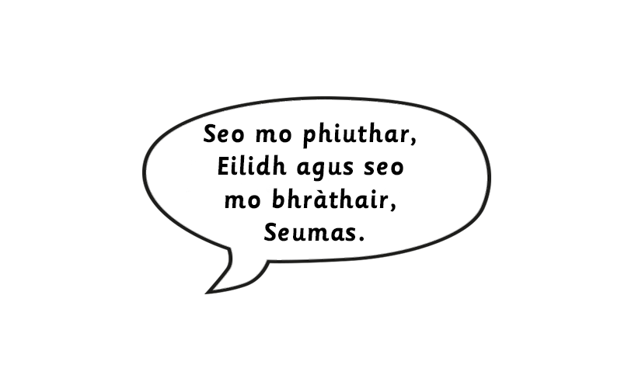
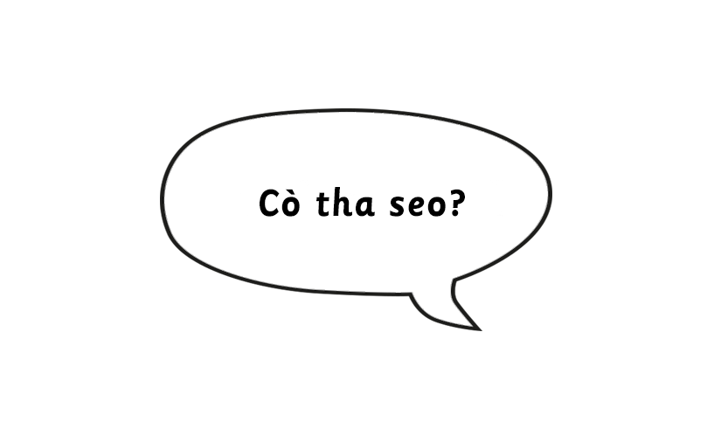

Slide 16



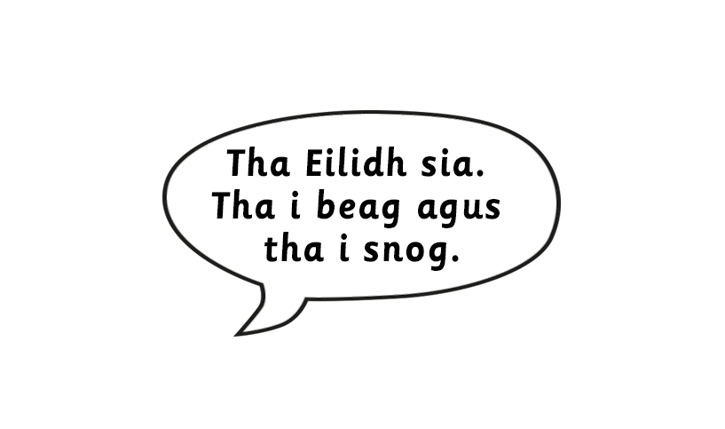
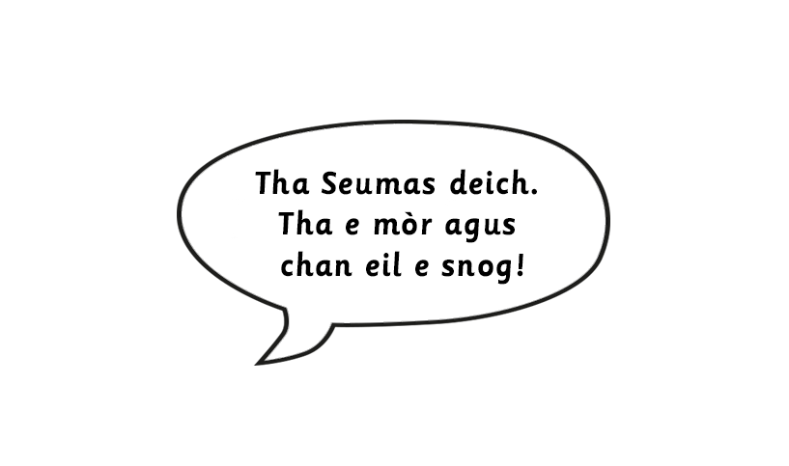

Slide 17

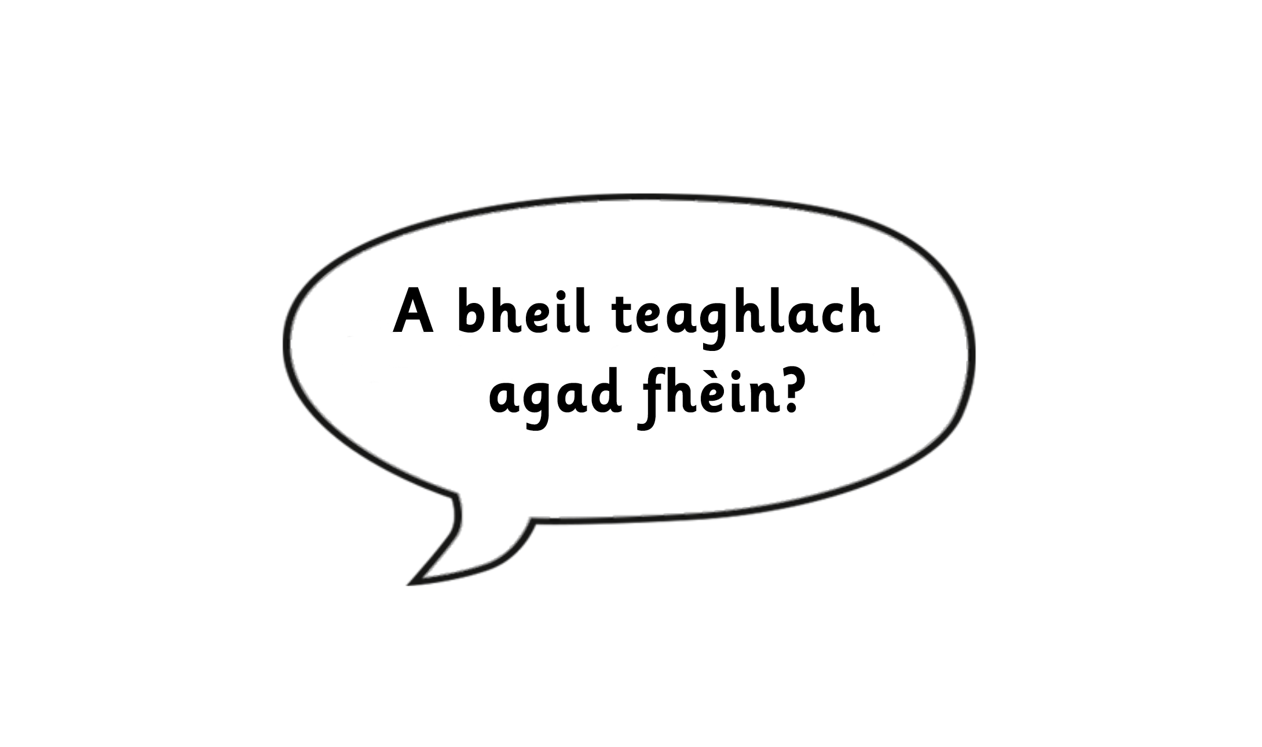

Slide 18
