Slide 1


Slide 2
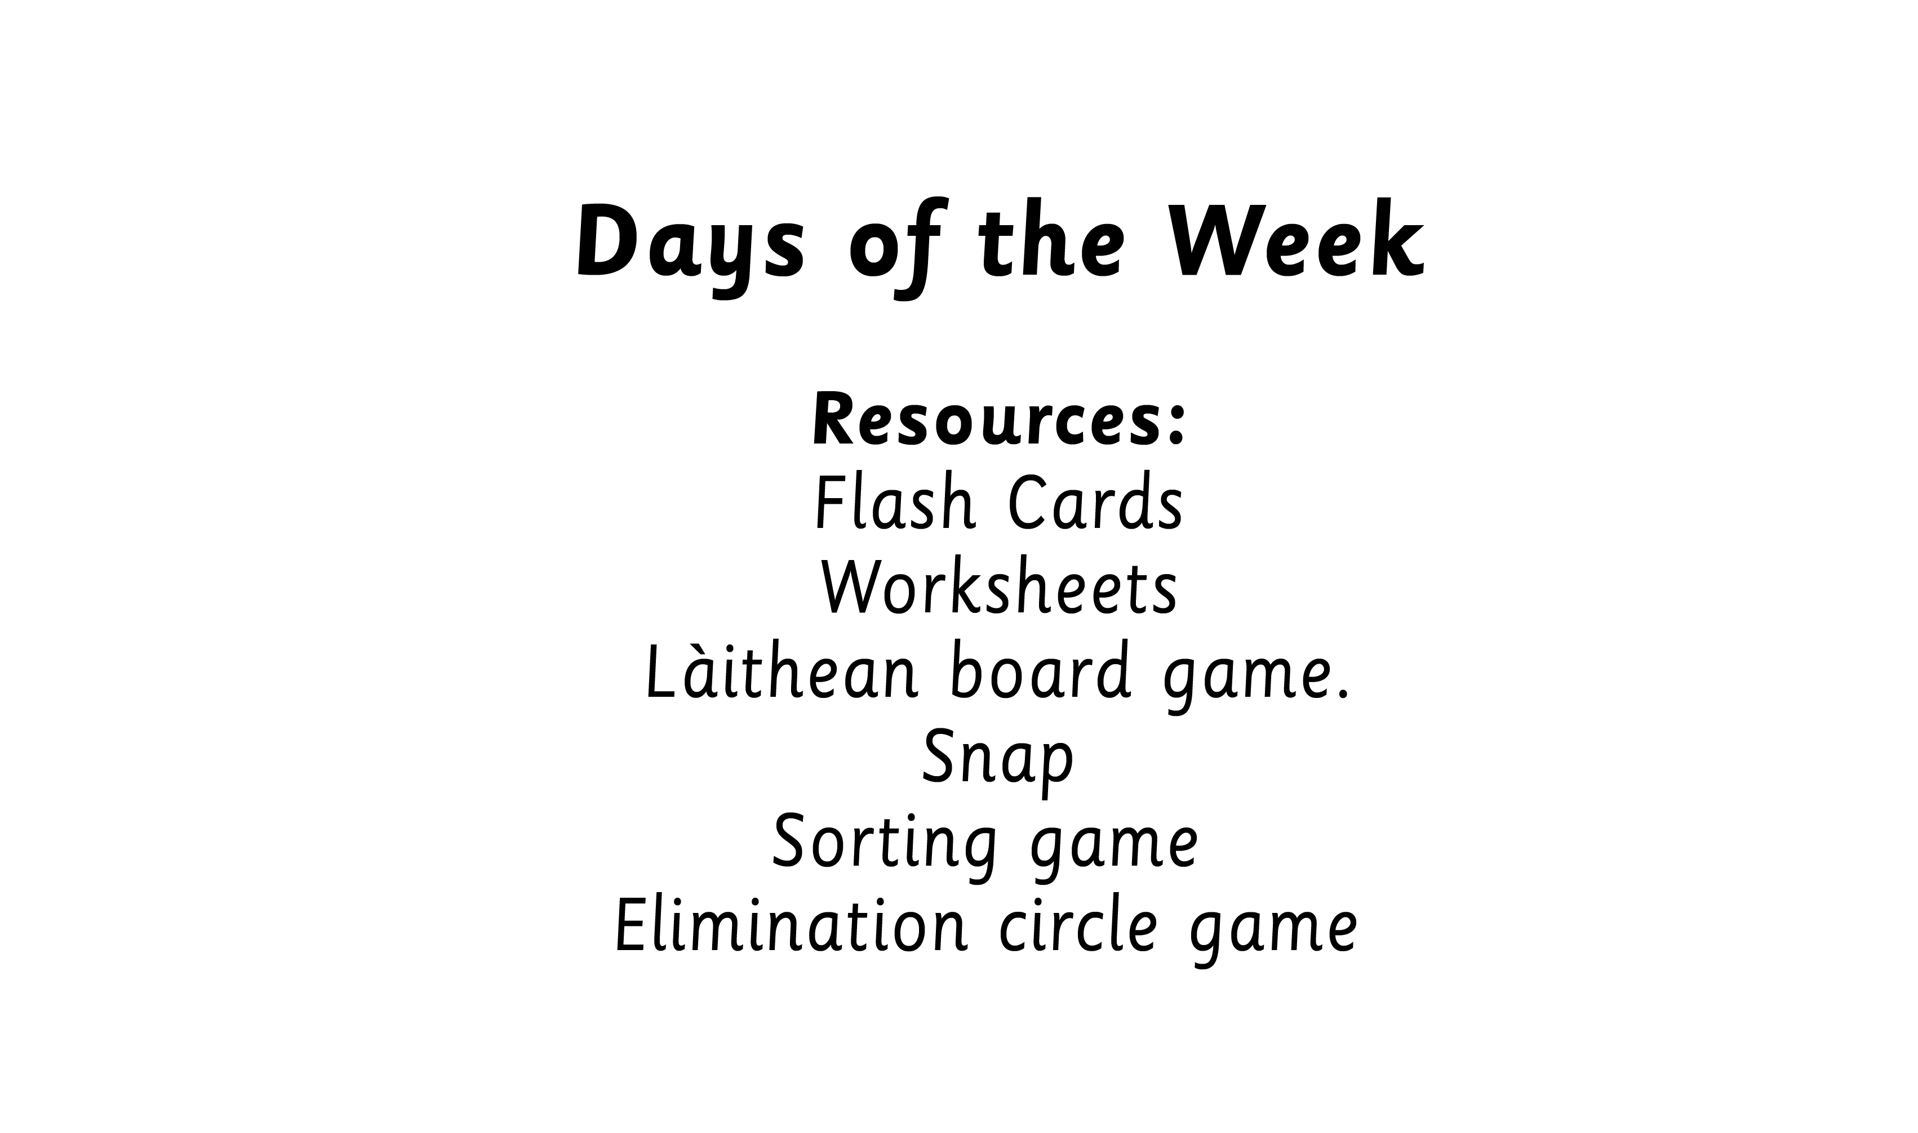
Notes:
Display Days of the Week
Sorting Game - sort cards into the order of the days of the week.
Elimination game - Children are allowed to say 1 or 2 days of the week, working around the circle, the child who has to say Didòmhnaich has to sit down.

Slide 3



Slide 4
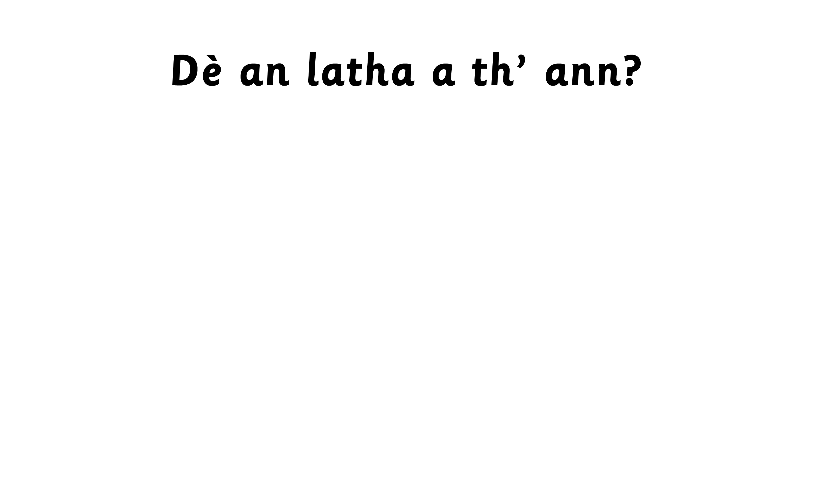
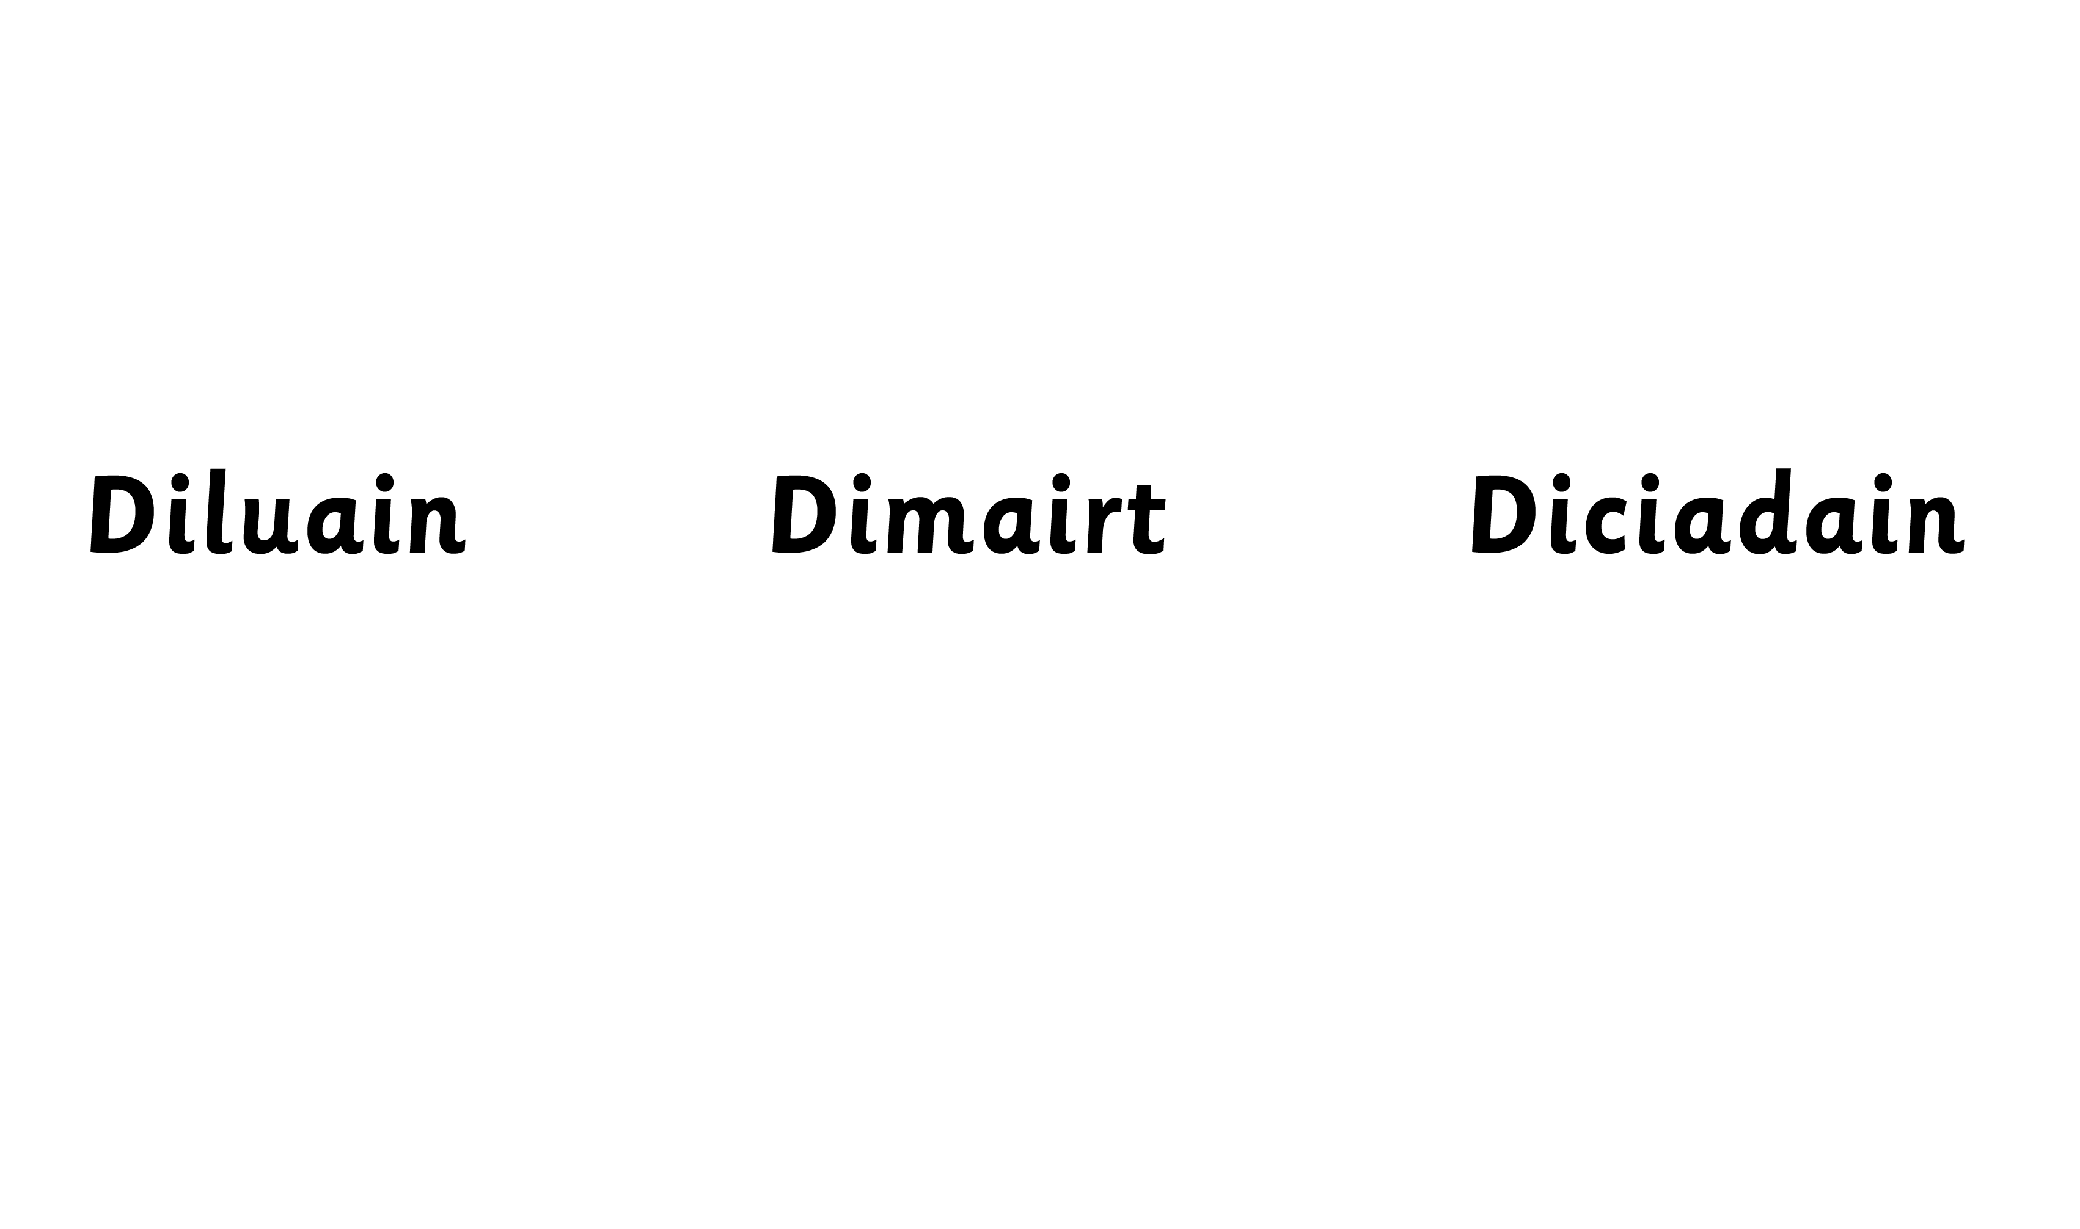


Slide 5
