Slide 1


Slide 2
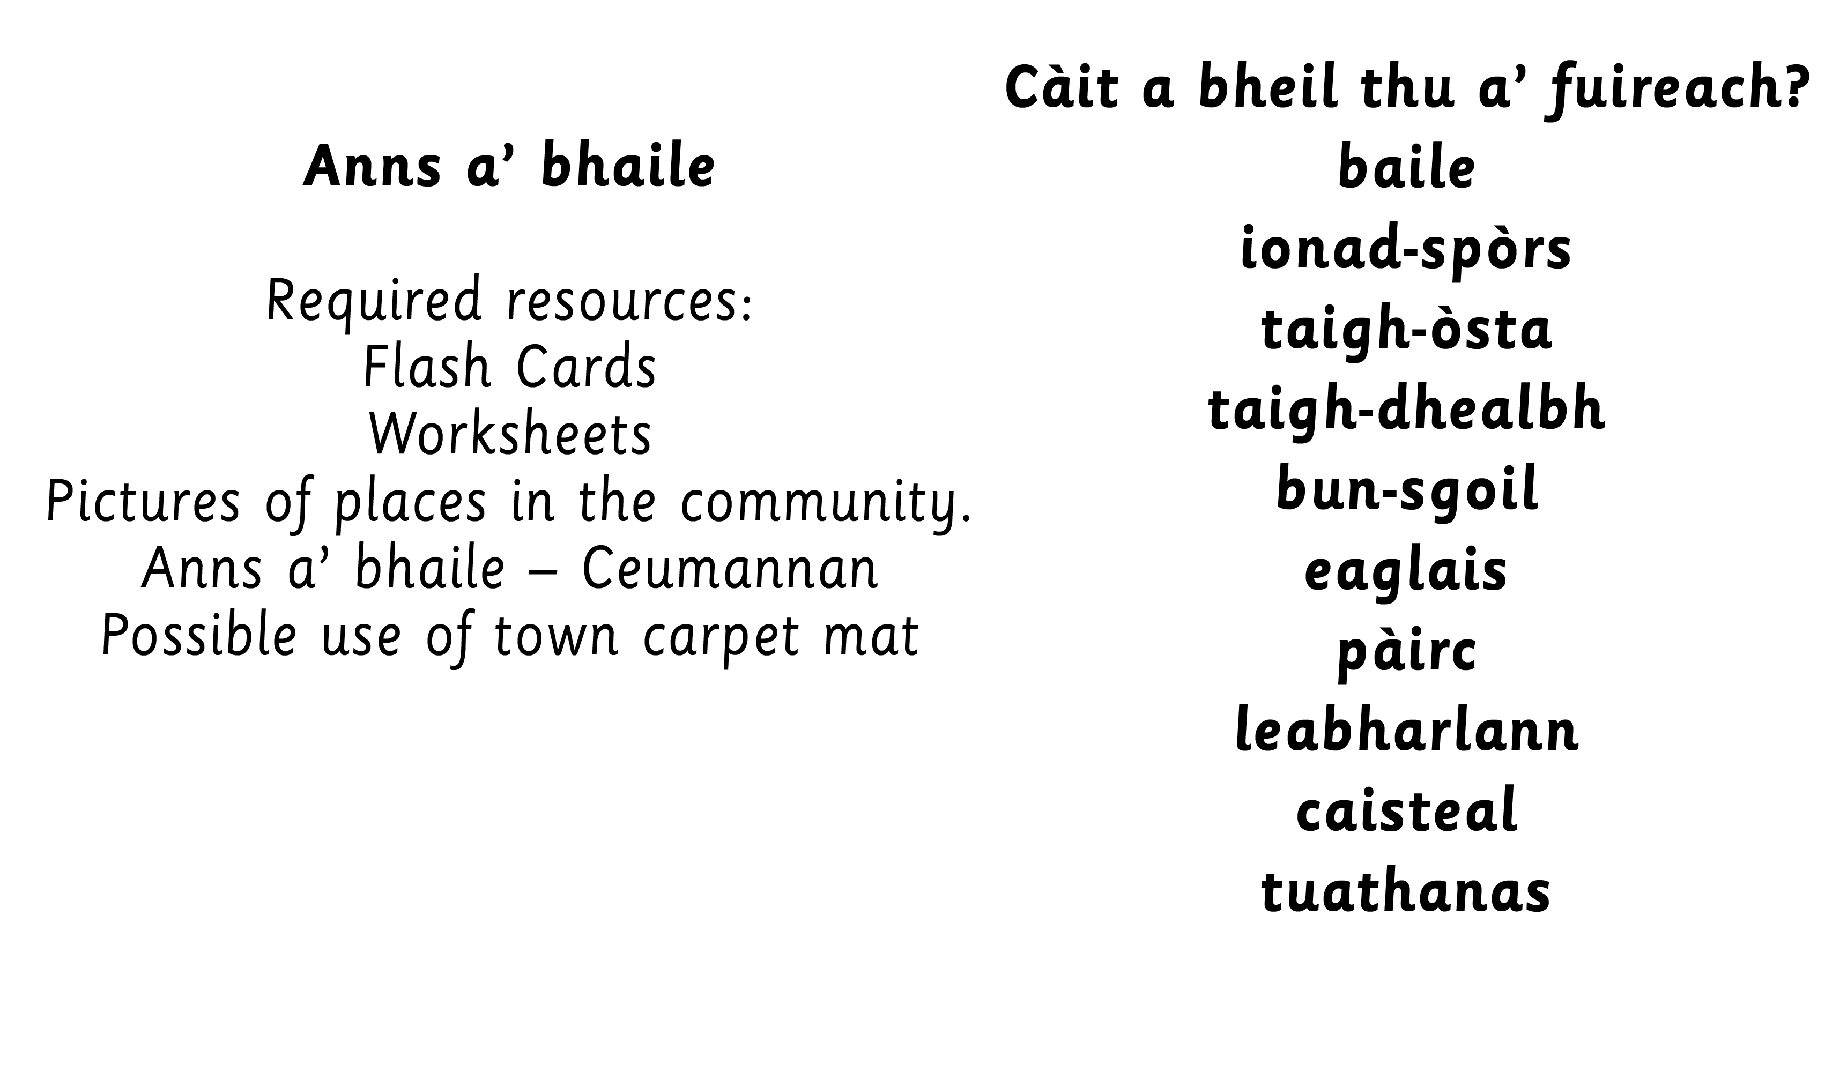

Slide 4


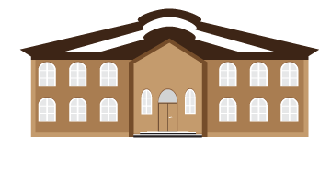
Notes:
Could revisit classroom items and subjects.

Slide 5

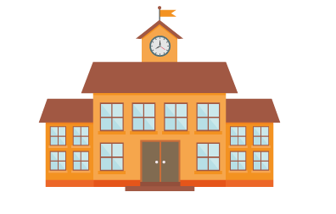
Notes:
Could revisit classroom items and subjects.

Slide 6
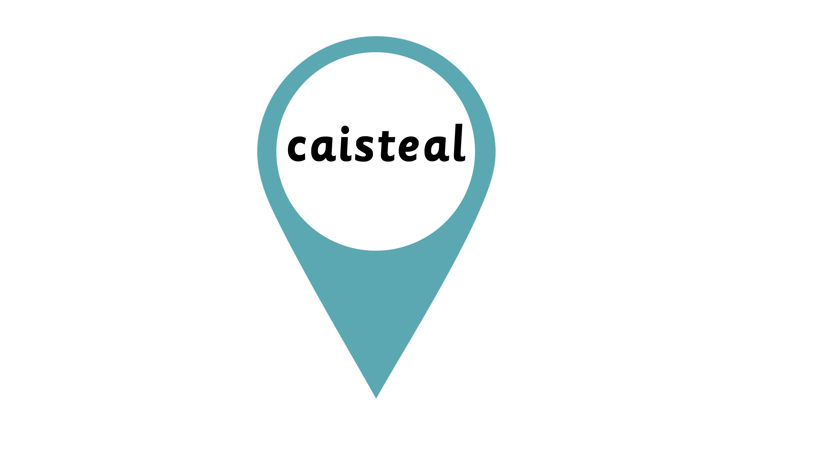
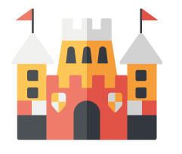
Notes:
Children could use a map to discuss the different places in the town. Children can draw their own map with what is in their local area.
Could play bingo with names of places.
Children could build their own town and label it.

Slide 7

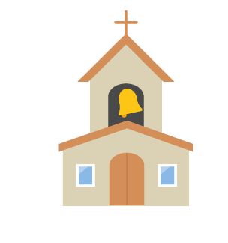
Notes:
Children could use a map to discuss the different places in the town. Children can draw their own map with what is in their local area.
Could play bingo with names of places.
Children could build their own town and label it.

Slide 8

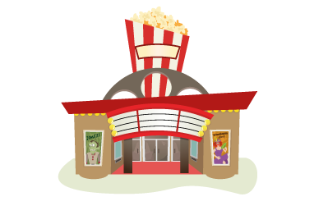
Notes:
Possibility for revising food and drink – e.g. role play restaurant with waiter and customer in hotel/ cinema shop etc.

Slide 9

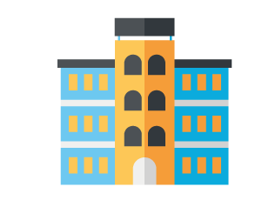
Notes:
Possibility for revising food and drink – e.g. role play restaurant with waiter and customer in hotel/ cinema shop etc.

Slide 10

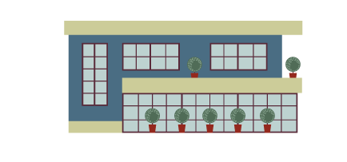
Notes:
Discuss activities that can take place in the sports centre/park. Revision of hobbies.

Slide 11

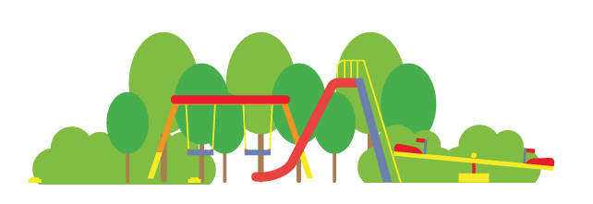
Notes:
Discuss activities that can take place in the sports centre/park. Revision of hobbies.

Slide 12

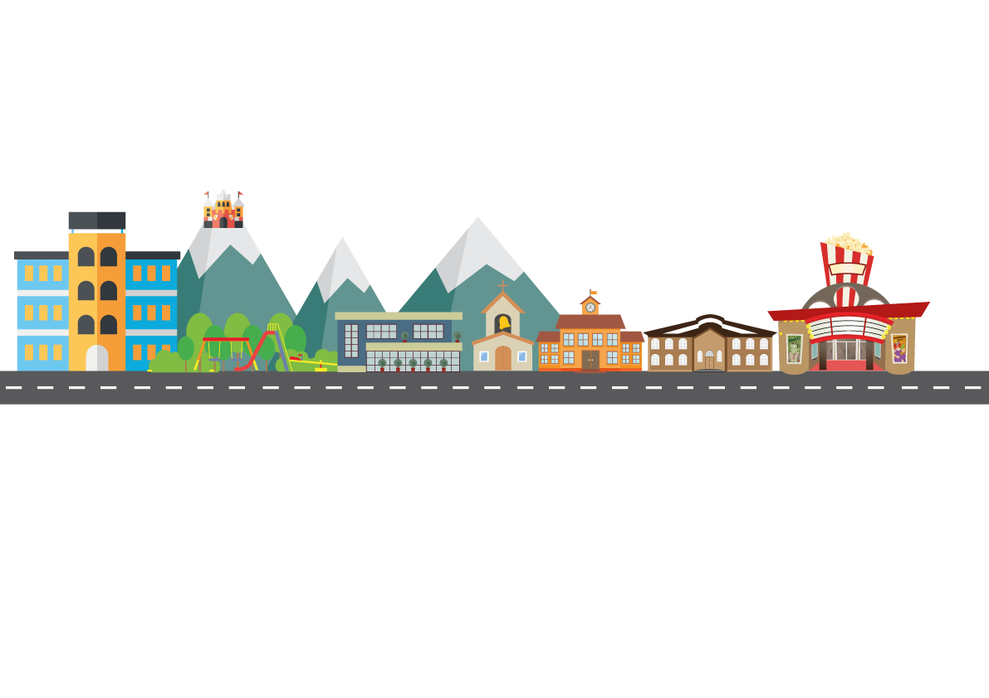
Notes:
Discuss activities that can take place in the sports centre/park. Revision of hobbies.

Slide 13


Slide 14
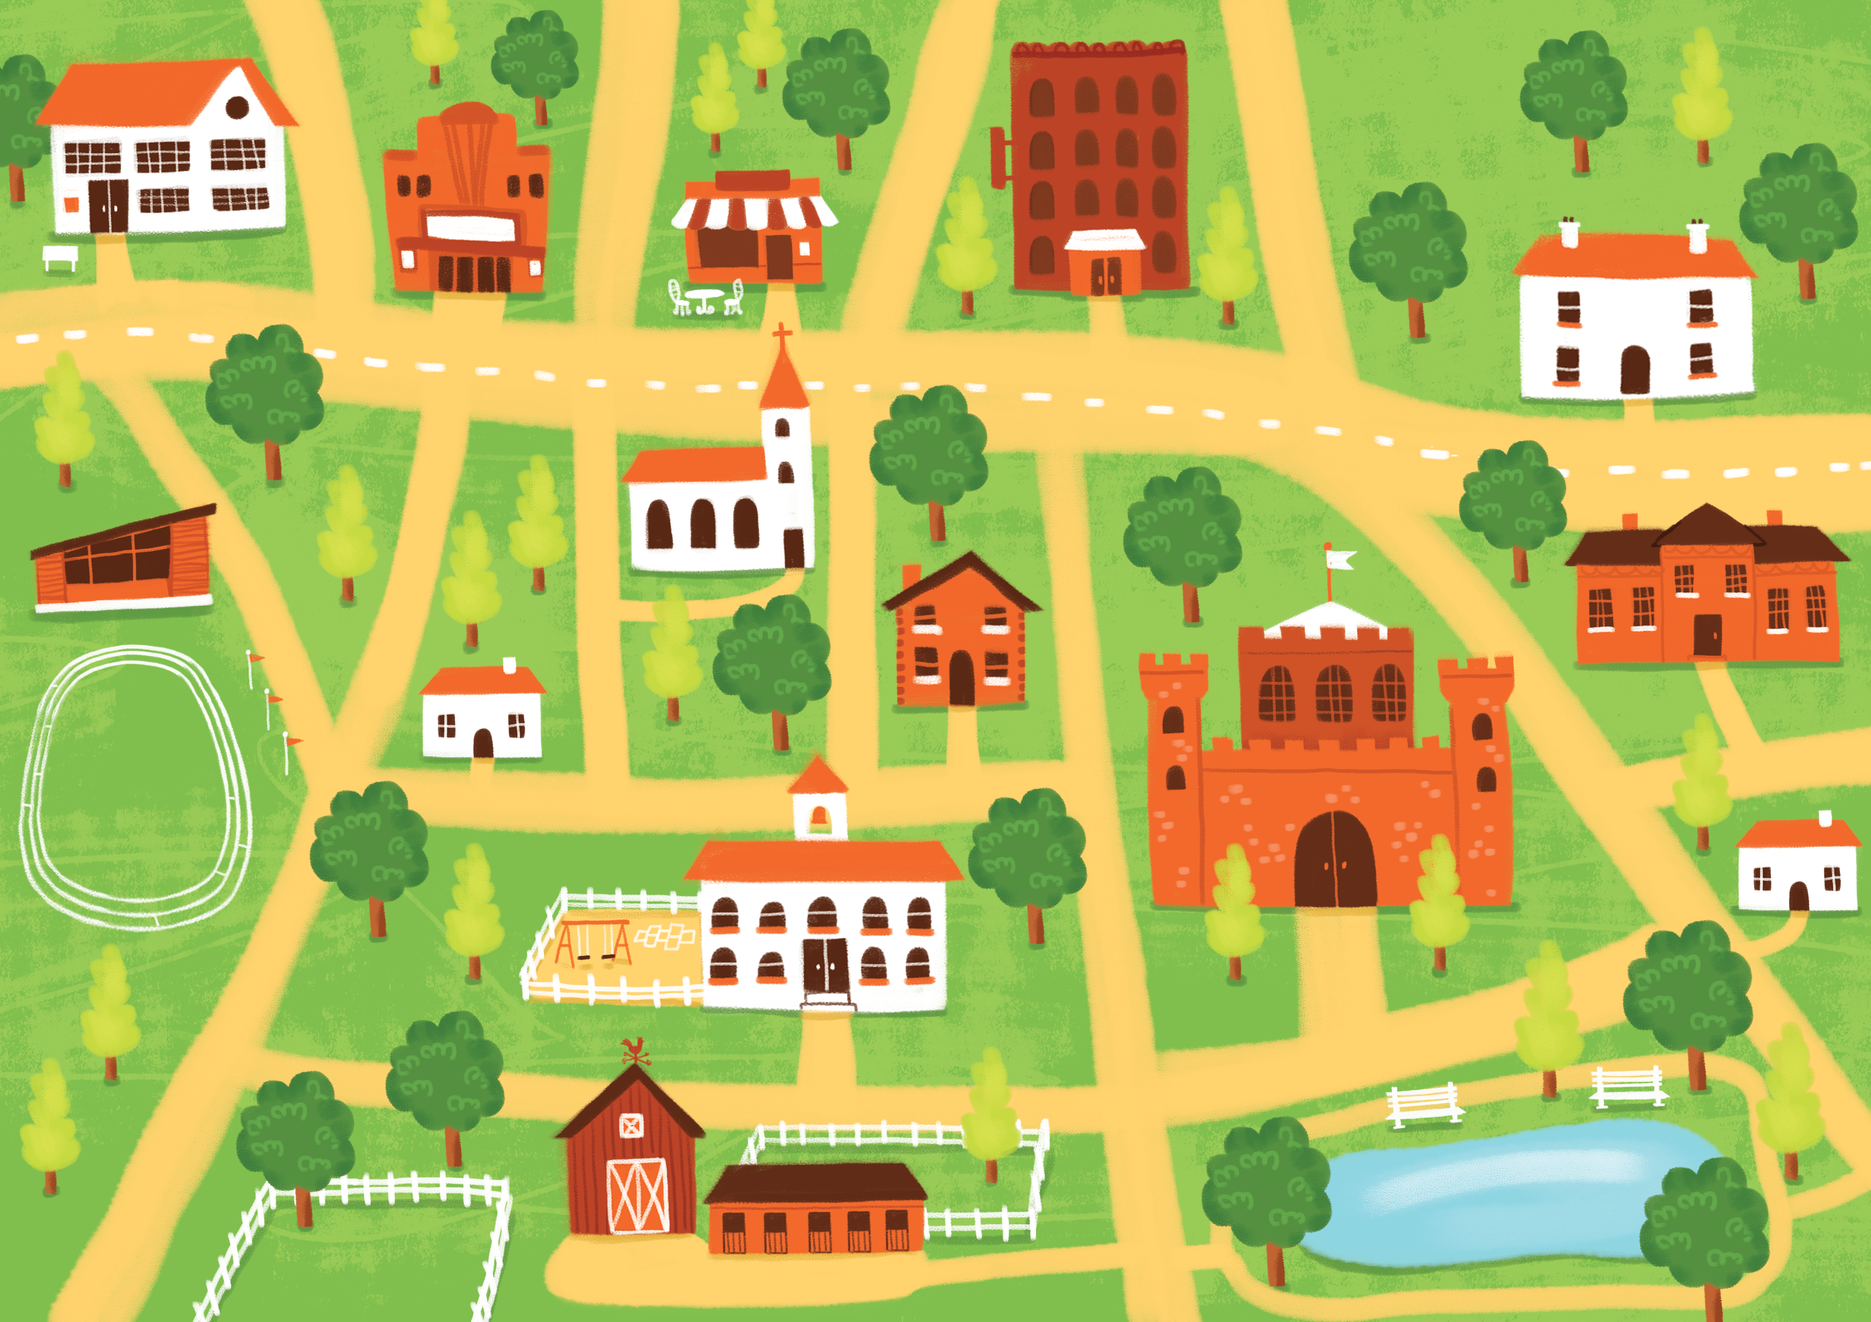

Slide 15
