Slide 1


Slide 2
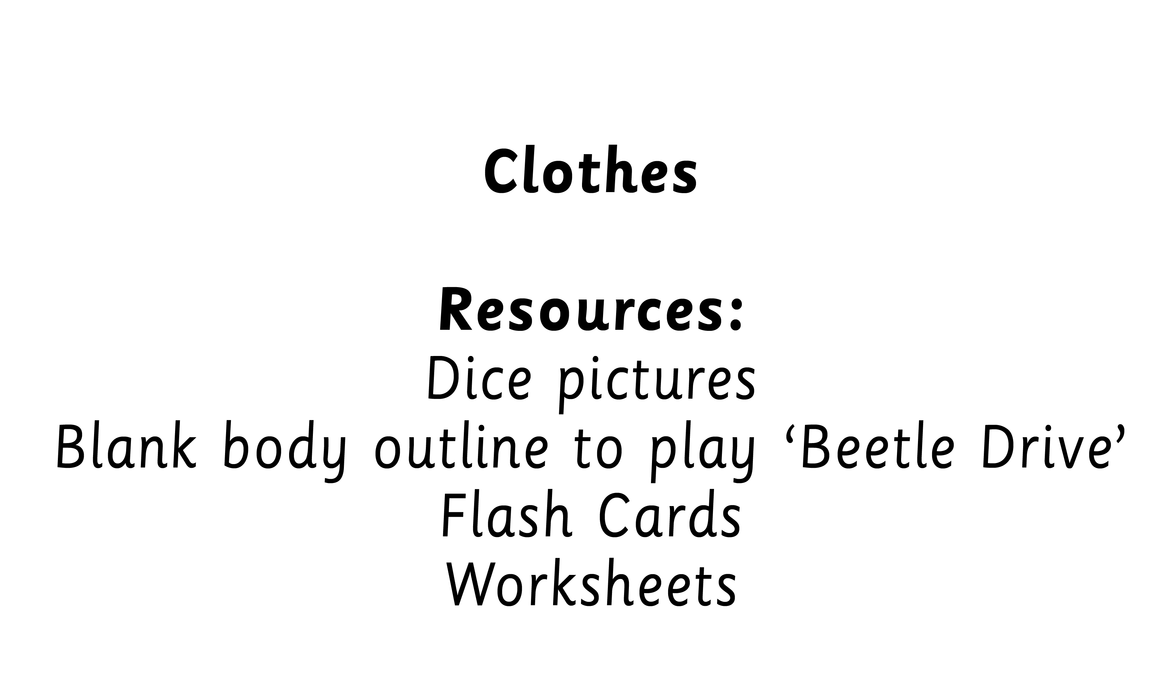

Slide 3
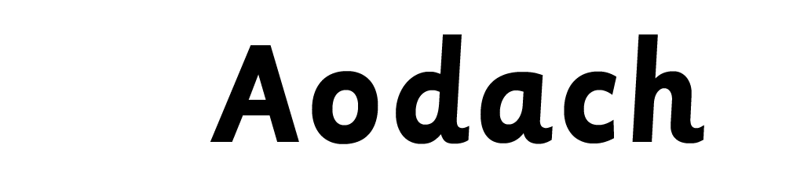


Slide 4
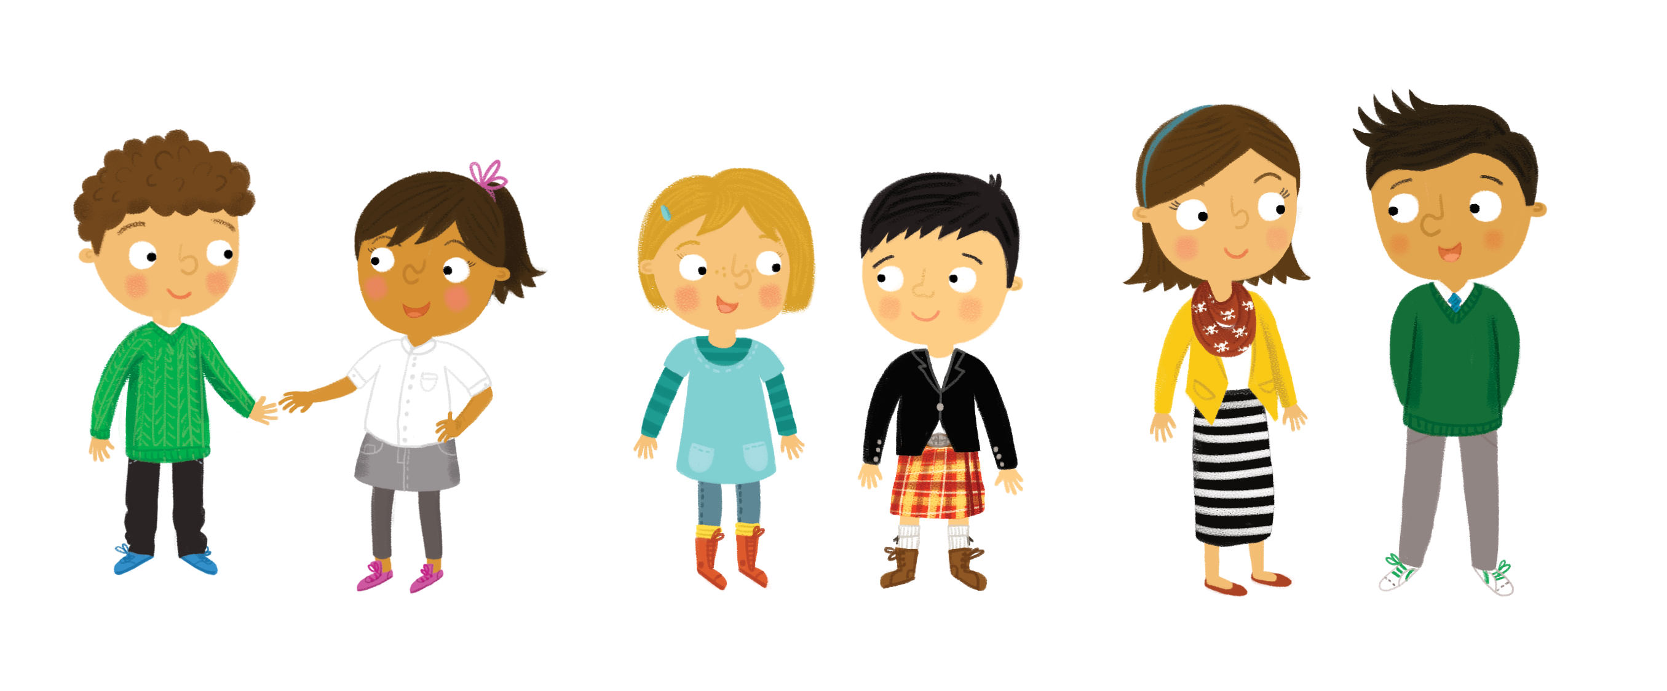
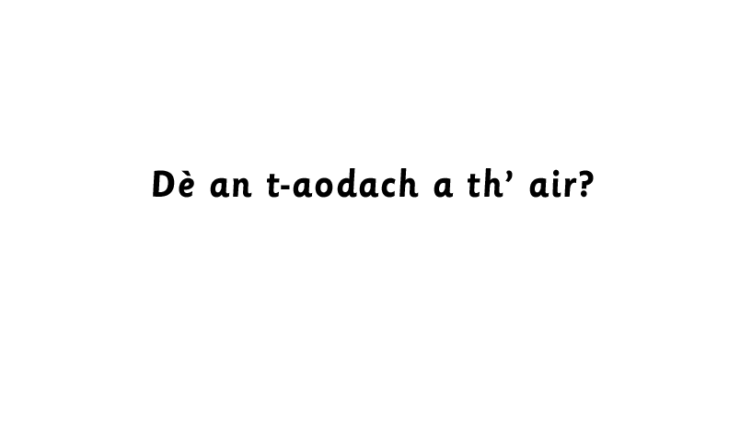
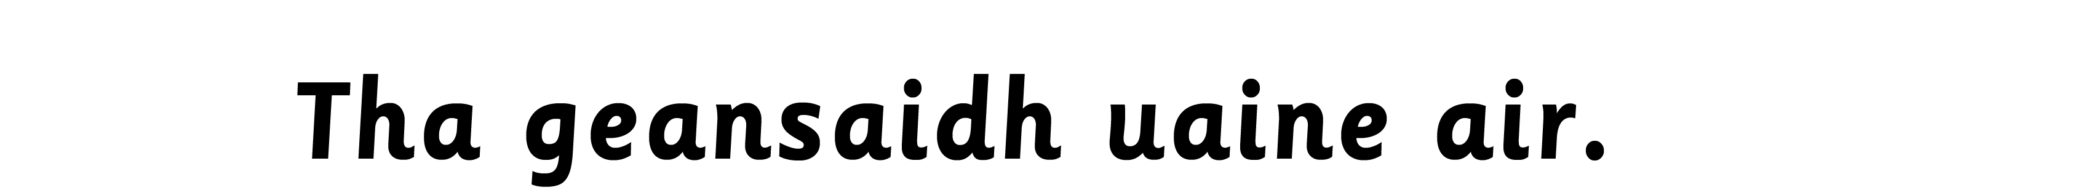
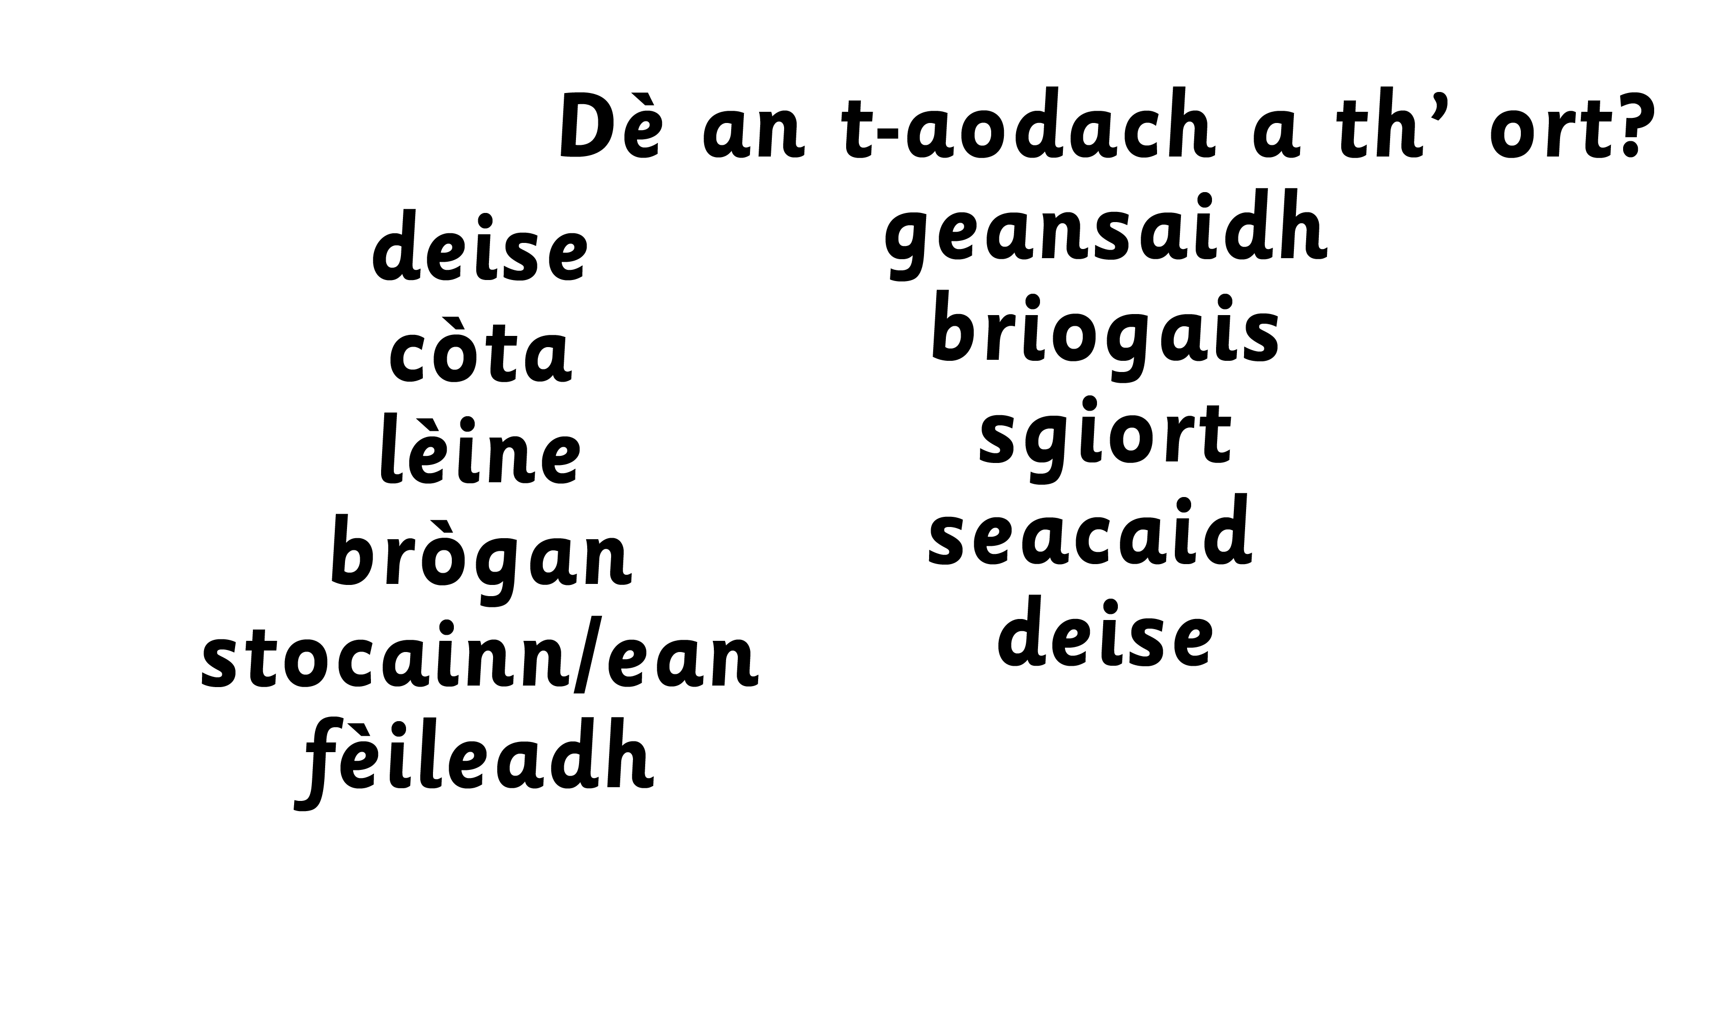
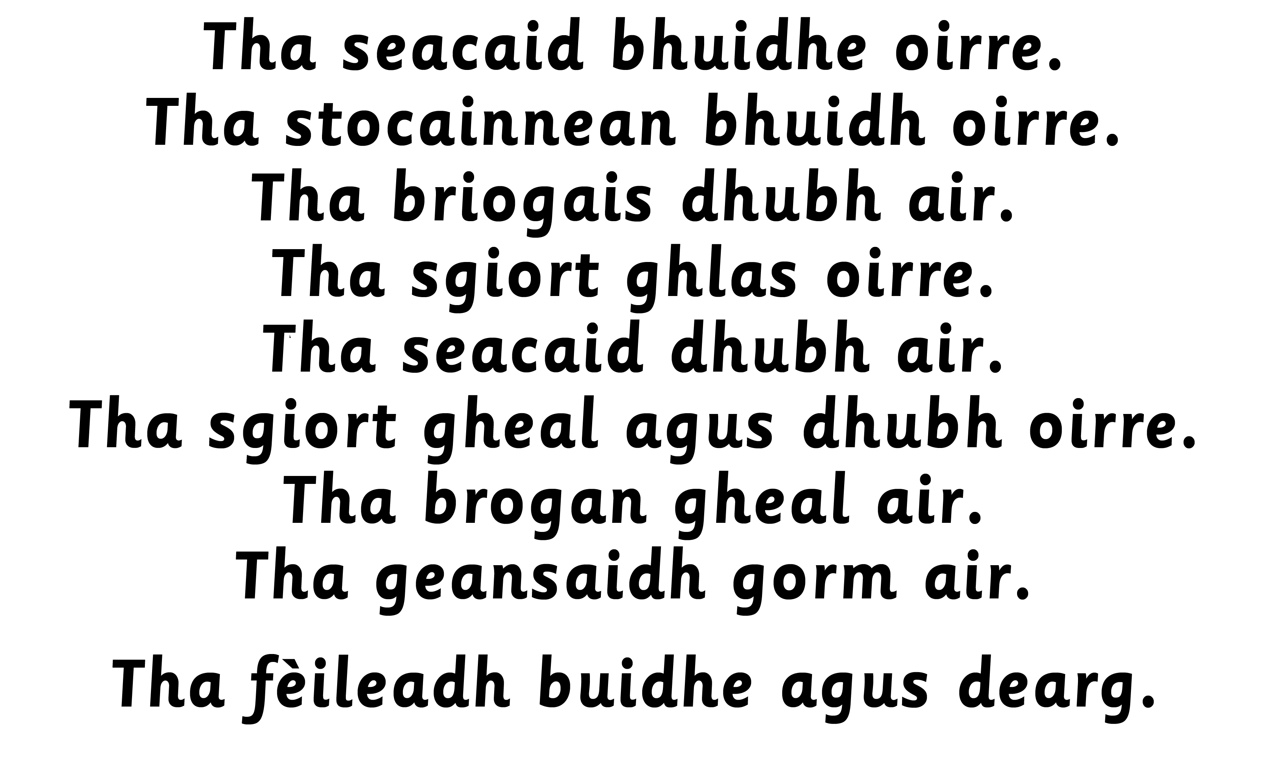
Notes:
Teacher to highlight use of ‘air’ for ‘he is wearing…’

Slide 5



Notes:
Teacher to highlight the use of ‘oirre’ for ‘she is wearing…’

Slide 6
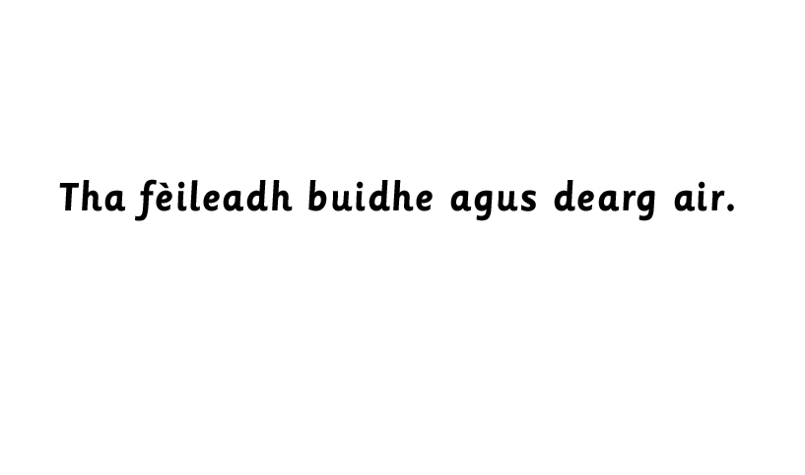

Slide 7

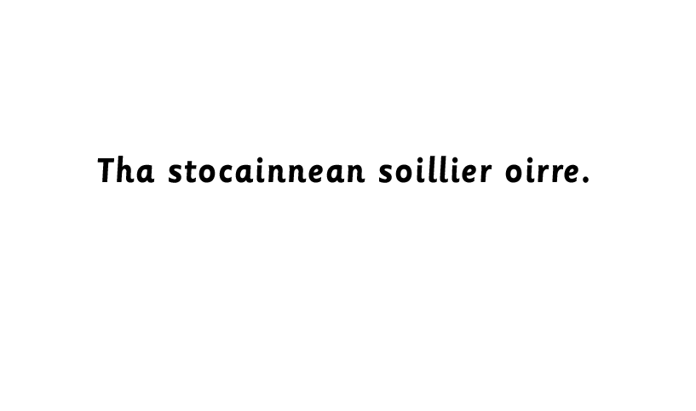

Slide 8
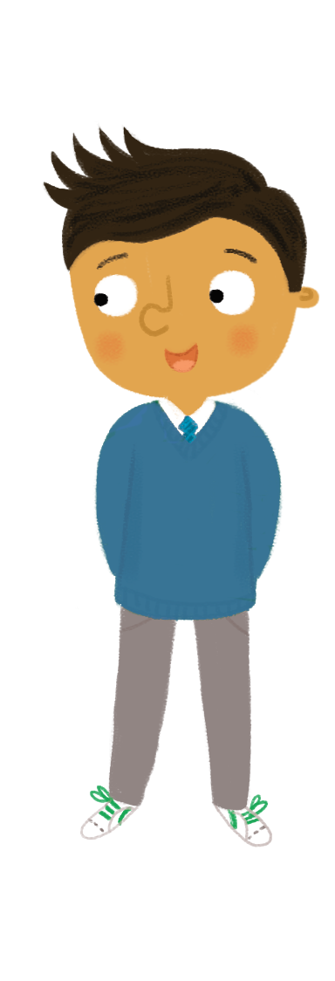


Slide 9
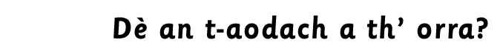
Notes:
Children to try to name the clothing.
Game – beetle drive – first to dress the character is the winner. Children to practise numbers when rolling the dice and say the sentence for each item of clothing, e.g. roll a 1: Tha briogais orm. (Draw trousers on the person)

Slide 10
