Slide 1


Slide 2
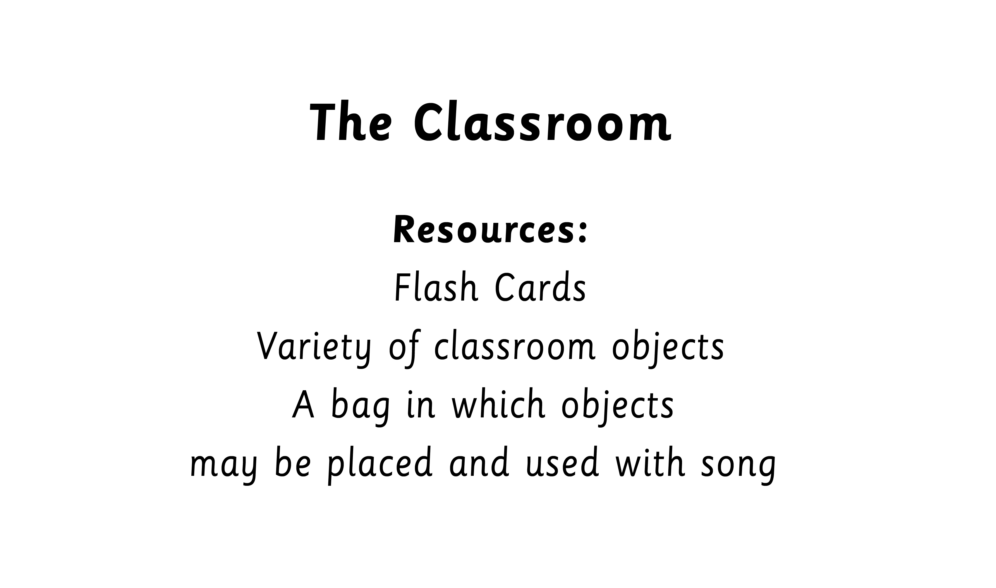

Slide 3
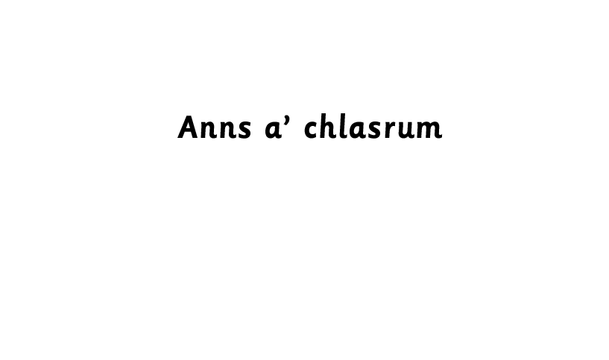


Slide 4

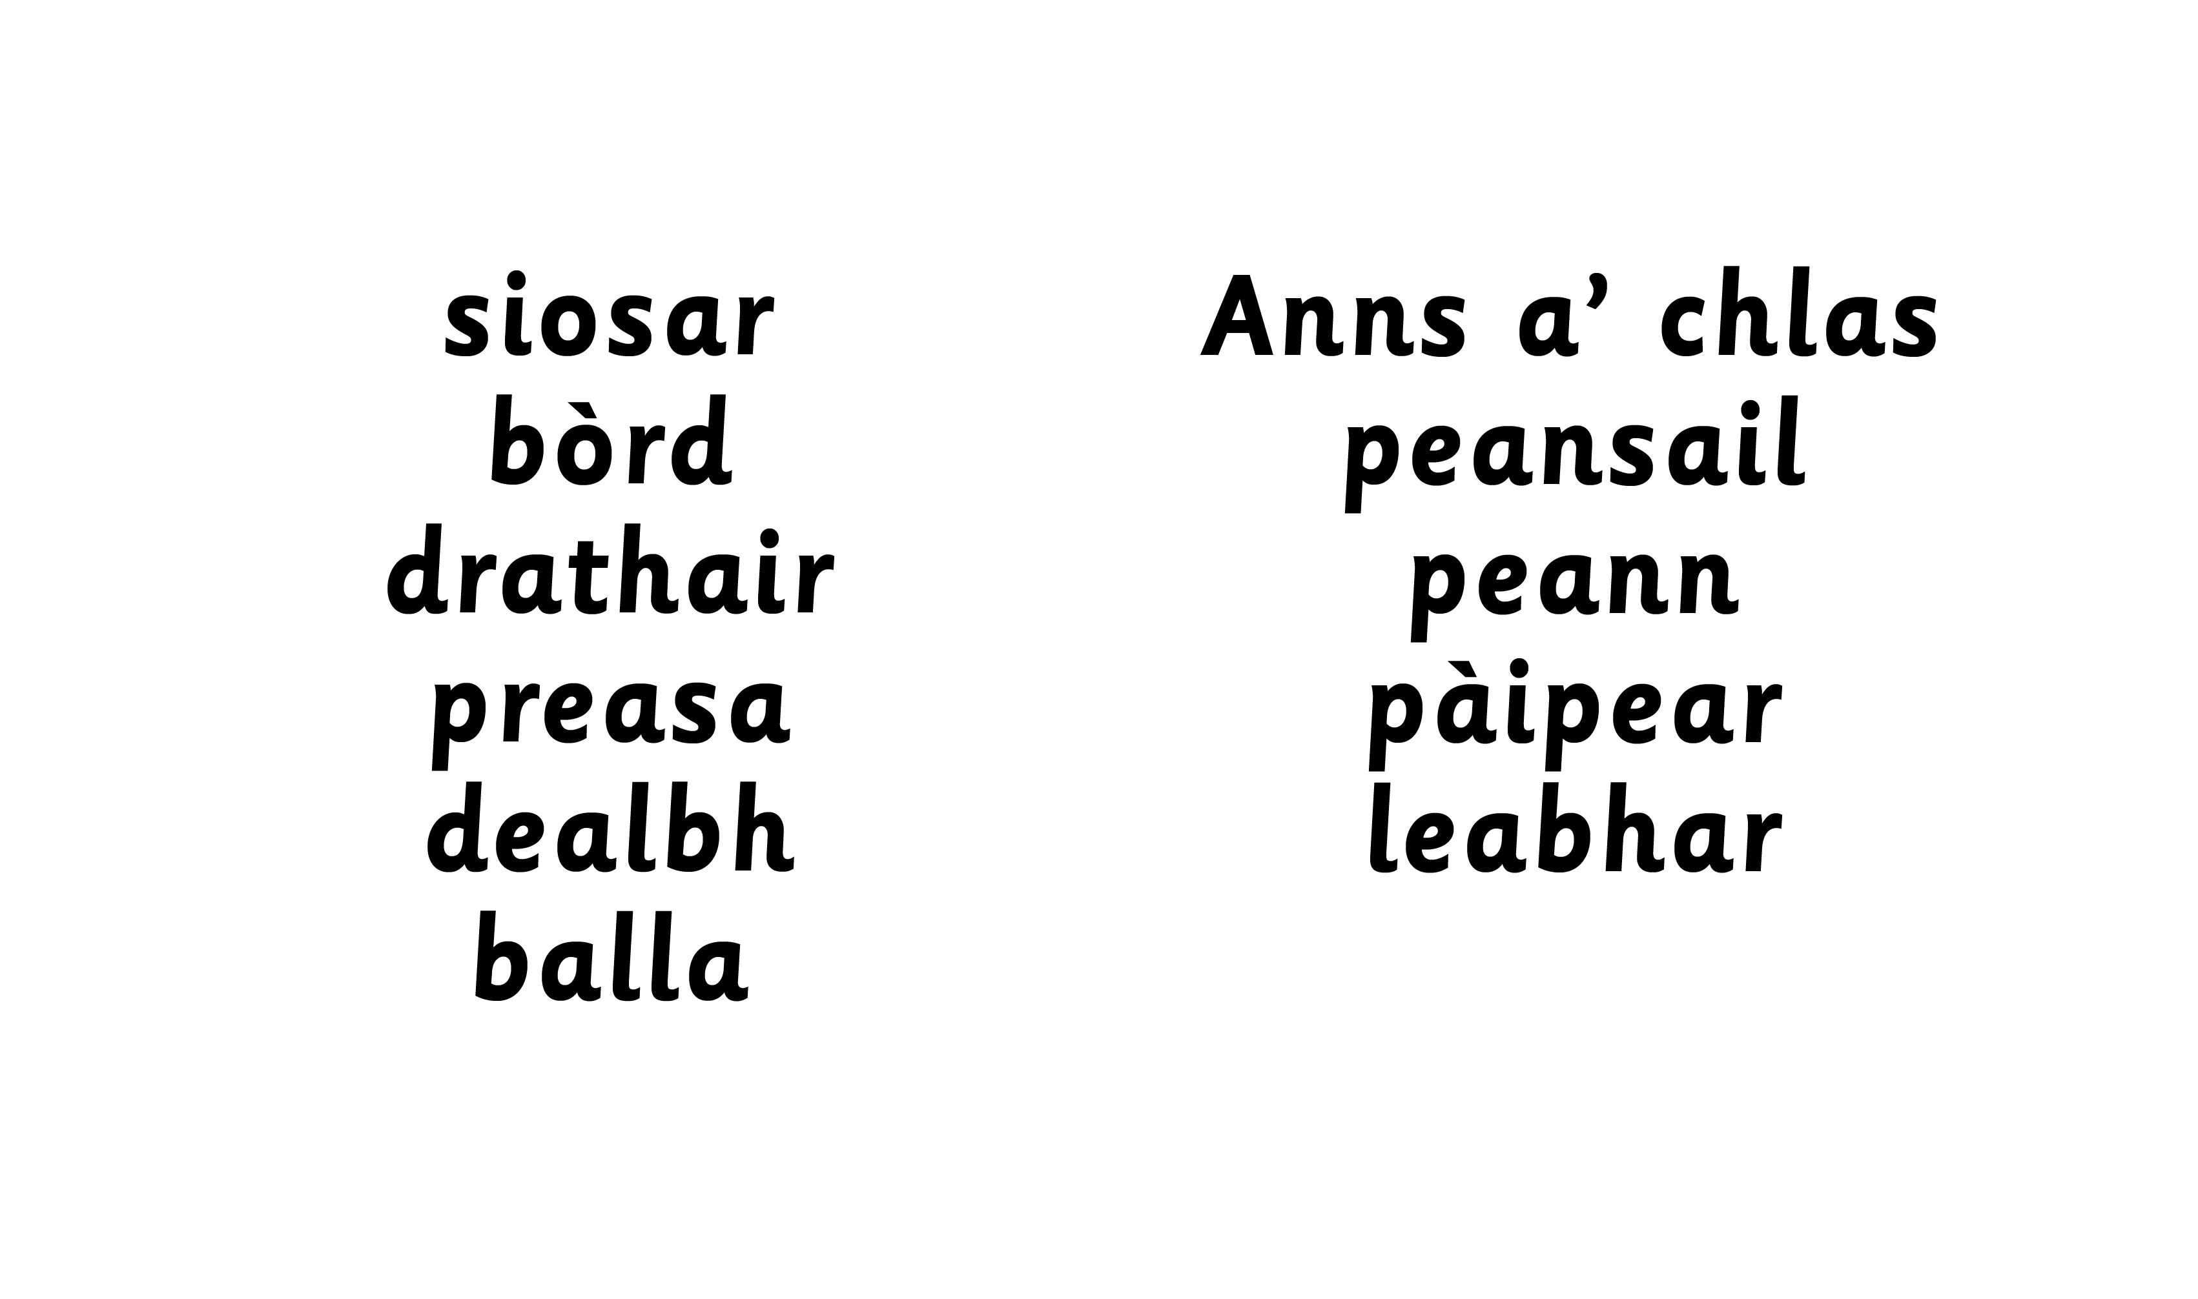
Notes:
Teacher to ask with each slide:
Am faigh mi peansail? Children to go and find the classroom objects.
Càit a bheil ……. ?

Slide 5

Notes:
Teacher to ask with each slide:
Am faigh mi peansail? Children to go and find the classroom objects.
Càit a bheil ……. ?

Slide 6
Notes:
Teacher can ask: Dè an dath a tha seo?
revising colours

Slide 7


Slide 8


Slide 10
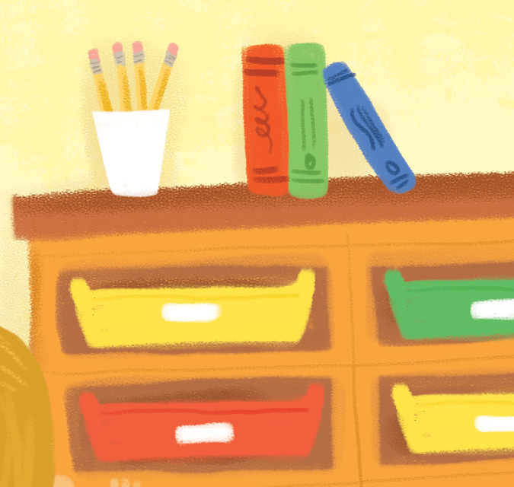

Slide 11
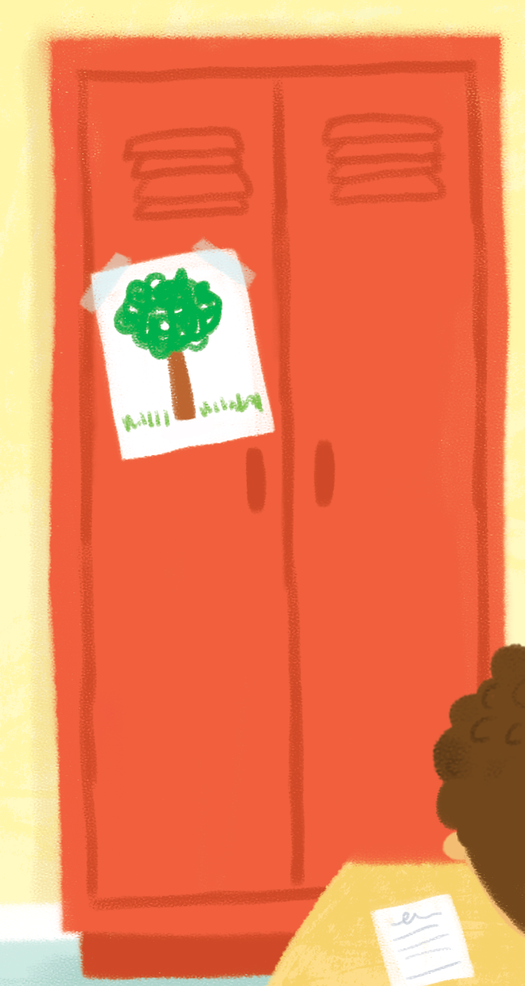

Slide 13
Notes:
Children to find the object and say
Seo …

Slide 14
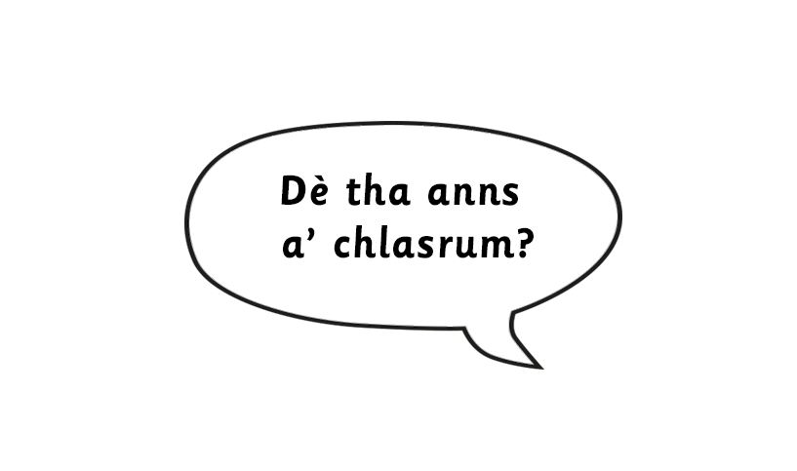
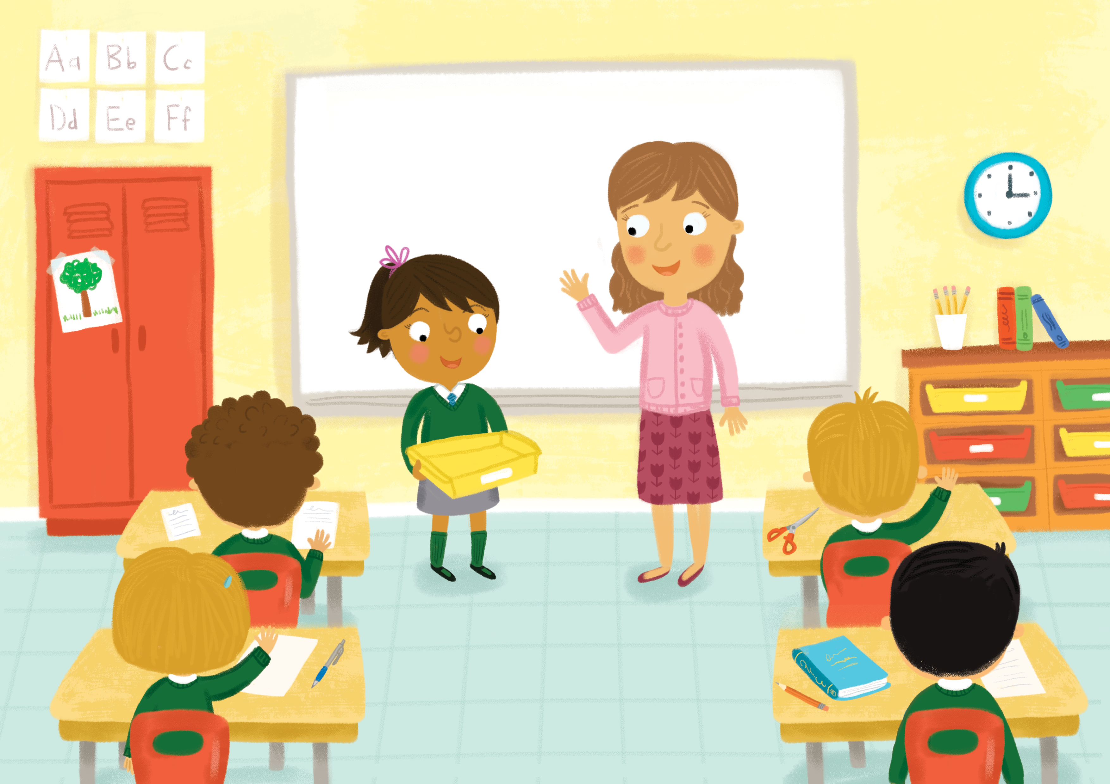
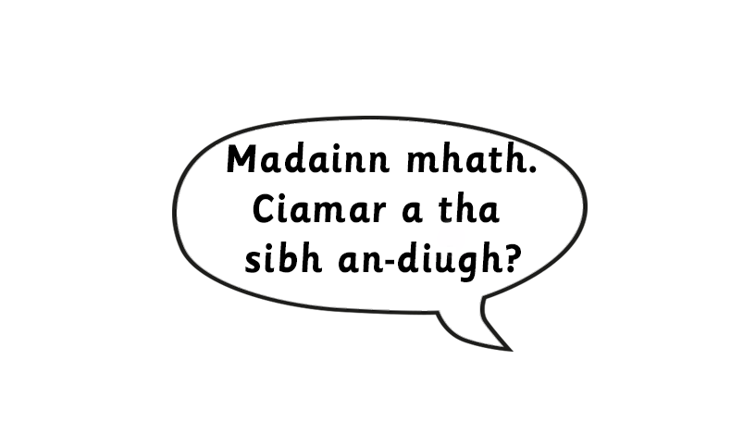
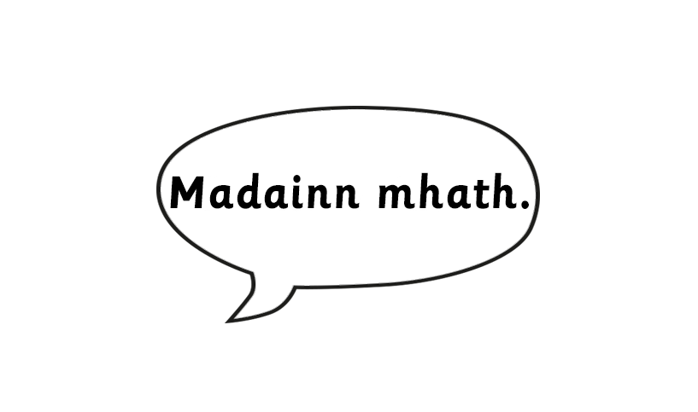
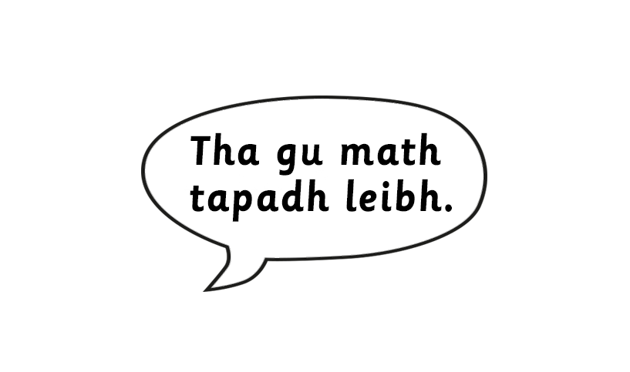
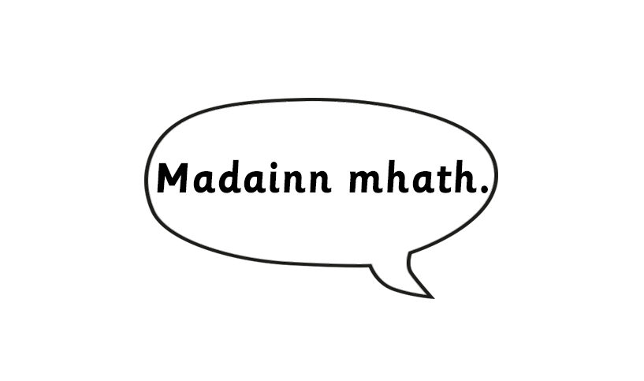
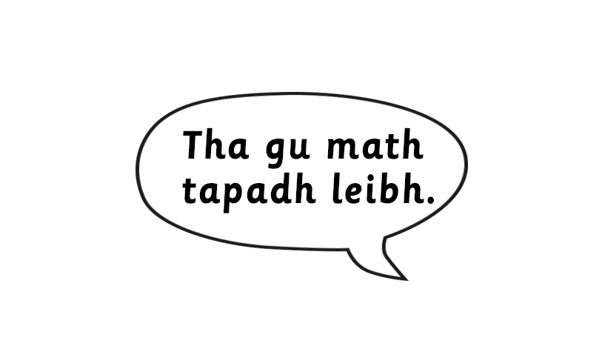

Slide 15


Slide 16
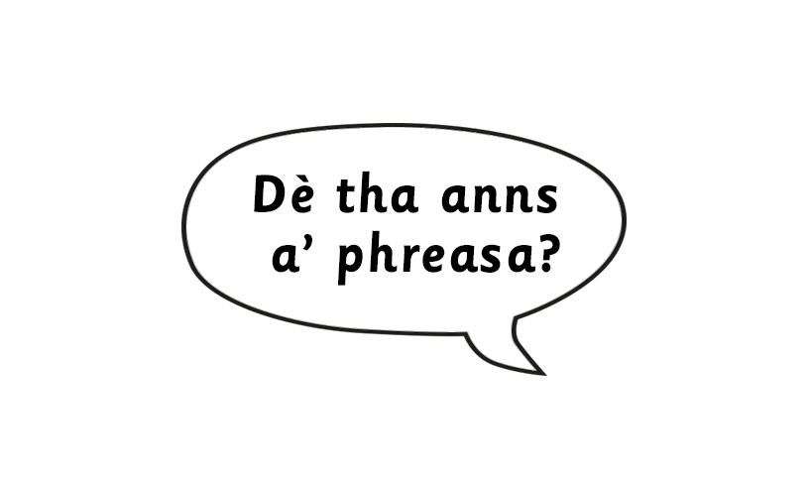
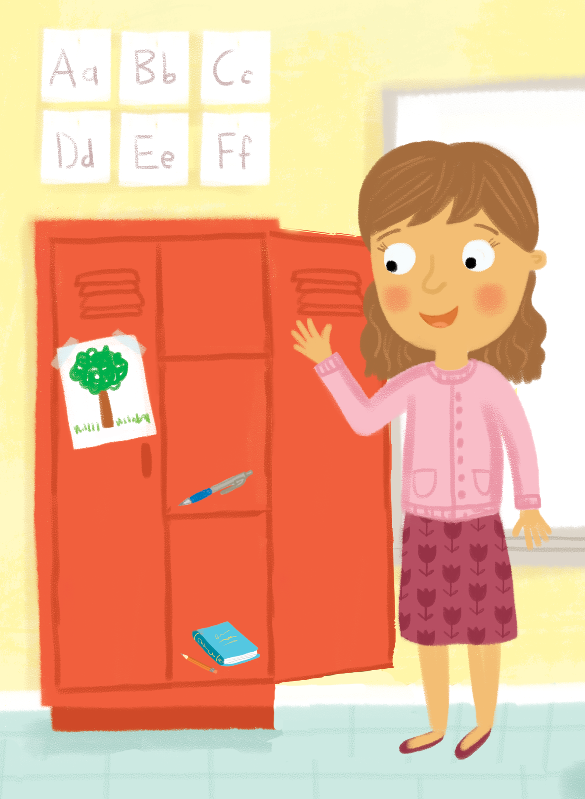
Notes:
Play game and sing song. (The bag will have classroom objects in it.)

